Slide 1
“Genome Stability”
「生殖 system 生物学」
動物生殖 system 分野 Laboratory of Genome Stability
Reproductive Biology
Radiation Biology
Sexual differentiation
DNA damage / DNA repair
Sexual maturation / sex hormone
Mutation → Speciation
→Evolution
Gamete = Sperm and Ova
Fertilization
Cell cycle arrest
Early embryonic development
Apoptosis

Slide 2
“Genome Stability”
「生殖 system 生物学」
動物生殖 system 分野 Laboratory of Genome Stability
Reproductive Biology
Radiation Biology
Sexual differentiation
DNA damage / DNA repair
Sexual maturation / sex hormone
Mutation → Speciation
→Evolution
Gamete = Sperm and Ova
Fertilization
Cell cycle arrest
Early embryonic development
Apoptosis
Mouse
Medaka

Slide 3
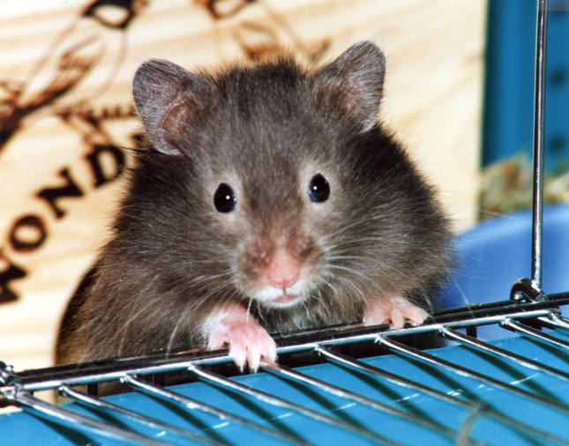
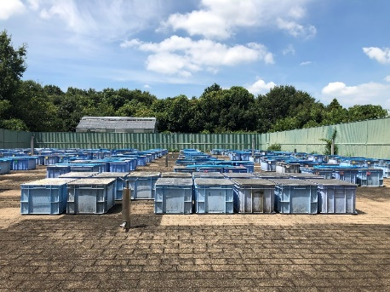
放射線生物学講座 Laboratory of Radiation Biology
@HONGO campus
動物生殖システム分野 Laboratory of Genome Stability
Prof. Hiroshi Mitani
（2021年3月Retired）
History of Lab of Genome Stability
Radiation Biology
Prof. Akihiro Shima
（2002年3月Retired）
DNA damage / DNA repair
Prof. Nobuo Egami
（1985年3月Retired）
Carcinogenesis
Effects on spermatogenesis ←
Succession effects
Mutation → Nucleotide sequence → Genome
↓
Intraspecific variation
↓
Speciation, Evolution
Genetic diversity of
wild medaka populations

Slide 4
動物生殖 system 分野 Laboratory of Genome Stability
Associate Prof. Shoji Oda
（2003年9月~）
Prof. Hiroshi Mitani
（2021年3月Retired）
Reproductive Biology
Radiation Biology
Sexual differentiation
DNA damage / DNA repair
Sexual maturation / sex hormone
Mutation → Speciation
→Evolution
Gamete = Sperm and Ova
Fertilization
Cell cycle arrest
Early embryonic development
Apoptosis
Medaka
To seek the driving force of evolution
in the diversity of the molecular
mechanisms of fertilization

Slide 5
動物生殖 system 分野 Laboratory of Genome Stability
Associate Prof. Shoji Oda
（2003年9月~）
Prof. Hiroshi Mitani
（2021年3月Retired）
Reproductive Biology
Radiation Biology
Gakyo Lab
Sexual differentiation
DNA damage / DNA repair
Sexual maturation / sex hormone
Ishikawa Lab
Iwasaki Lab
Mutation → Speciation
→Evolution
Gamete = Sperm and Ova
Kawamura Lab
Fertilization
Cell cycle arrest
Ohya Lab
Early embryonic development
Apoptosis
Medaka

Slide 6
“Genome Stability”
「生殖 system 生物学」
動物生殖 system 分野 Laboratory of Genome Stability
Associate Prof. Shoji Oda
（2003年9月~）
Prof. Hiroshi Mitani
（2021年3月Retired）
Reproductive Biology
Radiation Biology
Gakyo Lab
Sexual differentiation
DNA damage / DNA repair
Sexual maturation / sex hormone
Ishikawa Lab
Iwasaki Lab
Mutation → Speciation
→Evolution
Gamete = Sperm and Ova
Kawamura Lab
Fertilization
Cell cycle arrest
Ohya Lab
Early embryonic development
Apoptosis

Slide 7
2023 “Genome Instability” Schedule
28th, November
10:25〜12:10 ： Sexual Reproduction and Meiosis
13:00〜14:45 ： Physiology of Fertilization
14:55〜16:40 ： Ova and Sperm
16:50〜18:35 ： Gametogenesis and Meiosis again
29th, November
10:25〜12:10 ： DNA Damages and Repair
13:00〜14:45 ： Impacts of Radiation on Human Health
14:55〜16:40 ： Natural History of Medaka
16:50〜18:35 ： What I Learned from Medaka
https://webpark1015.sakura.ne.jp/LGS2021/

