Slide 1
202３ “Genome Instability” Schedule
28th, December
10:25〜12:10 ： Sexual Reproduction and Meiosis
13:00〜14:45 ： Cell Physiology of Fertilization
14:55〜16:40 ： Ova and Sperm
16:50〜18:35 ： Gametogenesis and Meiosis again
29th, December
10:25〜12:10 ： DNA Damages and Repair
13:00〜14:45 ： Impacts of Radiation on Human Health
14:55〜16:40 ： Natural History of Medaka
16:50〜18:35 ： What Medaka Taught Me
https://webpark1015.sakura.ne.jp/LGS2021/

Slide 2
Genomic Instability
2023.11.28 by Shoji Oda
2022_11_28 Period 2
“Sexual Reproduction and Meiosis ”
References
“Molecular Biology of The Cell”
By Bruce Alberts, Alexander Johnson,
Julian Lewis, David Morgan, Martin Raff,
Keith Roberts, Peter Walter
“Genetics notes” by Crow，James F.
Sentan-kun

Slide 3
An animal has a baby, and the baby grows up and has a next baby, and the next baby grows up and has a next next baby and the next next baby grows up and has a next next next baby, and so on, forever, as far as the species will be present.
Reproduction 生殖
Maybe You learn more details
in the class by Prof. Gakyo Suzuki.
Female and Male 女性と男性
Human (Homo sapiens) reproduce sexually. 有性生殖
Why we need sexual reproduction ?
To produce and maintain the genetic variations
To produce child different from parents
In sexual reproduction, the child is not identical to the parents
In cell proliferation (Biological Self-Replication ;生物学的自己複製),
daughter cells are identical to the parent cell and to each other. In contrast,
individual animals reproduce individuals almost the same but not identical.

Slide 4
Germ line cells (gametes) and Somatic cells
Germ line
Germ line cells possess totipotency, the potential to produce all type of cells and form a complete body of an animal.
In a sense, the germ line in our body is continuous to the first “ancestral” cell on the earth !
My body and your bodies might be continuous !

Slide 5
diploid generation
2n
In sexual reproduction system
Female
Ova
n
haploid generation
Spermatozoon
2n
n
diploid generation
Male
haploid generation
Diploid generation and haploid generation appear alternately.
2n
diploid generation

Slide 6
*
*
*
In sexual reproduction system
2n
Mutations in genomes of somatic cells are not inheritable.
*
*
*
Ova
*
n
*
*
*
*
*
*
2n
*
*
*
*
*
*
*
*
*
*
*
*
*
*
*
*
*
*
Spermatozoon
Only Mutations in genomes of germ cells are inheritable and have effects
on the next generation (and evolution).
n
2n

Slide 7
Only Mutations in genomes of germ cells are inheritable
and contributable to Evolution.
Only Mutations in genomes of germ cells are inheritable
This is why mutations only in gametes have significance for population.
Of course, mutations in somatic cells are important matter
for individual persons (and his/her family).
Mutations in somatic cells are the main causes of cancer.
Suppression of cancer in young (during reproductive years) has significance for population, in contrast cancer in senior individuals (grandfather and grandmother) has little significance to be cared by population.
(This could be the reason why cancer is popular disease in senior persons !)
This is a conclusion by “Biological consideration”, however, we also have to deal with this matter in the social common sense....

Slide 8
diploid
Mitosis
2n
In sexual reproduction system
Meiosis
Mitosis
Female
haploid
n
diploid
2n
Ova
Spermatozoon
n
Meiosis
Male
haploid
2n
diploid
Mitosis

Slide 9
体細胞分裂
減数分裂
Mitosis
Only one set of homologous chromosome is shown to make story simple.
Meiosis
“Reduction division”
2n
2n
4n
4n
Meiotic division I
+
2n
2n
2n
+
2n
Meiotic division II
n
+
n
+
n
+
n

Slide 10
体細胞分裂
減数分裂
Mitosis
Only one set of homologous chromosome is shown to make story simple.
Meiosis
“Reduction division”
2n
2n
4n
4n
Meiotic division I
+
2n
2n
2n
+
2n
Meiotic division II
n
+
n
+
n
+
n

Slide 11
Diploids inherit half of its genes from its mother and the other half from its father.
2n
2n
♀
♂
2n
Human cells have 22 autosomes and 2 sex chromosome (X and Y).
So, human cells have 46 chromosomes in total.
n = 23, 22 + XX, 22 + XY
The combination of chromosomes inherited from each parent is
2^23 = 8,388,608 different combinations !
In addition, genetic recombination occurs between homologous chromosomes.

Slide 12
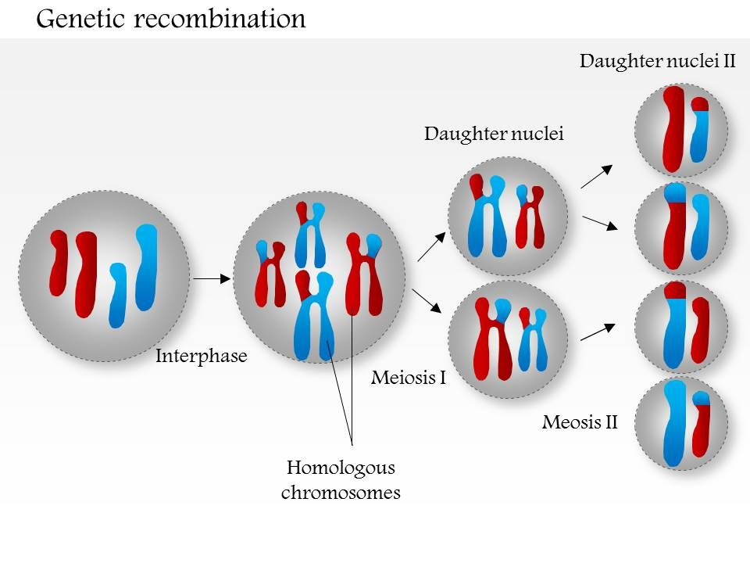
What is genetic recombination ?
https://www.slideteam.net/0714-genetic-recombination-medical-images-for-powerpoint.html

Slide 13
What is genetic recombination ?
1st Meiosis
細糸期 leptotene phase
合糸期 zigotene stage
太糸期 pachytene stage
複糸期 diplotene stage
移動期 diakinesis stage

Slide 14
（diploid）2n
2n
P1
（female）♀
♂（male）
配偶子（gamete）
大配偶子
卵子（ovum, ova）
卵（egg）
生殖細胞（germ cell）
小配偶子
精子（spermatozoon,
spermatozoa or sperm）
（haploid）n
n
受精（fertilization）
F1
受精卵（fertilized egg）
胚（embryo）
2n

Slide 15
Sexual and Asexual reproduction
To evolve (to change) efficiently, sex is prerequisite.
However, the resources spent for sexual reproduction are large.
Need to produce “male”
“ Female is present, but male is a phenomenon.”
The ancestral (original) sex is female. Male develops from Female.
In some species, males become “specialists” to produce sperm.

Slide 16
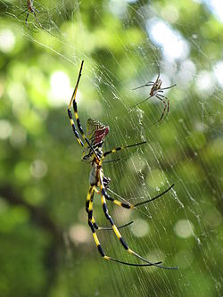
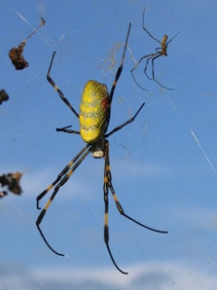
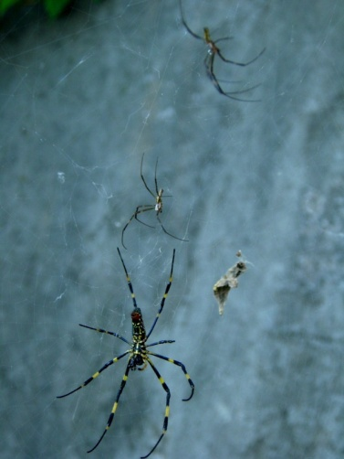
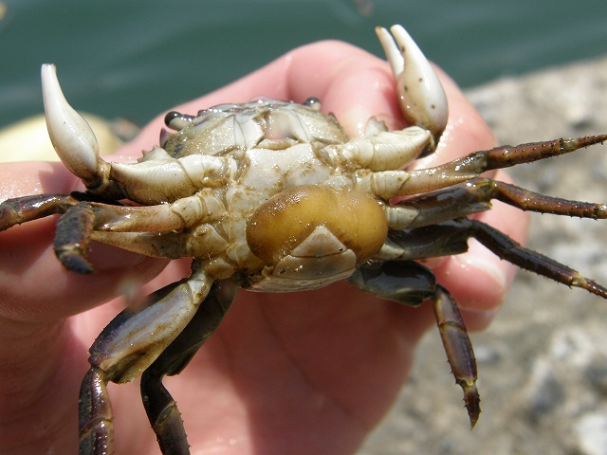
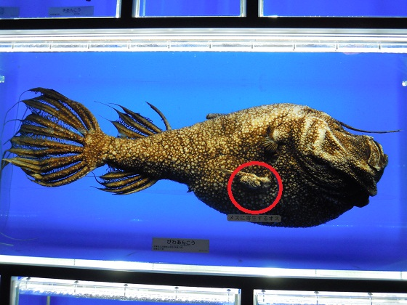
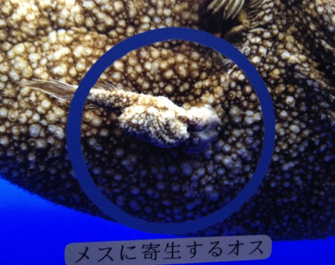
Japanese silk spider
Rhizocephalan barnacle
https://upload.wikimedia.org/wikipedia/commons/thumb/1/14/Nephila-clavata-f-eating-and-2-m.jpg/250px-Nephila-clavata-f-eating-and-2-m.jpg
http://pds.exblog.jp/pds/1/200510/29/90/e0038990_12115953.jpg
Paracitized crab
http://stat.ameba.jp/user_images/20150930/21/kamiosanjin/1f/17/j/o0600080013440442064.jpg
Footballfish
Female
male
http://www.geocities.jp/ds23ie_73y/caravan/2010_09_17/DSCN3221.JPG
http://art58.photozou.jp/pub/339/1284339/photo/87689220_624.jpg

Slide 17
Sexual and Asexual reproduction
To evolve efficiently (to change rapidly), sex is highly advantageous
(in practical, almost prerequisite).
However, the resources spent for sexual reproduction are large.
Need to produce “male”
“ Female is present, but male is a phenomenon.”
The ancestral (original) sex is female. Male develops from Female.
In some species, males become “specialists” to produce sperm.
Some species produce offspring via asexual reproduction !
However, not “budding” or “cleavage” like unicellular organisms,
but versions of sexual reproduction

Slide 18
Sexual reproduction
（diploid）2n
2n
P1
（female）♀
♂（male）
大配偶子
卵子（ovum, ova）
卵細胞（oocyte）
卵（egg）
配偶子（gamete）
生殖細胞（germ cell）
小配偶子
精子（spermatozoon,
spermatozoa or sperm）
（haploid）n
n
受精（fertilization）
F1
受精卵（fertilized egg）
胚（embryo）
2n

Slide 19
Asexual reproduction
（diploid）2n
2n
P1
（female）♀
Omit the male !
♂（male）
大配偶子
卵子（ovum, ova）
卵細胞（oocyte）
卵（egg）
配偶子（gamete）
小配偶子
精子（spermatozoon,
spermatozoa or sperm）
n
（diploid）2n
受精（fertilization）
F1
胚（embryo）
2n

Slide 20
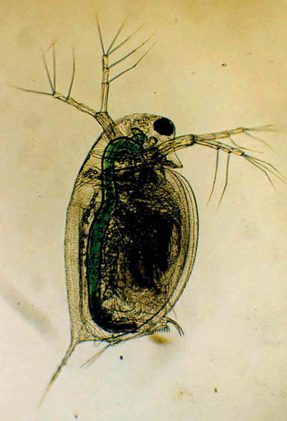


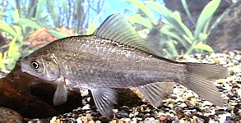
plant lice (Aphids)
Water flea（Daphnia longispina）
Gin-funa（Carassius auralus）

Slide 21
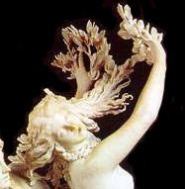
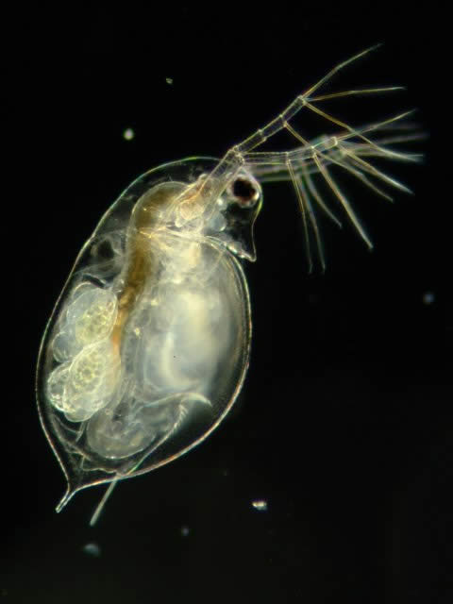
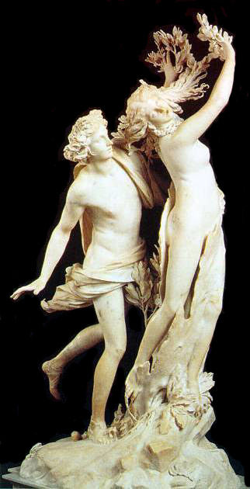

Apolon
Daphne
Aplon was the first “stalker” and
Daphne changed to laurel to escape
from the stalking by Apolon.
Apolon still loves Daphne and
he puts on laurel wreath.
Trivia

Slide 22
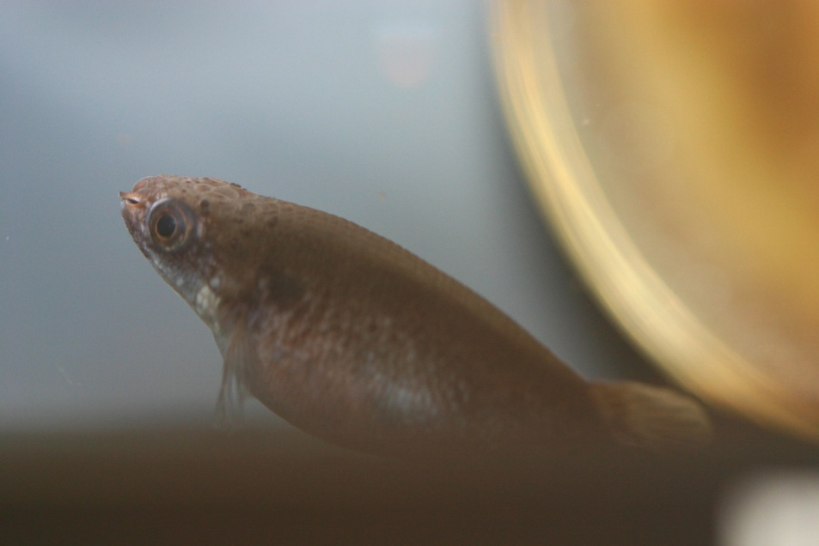
“ Self-fertilization ” ! !
Kryptolebias marmoratus
Livulus marmoratus
Self-fertilized species can not evolve !
Are they in the “cul‐de‐sac” in evolution ?
Why do they produce both of sperm and eggs?
To tell the truth, male will appear occasionally !

Slide 23
hermaphroditism
hermaphroditism
hermaphroditism
hermaphroditism
hermaphroditism
hermaphroditism
hermaphroditism
hermaphroditism
hermaphroditism
hermaphroditism
hermaphroditism
hermaphroditism
Rejuvenation by self-cloning ! !
Male
They could be the ultimate
“sexual reproducer” !?
hermaphroditism
hermaphroditism
hermaphroditism
hermaphroditism
hermaphroditism
hermaphroditism
hermaphroditism
hermaphroditism
hermaphroditism
hermaphroditism

Slide 24
2n
Only female mitochondria are inherited
to the offspring.
雌 Female
n
2n
Egg
Sperm
n
Male mitochondria are destroyed in egg cytoplasm and digested.
雄 Male
We can trace the female linage
By mitochondrial DNA diversity.
2n
no recombination in haploid mitochondrial genomes

Slide 25
Mitosis
Meiosis
Question
How meiosis evolved ?
2n
2n
4n
4n
Meiotic division I
+
2n
2n
2n
+
2n
Meiotic division II
n
+
n
+
n
+
n

Slide 26
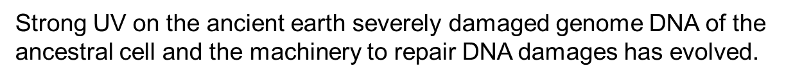
A hypothesis for the origin of sexual reproduction
Is there anyone who disagrees?
The ancestral cells were haploid (n ).
Strong UV on the ancient earth severely damaged genome DNA of the ancestral cell and the machinery to repair DNA damages has evolved.
Two haploid cells fused to be a diploid cell transiently and perform gene exchange between DNA strands .
The start of “conjugation = fertilization”
The start of “genomic recombination”
After DNA repair was completed, the cells had to back to haploid.
The start of “meiosis”

Slide 27
Ultra-Violet
Less Oxygen, Ozon in the air
Ancestral cell
Another ancestral cell
Ｘ
Ｘ
Ｘ
DNA damage
Be a diploid cell by fusion
Ｘ
Ｘ
Ｘ
To repair genome, exchange DNA by genetic recombination.

Slide 28
DNA repair completed ＼（＾〇＾）／
Back to haploids
Ｘ
Ｘ
Ｘ
Ｘ
Ｘ
Ｘ
Unlucky cell
would dye
But, it is OK, since cells can proliferate.

Slide 29
Genome repair theory
in ancestral haploid cell
In the case of
diploid organisms,
Ｘ
Ｘ
Ｘ
“Fertilization”
“Conjugation”
Fuse to diploid
Gametes fertilized to be diploid
we
Ｘ
Ｘ
Genomic recombination between homologous chromosome
during gametogenesis
DNA repair by
genetic recombination
Ｘ
Back to haploids
Gametes are produced via
meiosis
DNA repair completed ＼（＾〇＾）／

Slide 30
Lets consider again “How meiosis evolved.”
Mitosis in diploid cells
Meiosis
2n
2n
4n
4n
Meiotic division I
+
2n
2n
2n
+
2n
Meiotic division II
n
+
n
+
n
+
n

Slide 31
Mitosis in haploid cells
Meiosis in diploid cells
2n
n
4n
2n
Meiotic division I
+
2n
Mitosis in haploid cells
2n
=
n
+
n
Meiotic division II
n
+
n
+
n
+
n

Slide 32
接合
Zygosis in haploid organisms
Meiosis
+
2n
Zygosis in haploid cells
Genetic
recombination
4n
Genetic
recombination
=
X
X
Meiotic division I
+
2n
2n
+
Meiotic division II
Meiosis in diploid cells might be a combination of “mitosis in haploid cells” and “zygosis in haploid cells”.
n
+
n
+
n
+
n

Slide 33
A hypothesis for the origin of sexual reproduction
The ancestral cells were haploid (n ).
Strong UV on the ancient earth severely damaged genome DNA of the ancestral cell and the machinery to repair DNA damages has evolved.
Two haploid cells fused to be a diploid cell transiently and perform gene exchange between DNA strands .
The start of “conjugation = fertilization”
The start of “genomic recombination”
After DNA repair was completed, the cells had to back to haploid.
The start of “meiosis”

Slide 34
A hypothesis for the origin of sexual reproduction
Haploid cells appeared which conduct homologous recombination (HR) for the precise repair of DNA.
The start of “diploid cell”
Some of haploid cells kept fused (diploid) phase, so that they had no more no need to fuse occasionally for DNA repairment. The life time of those “diploid cells” might be longer than haploid cells.
How can multi-cellular organisms evolve ?
Multi-cellular organisms = gametes + somatic cells
Is it possible that haploid cells construct multi-cellular organism ?
Or, only diploid cells can construct multi-cellular organisms ?
Currently, I have no cool answer. Please think by yourself.

Slide 35
“ODA hypothesis for the origin of sexual reproduction”
Multicellular organisms with diploid cells became larger, more complicated, and longer life because of efficient DNA repair.
At the same time, because of longevity of the organism, the machinery to exchange genome between organisms were advantageous to rebuilt damage-free genome (the origin of sexual reproduction), but simple zygosis was impossible.
Haploid generation cells produced via meiosis became the specific carrier of genome (the origin of gamete) and to built new individual organism.
Since DNA repair machineries are not perfect, genomes of organisms become complicated as the result of accumulated mutations and natural selection.
And sexual reproduction also promotes genomic variation and evolution strongly.
The origin of sex might be the demand to genome stability by DNA repair !!
This is why we study DNA repair with our Japanese name:
“Laboratory of Animal Reproduction System”.
Genomic variations (and life evolution) might be the inevitable outcome of
imperfect DNA repairing.

