Slide 1
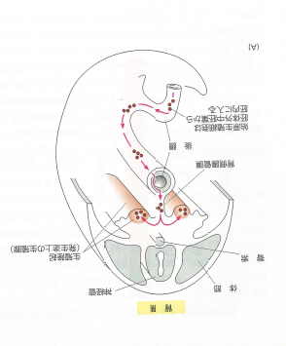
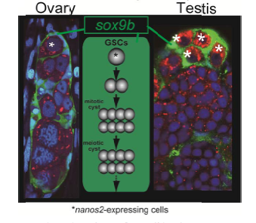
始原生殖細胞（primordial germ cell; PGC）
PGCs are not located in the gonads (ovaries and testes) and develop independently outside the gonads at the early embryonic development. After the gonads have been constructed, PGC migrate into the gonads.
Without the support by somatic cells, eggs and sperm cells are not proliferated, differentiated, and even kept alive.
Mammalisn 哺乳類
Medaka

Slide 2
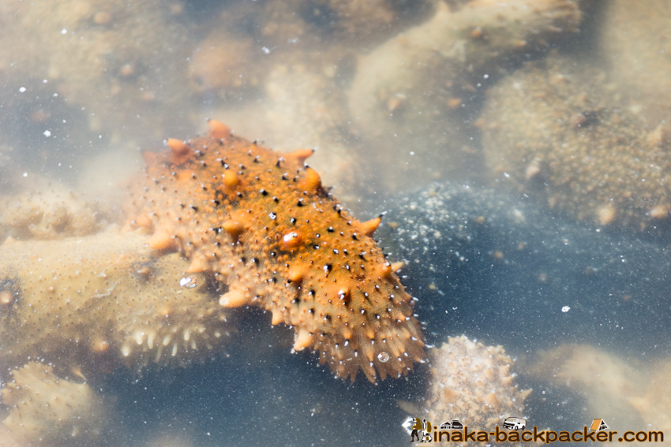
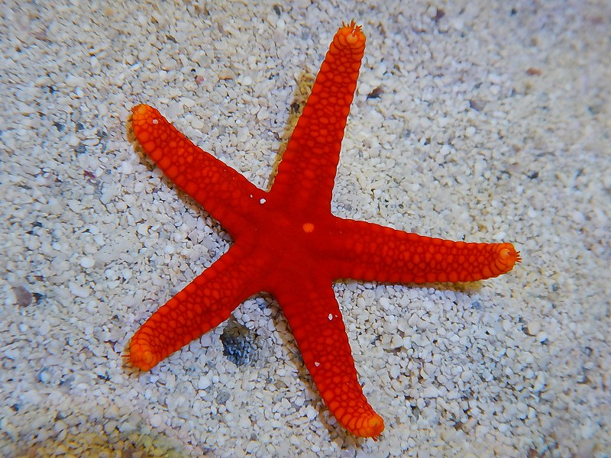
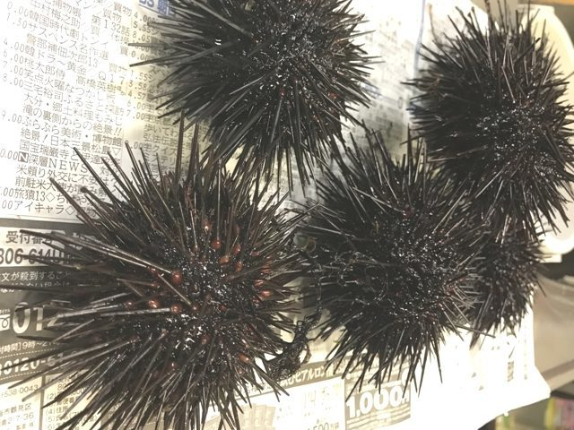
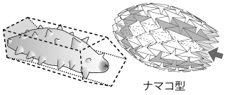
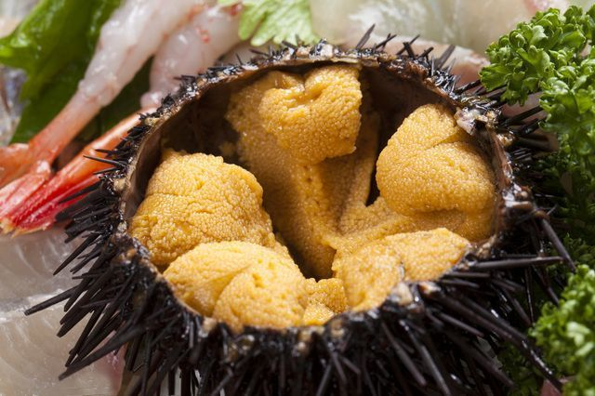
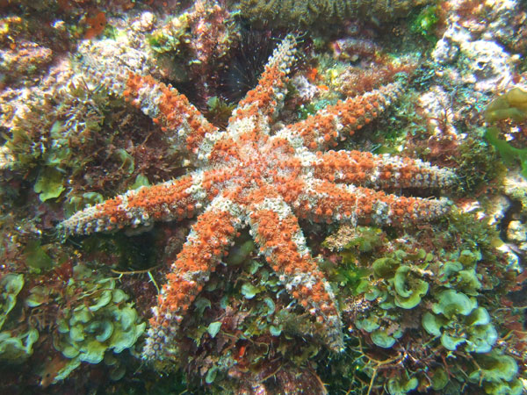
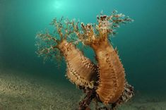
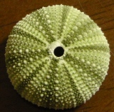
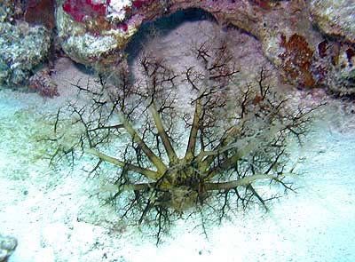
棘皮動物
5 放射相称
Echinoderm
"pentaradial symmetry”
5
1
4
2
3
ヤツデヒトデ
キンコ
8
1
5
1
1
2
5
7
3
4
2
2
4
6
4
3
3
5

Slide 3
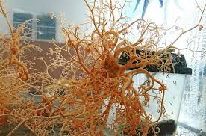
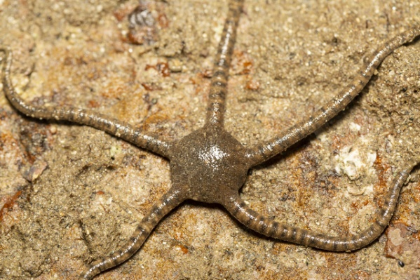
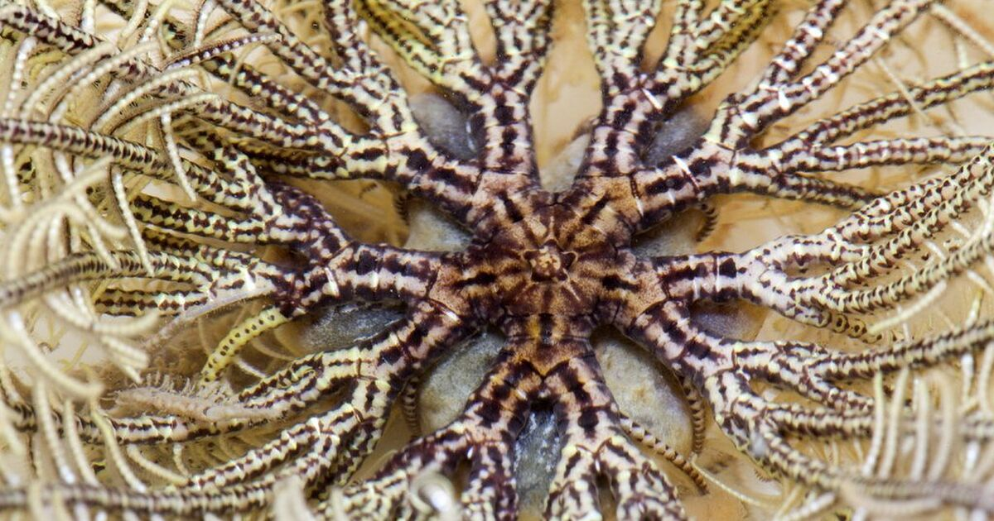
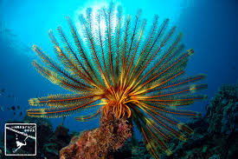
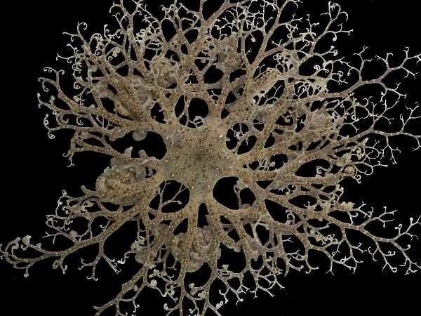
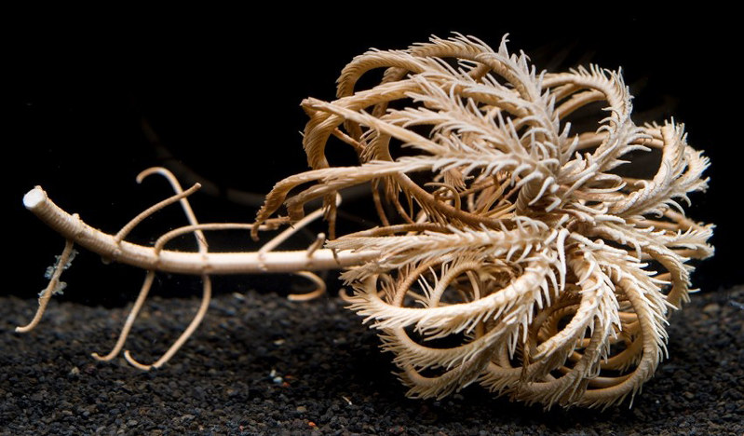
All echinoderms are pentaradial symmetry !
Basket star (Euryalina)
Brittle star (Ophiuroidea)
Feather stars (Comatulida)
5
1
5
1
2
4
4
2
3
3
Sea lily
1
1
5
5
2
2
4
4
3
3

Slide 4
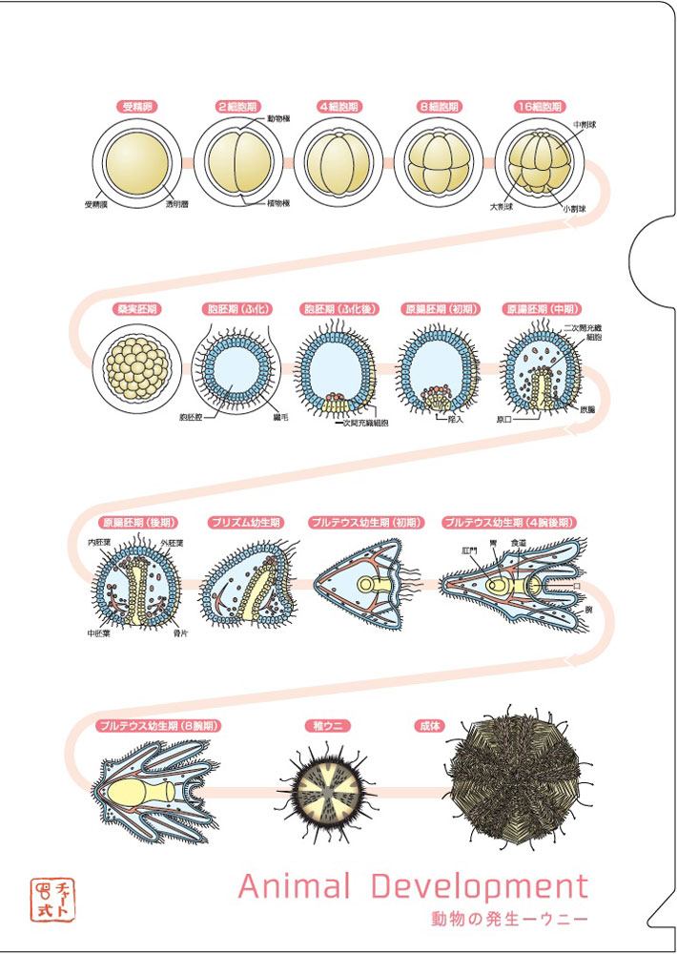
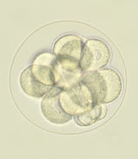
Micromere

Slide 5
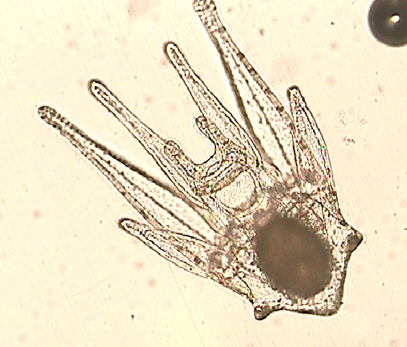
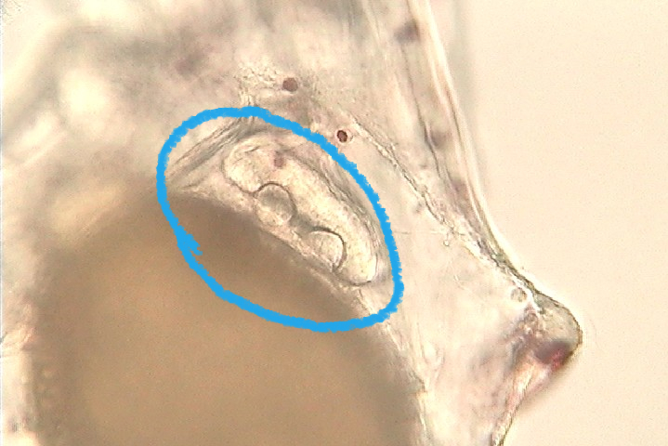
Echinus rudiment

Slide 6
棘皮動物
5 放射相称
Echinoderm
“Pentaradial symmetry”
5
1
4
2
3
ヤツデヒトデ
キンコ
8
1
5
1
1
2
5
7
3
4
2
2
4
6
4
3
3
5

Slide 7
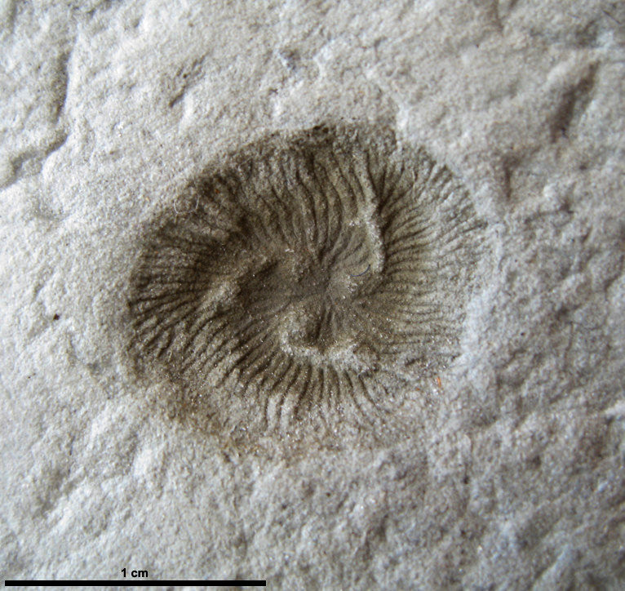
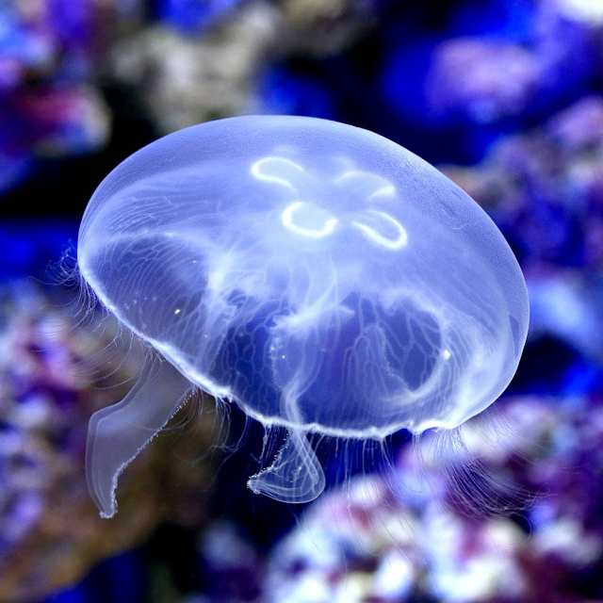
棘皮動物
Echinoderm
「３ 放射相称？」
5 放射相称
“Pentaradial symmetry”
“Triradial symmetry ?”
But is it an echinoderm ?
8 - 5 = 3
Tribrachidium
“Pentaradial
symmetry”
トリブラキディウム
Jelly fish
Radial symmetry
“Octaradial
symmetry”

Slide 8
始原生殖細胞（primordial germ cell; PGC）
PGCs are not located in the gonads (ovaries and testes) and develop independently outside the gonads at the early embryonic development. After the gonads have been constructed, PGC migrate into the gonads.
Without the support by somatic cells, eggs and sperm cells are not proliferated, differentiated, and even kept alive.
Mammalisn 哺乳類

