Slide 1
202３ “Genome Instability” Schedule
28th, December
10:25〜12:10 ： Sexual Reproduction and Meiosis
13:00〜14:45 ： Cell Physiology of Fertilization
14:55〜16:40 ： Ova and Sperm
16:50〜18:35 ： Gametogenesis and Meiosis again
29th, December
10:25〜12:10 ： DNA Damages and Repair
13:00〜14:45 ： Impacts of Radiation on Human Health
14:55〜16:40 ： Natural History of Medaka
16:50〜18:35 ： What Medaka Taught Me
https://webpark1015.sakura.ne.jp/2023_11_28_29_ShojiODA/

Slide 2
Genomic Instability
2023.11.29 by Shoji Oda
2023_11_29 Period 2
“DNA Damages and Repair”
Sentan-kun

Slide 3
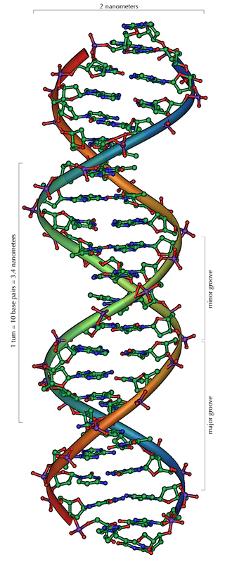
DNA repair DNA 修復
DNA is a highly stable molecule, however,
DNA can be damaged by environmental factors.

Slide 4
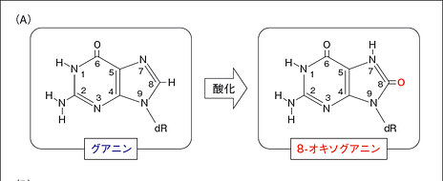
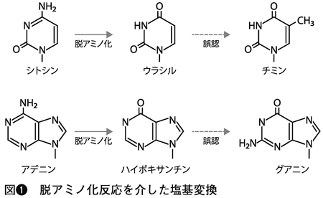
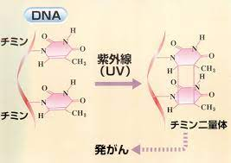
DNA Damages DNA 損傷
Break of DNA strand
Double strand break (DSB), Single strand break (SSB) by radiation
Change of Base (Chemical modification)
Oxidative (production of 8-oxo guanine)
Methylation（7-methylguanin）
Hydrolysis（deletion of purine and pyrimidine bases ）
Illegal pairing of bases
Deamination（Cytosine to Uracil）
Insertion, deletion,
Misincorporation of nucleotides
Thymidine-dimer by UV
Cross-linking
with base on the same strand
with base on the other strand
with proteins (histone etc)
DSB
SSB

Slide 5
Causes of DNA damages
Attack by reactive oxygen species (ROS, radicals), a byproduct of normal cell metabolism
Environmental factors
ultra violet
Ionizing radiation ( X rays, γ rays, β rays, α rays)
Mutagenic chemicals such as hydrocarbons from cigarette smoke
DAPI, EtBr, DNA staining dye can be carcinogenic.
Radiation induces DSB.
Cells can not divide with DSB.
So, radiation suppressed cell proliferation.
This is one of the reasons why radiation is useful in cancer therapy.

Slide 6
Cells can not divide when DNA double strand is broken.
So, cells repair DSBs very well.
Cells have 2 main machineries to repair DSBs.
Homologous recombination (HR) 相同組換え
Non-Homologous End Joining (NHEJ) 非相同末端結合
classical NHEJ(C-NHEJ)
alternative end joining (AEJ)
backup NHEJ (B-NHEJ) or microhomology-mediated end joining (MMEJ)

Slide 7
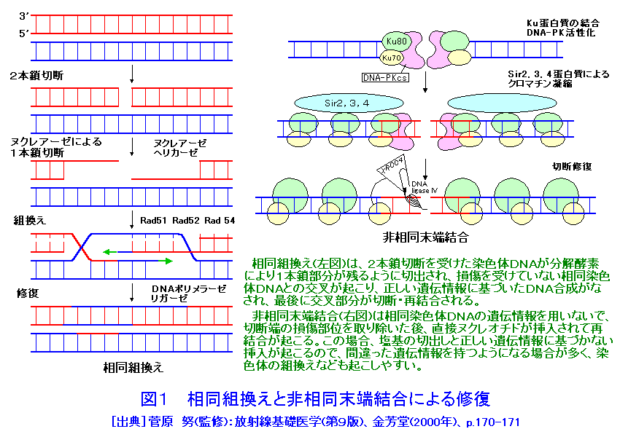
Homologous recombination (HR)
相同組換え
Non-Homologous End Joining (NHEJ)
非相同末端結合
In homologous recombination (HR), the chromosome with DSB is cut by nucleases and DNA single strands remain. Then, they cross over with the undamaged strands of the homologous chromosome and DNA is synthesized based on the correct nucleotide sequences, and finally the crossing is cut and rejoined.
In non-homologous end joining (NHEJ), nucleotides are inserted into the broken end without using the sequence of homologous chromosomal DNA and the strands will be rejoined. Thus, incorrect repair often occurs.
https://atomica.jaea.go.jp/data/fig/fig_pict_09-02-02-12-01.html

Slide 8
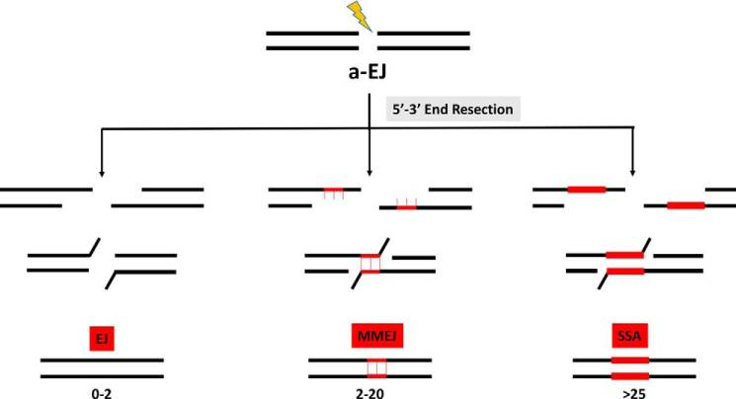
Non-Homologous End Joining (NHEJ) 非相同末端結合
Three pathways of NHEJ are known.
Ku70/Ku80
DNA-PKcs
classical
NHEJ (C-NHEJ)
Alternative end joining (AEJ)
single-strand annealing (SSA)
microhomology-mediated end joining (MMEJ)

Slide 9
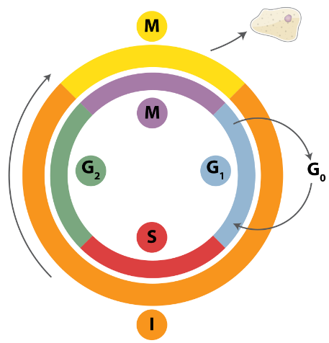
Cells can not divide when DNA double strand is broken.
So, cells work very hard to repair DNA damage.
Cells have 2 main machineries to repair DSBs.
Homologous recombination (HR) 相同組換え
Fix the damage correctly. However, it is possible only at the end of S phase and G2 phase, since it requires a template DNA strand.
Non-Homologous End Joining (NHEJ) 非相同末端結合
Many mistakes. However, it can be done at any time of cell cycle, since no template DNA strand is needed.

Slide 10
To repair DNA damages, cells have to arrest cell cycle.
Expose to radiation
DNA damage induction
Cyclins
DAPI
γH2AX
Cell cycle arrest
= phosphorylated H2AX
ATM
（ataxia telangiectasia mutated）
p53
Most famous “tumor suppressor gene”
DNA Repair
Apoptotic cell death
DNA-PKcs
Ku70/80
Caspase 3
NBS1
BRCA1
Defects in DNA repair-related genes are very often associated with defects in spermatogenesis.

Slide 11
Cells can not divide when DNA double strand is broken.
So, cells repair DSBs very well.
Cells have 2 main machineries to repair DSBs.
Homologous recombination (HR) 相同組換え
The enzymatic mechanism of HR process is almost identical to the molecular mechanism of genetic recombination during meiosis.
Non-Homologous End Joining (NHEJ) 非相同末端結合

Slide 12
What is genetic recombination ?
1st Meiosis
細糸期 leptotene phase
合糸期 zigotene stage
太糸期 pachytene stage
複糸期 diplotene stage
移動期 diakinesis stage

Slide 13
Homologous recombination (HR)
相同組換え
Non-Homologous End Joining (NHEJ)
非相同末端結合
In homologous recombination (HR), the chromosome with DSB is cut by nucleases and DNA single strands remain. Then, they cross over with the undamaged strands of the homologous chromosome and DNA is synthesized based on the correct nucleotide sequences, and finally the crossing is cut and rejoined.
In non-homologous end joining (NHEJ), nucleotides are inserted into the broken end without using the sequence of homologous chromosomal DNA and the strands will be rejoined. Thus, incorrect repair often occurs.
https://atomica.jaea.go.jp/data/fig/fig_pict_09-02-02-12-01.html

Slide 14
接合
Zygosis in haploid organisms
Meiosis
+
2n
Genetic
recombination
4n
Genetic
recombination
X
X
Meiotic division I
+
2n
2n
+
Meiotic division II
Meiosis in diploid cells might be a combination of “mitosis in haploid cells” and “zygosis in haploid cells”.
n
+
n
+
n
+
n

Slide 15
“Sex” started to repair DNA.
Believe or not, it's up to you.
Because I have no direct evidences.
Medaka lab believes so, and we are studying DNA repair, however our lab name is "animal reproductive systems“.
Genetic diversity is an inevitable consequence of incompleteness of genome repair system.
The world (creatures) have survived by endless addition to a building.
Now, sex is to produce and maintain genetic diversity.

Slide 16
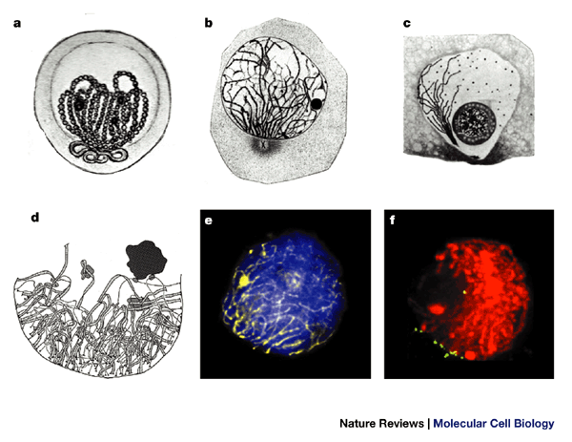
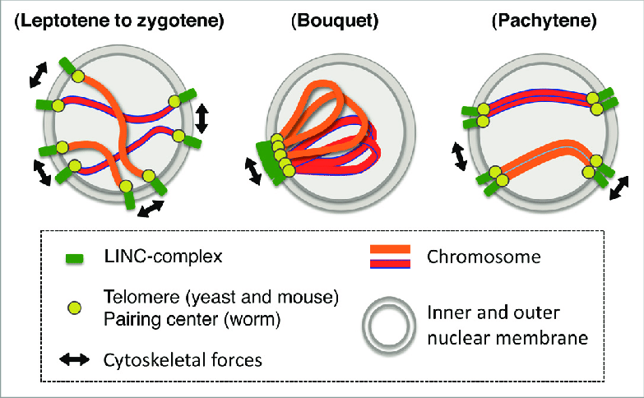
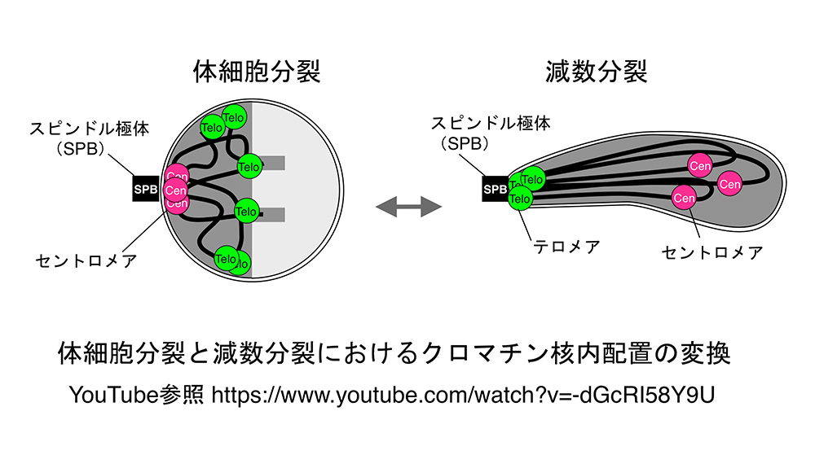
“Telomere Bouquet”
Shibuya and Watanabe, 2014
Scherthan, H. Nat Rev Mol Cell Biol 2, 621–627 (2001).
In early meiosis I (leptotene and zygotene), telomeres, the ends of chromosomes,
attach to the nuclear membrane and then, homologous chromosomes pair with each other.
Recently, the machinery of the pairing of homologous chromosomes has been clalified.
https://www.nibb.ac.jp/potentia/member/hiraoka.html

Slide 17
