Slide 1
202３ “Genome Instability” Schedule
28th, December
10:25〜12:10 ： Sexual Reproduction and Meiosis
13:00〜14:45 ： Cell Physiology of Fertilization
14:55〜16:40 ： Ova and Sperm
16:50〜18:35 ： Gametogenesis and Meiosis again
29th, December
10:25〜12:10 ： DNA Damages and Repair
13:00〜14:45 ： Impacts of Radiation on Human Health
14:55〜16:40 ： Natural History of Medaka
16:50〜18:35 ： What Medaka Taught Me
https://webpark1015.sakura.ne.jp/LGS2021/

Slide 2
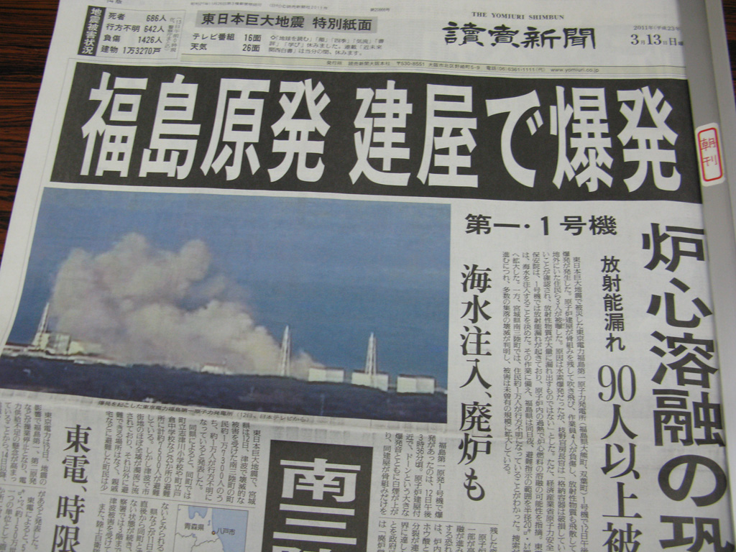
Genomic Instability
2023.11.29 by Shoji Oda
2023_11_29 Period 3
“Impacts of Radiation on Human Health”
Sentan-kun

Slide 3
What is Radiation Biology ?
Studies dealing with biological effects of irradiation
What is Irradiation ?
Ionizing radiation (放射線) is radiation that carries sufficient energy to detach electrons from atoms or molecules, thereby ionizing them (from Wikipedia)
Alfa rays, Beta rays, Gamma rays, X-rays,
Heavy ion beams and the higher ultraviolet

Slide 4
What is Ionizing Radiation?
¹³¹ Iodine has too many neutrons and unstable. It causes a beta decay ( a neutron slips an electron and an anti-electron neutrino and becomes a proton) and become ¹³¹ Xes.
electron
anti-electron neutrino
β rays
Radioactivity is a property of certain types of elements which emit energy and sub-atomic particles spontaneously.
β decay is a type of radioactive decay in which electron is emitted from an atomic nucleus, and the original element changes to an isobar.
Isobars are atoms (nuclides) of different chemical elements that have the same number of nucleons.
The becquerel (Bq) is the the International System of Units (SI) derived unit of radioactivity. One Bq is defined as radio-activity of a quantity of radioactive material in which one nucleus decays per second.
Half-life (symbol t_{1⁄2}) is the time required for a quantity to reduce to half of its initial value and commonly used to describe how quickly radioactive atoms decay.
The sievert (Sv) is a derived unit of ionizing radiation dose in the SI and is a measure of the health effect of low levels of ionizing radiation on the human body. The Sv is widely used in dosimetry and radiation protection.

Slide 5
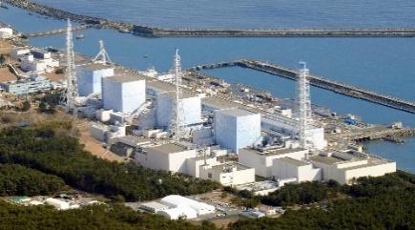
Nuclear fission reaction and Nuclear Power Generation
²³⁵U + Neutron
⁹⁵Y + ¹³⁹I + 2 Neutron
+ Huge Thermal Energy
¹³⁹I → ¹³⁸Xe ¹³⁷Cs ,¹³⁷Ba , ・・・
(from Wikipedia）
²³⁵U + Neutron
¹⁴¹Ba + ⁹²Kr + 3 Neutron
+ Huge Thermal Energy
(from HP pf The Institute of Applied ）
1g of ²³⁵U give us 8.2 x 10¹⁰J energy !
Energy performance of NPG is more than 3 million times
of thermal power generation !!

Slide 6
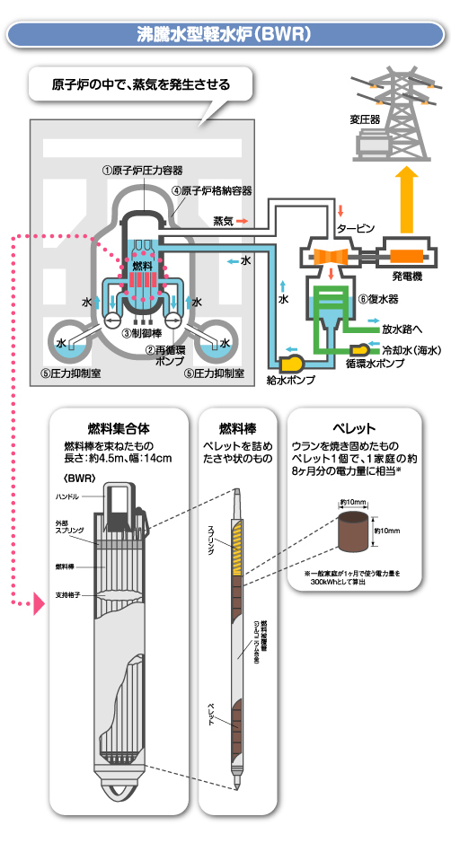
Nuclear Power Plant
原子力発電所
A nuclear power plant (NPP) is a thermal power station in which the heat source is a nuclear reactor. As is typical of thermal power stations, heat is used to generate steam that drives a steam turbine connected to a generator that produces electricity.
(from Wikipedia）
東北電力ホームページより
(http://www.tohoku-epco.co.jp/electr/genshi/shiryo/system/03.html）

Slide 7
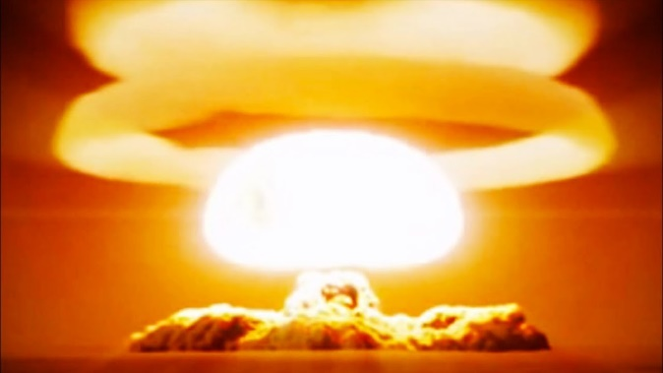
Radiation Biology is most eagerly studied in 1960s-1980s.
Because people in the world were preparing Nuclear War.
USA and USSR were racing to develop more and more powerful nuclear bombs to kill each other
(and all the other countries on the Earth with them).
https://www.youtube.com/watch?v=f_2ps6RIR9U

Slide 8
What will occur in your cells when you are exposed to High Dose IR?
Irradiation breaks DNA double strand (DNA DSB). Cells repair these DSBs powerfully (DNA repair), however, DNA repair system is not 100% perfect but failed by a low probability (about 1/10,000 per 1 Sv), resulting in mutation. Accumulated mutations will transform a cell to a cancer cell.
Irradiation
HR / NHEJ repair
DNA double strand
Repaired !
DNA double strand break
MPN complex
MPN complex
Apoptosis
Programed cell death
Transformation
Cancer/Tumor
Mutation
NK cell
Deterministic effects
(＝ Acute radiation injury )
(＝ stem cell death)
Stochastic effects
(= Cancer risk in future)
(= Increased mutations)

Slide 9
What will occur when you are exposed to High Dose IR?
1 Sv | The symptom that resembles to a hangover such as the vomit, weariness (radiation sickness) is induced in some persons but doesn't result in the death.
1.5 SV < | Hematopoietic cells are killed and leukocytes and platelet decrease. Bleeding increases and the immunity functions declines, and an infection occurs frequently. Some of the irradiated die in 30-60 days (acute bone marrow syndrome).
3-4 Sv | Hair loss and temporary erythema. Half of the irradiated die in 30 days by acute bone marrow syndrome and intestinal death.
5 Sv < | Stem cells of the small intestines are killed, and an intestines epithelium will be lost. Trots, bacterial-infection and sepsis are induced, resulting in the death (intestinal death).
7 Sv < | All of the irradiated die in 30 days by acute bone marrow syndrome and intestinal death.
30 Sv < | Neural system is severely damaged and consciousness disorder, Shock-disease are induced before you die.
The public people will never be exposed to such a high dose radiation. It also never happens with low dose exposure.
（ Deterministic effects ＝ Acute radiation injury ）

Slide 10
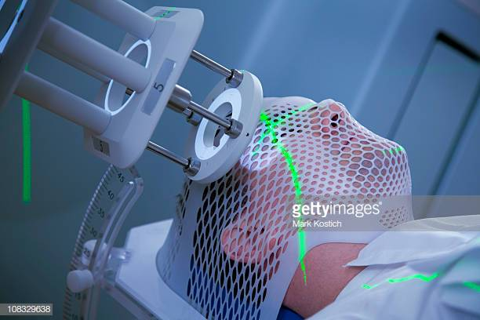
Radiation Biology is most eagerly studied in 1960s-1980s.
Because people in the world were preparing Nuclear war.
USA and USSR were racing to develop more and more powerful nuclear bombs to kill each other
(and all the other countries on the Earth).
And in addition,
https://www.youtube.com/watch?v=f_2ps6RIR9U
Physicians found that irradiation can
specifically kill cancer cells of patients
those whom surgical operation can not help.
Radiation therapy
https://www.gettyimages.co.jp/%E5%86%99%E7%9C%9F/%E6%94%BE%E5%B0%84%E7%B7%9A%E6%B2%BB%E7%99%82

Slide 11
What will occur in your cells when you are exposed to High Dose IR?
Irradiation breaks DNA double strand (DNA DSB). Cells corrects these DSBs powerfully (DNA repair), however, DNA repair system is not 100 % perfect but failed by a low probability (about 1/10,000 per 1 Sv), resulting in mutation. Accumulated mutations will transform a cell to a cancer cell.
Irradiation
HR / NHEJ repair
DNA double strand
Repaired !
DNA double strand break
MPN complex
MPN complex
Apoptosis
Programed cell death
Transformation
Cancer/Tumor
Mutation
NK cell
“Radiation therapy”

Slide 12
Radiation Biology is most eagerly studied in 1960s-1980s.
Because people in the world were preparing Nuclear war.
USA and USSR were racing to develop more and more powerful nuclear bombs to kill each other
(and all the other countries on the Earth).
And in addition,
https://www.youtube.com/watch?v=f_2ps6RIR9U
Physicians found that irradiation can
specifically kill cancer cells of patients
those whom surgical operation can not help.
Radiation therapy
https://www.gettyimages.co.jp/%E5%86%99%E7%9C%9F/%E6%94%BE%E5%B0%84%E7%B7%9A%E6%B2%BB%E7%99%82
In both of nuclear war and radiation therapy,
we will be exposed to high dose and high dose rate irradiation.

Slide 13
What will occur in your cells when you are exposed to High Dose IR?
Irradiation breaks DNA double strand (DNA DSB). Cells corrects these DSBs powerfully (DNA repair), however, DNA repair system is not 100 % perfect but failed by a low probability (about 1/10,000 per 1 Sv), resulting in mutation. Accumulated mutations will transform a cell to a cancer cell.
Irradiation
HR / NHEJ repair
DNA double strand
Repaired !
DNA double strand break
MPN complex
MPN complex
Apoptosis
Programed cell death
Transformation
Cancer/Tumor
Mutation
NK cell
Deterministic effects
(＝ Acute radiation injury )
(＝ stem cell death)
Stochastic effects
(= Cancer risk in future)
(= Increased mutations)

Slide 14
Stochastic effects of irradiation (= Increased mutations) (= Cancer risk in future)
The data from Hibakusha in Hiroshima and Nagasaki atomic bombings tell us that 1000 mSv exposure increases cancer risk by 60%. In the LNT (Linear Non-Threshold) model, we can expect that 100 mSv exposure increases the risk by 6%, 20 mSv by 1.2%, 10 mSv by 0.6 %.
Cancer risk increases 60% by 1000 mSv exposure
Cancer risk increases 6% by 100 mSv exposure
Cancer risk increases 1.2% by 20 mSv exposure
Cancer risk increases 0.6% by 10 mSv exposure
300
LNT (Linear Non-Threshold) model
200
Rate of carcinogenesis (%)
Increase due to radiation exposure
6
60
100
100
100
Naturally occurred = BG
UNSCARE report 1993
0
100
1000
2000
3000
Dose (mSv)

Slide 15
Stochastic effects of irradiation (= Increased mutations) (= Cancer risk in future)
The data from Hibakusha in Hiroshima and Nagasaki atomic bombings tell us that 1000 mSv exposure increases cancer risk by 60%. In the LNT (Linear Non-Threshold) model, we can expect that 100 mSv exposure increases the risk by 6%, 20 mSv by 1.2%, 10 mSv by 0.6 %.
Cancer risk increases 60% by 1000 mSv exposure
Cancer risk increases 6% by 100 mSv exposure
Cancer risk increases 1.2% by 20 mSv exposure
Cancer risk increases 0.6% by 10 mSv exposure
300
LNT (Linear Non-Threshold) model
200
Rate of carcinogenesis (%)
Increase due to radiation exposure
6
60
100
100
100
Naturally occurred = BG
UNSCARE report 1993
0
100
1000
2000
3000
Dose (mSv)

Slide 16
?
Rate of carcinogenesis (%)
Increase due to radiation exposure
100
Naturally occurred = BG
0
Dose (mSv)
0.1
1
2
3
（Linear Non-Threshold : LNT hypothesis）
UNSCARE report 1993
The LNT model lies at a foundation of a postulate that all exposure to ionizing radiation is harmful, regardless of how low the dose is, and that the effect is cumulative over lifetime.
The LNT model ignores existing DNA repair ability of cells and is not supported by biological evidence, however, it is still heavily used by the precautionary principle.

Slide 17
2011.3.13

Slide 18
Stochastic effects of irradiation (= Increased mutations) (= Cancer risk in future)
Without irradiation, |  | 3,000 persons will be cancer among 10,000. |  | 3,333 persons will be cancer among 10,000.
Dose | Cancer risk | Cancer patients | Increase | Cancer patients | Increase
1000 mSv | 160 % | 4,800 | 1,800 | 5,333 | 2000
100 mSv | 106 % | 3,180 | 180 | 3,533 | 200
20 mSv | 101.2 % | 3,036 | 36 | 3,373 | 40
10 mSv | 100.6 % | 3,018 | 18 | 3,353 | 20
1.31 mSv
100.0804 %
3002.4
2.4
3,335.68
2.68
Dose rate at Kashiwa campus on 2011年12月25日 = 0.20 μSv /h
Normal dose rate in Kashiwa was 0.05～0.1μSv/h
Nuclear power plant accident increased the dose rate by 0.20 – 0.05 = 0.15 μSv /h
The maximum dose per year was
0.15 (μSv /h) x 24 (h) x 365 (day) = 1314 μSv = 1.314 mSv

Slide 19
Natural radiation in daily life
Natural radiation 2.4 mSv/year (1.4 mSv in Japan) | 0.36 mSv from Space
 | 0.41 mSv from ground
 | 0.33 mSv from food
 | 1.3 mSv from air (Radon etc)
Medical exposure 2.2 mSv/year (Japan) | 0.1 mSv by Chest X-ray
 | 4 mSv by Stomach x-ray
 | 7-20 mSv by CT scanning
Before 3.11, Japanese people were exposed to an average of 3.6 mSv of radiation per year, including natural radiation and medical exposure.
The limit of 1 mSv per year is only a guideline in the case there is no abnormal situation such as a nuclear power plant accident.
It does not mean that if you exceed 1 mSv, you will have health problems.
But, if you stay below 1 mSv, you will have no health problems at all in practical.

Slide 20
Comparison of radiation-induced cancer risk and other risks
Cancer death risk of 10 mSv irradiation | 1.65/10,000
Cancer death risk of 1.13 mSv/year irradiation | 0.187/10,000
Suicide in Japan (2020) | 1.68/10,000
Death in a car accident in Japan (2020) | 0.226/10,000
Car accident in Japan (2017) | 46.5/10,000
Probability of big earthquake under Tokyo tomorrow | 0.79/10,000
Exposure to up to 20 mSv per year has virtually no health effects.
It would be worse to worry about and stressed unnecessarily.

Slide 21
Stochastic effects of irradiation (= Increased mutations) (= Cancer risk in future)
Without irradiation, |  | 3,000 persons will be cancer among 10,000. |  | 3,333 persons will be cancer among 10,000.
Dose | Cancer risk | Cancer patients | Increase | Cancer patients | Increase
1000 mSv | 160 % | 4,800 | 1,800 | 5,333 | 2000
100 mSv | 106 % | 3,180 | 180 | 3,533 | 200
20 mSv | 101.2 % | 3,036 | 36 | 3,373 | 40
10 mSv | 100.6 % | 3,018 | 18 | 3,353 | 20
100 mSv exposure increases the cancer risk, the risk of a carcinogenesis rises,
but the increase is too small to be recognized .
Biological effects by fractionized (or chronic) irradiation are less than acute irradiation of the same total dose, since the cells can repair genome damages during (interval of) irradiations. (“Dose rate effect”)

Slide 22
“Dose rate effect”
High Dose Rate (= acute) Irradiation
Cell Death
Mutations
DSB
DSB
DSB
Low Dose Rate (= chronic) Irradiation
x5
Repaired !

Slide 23
Dose rate effect
Acute irradiation induces more severe biological effects than chronic irradiation.
+
Increase of cancer risk by 100 mGy acute irradiation is small and can be negligible.
Increase of cancer risk by 100 mGy of low dose rate (chronic) irradiation might be smaller than 100 mSv high dose rate (acute) irradiation and must be negligible.
(So, there will be no problem !)

Slide 24
?
Rate of carcinogenesis (%)
Increase due to radiation exposure
100
Naturally occurred = BG
0
Dose (mSv)
0.1
1
2
3
（Linear Non-Threshold : LNT hypothesis）
UNSCARE report 1993
The LNT model lies at a foundation of a postulate that all exposure to ionizing radiation is harmful, regardless of how low the dose is, and that the effect is cumulative over lifetime.
The LNT model ignores existing DNA repair ability of cells and is not supported by biological evidence, however, it is still heavily used by the precautionary principle.

Slide 25
The efforts of radiation biologists have been put mainly (fully)
into the high dose / high dose rate irradiation in human and animals.
And the researchers found that
Biological effects of radiation are
1. Induction of apoptosis (stem cell death)
2. Induction of mutations (cancer risk)
But,
DNA damage is the only effect of irradiation on life?

Slide 26
2011.3.13

Slide 27
２０１１年の東葛地区の状況
東京電力福島第一原発事故に伴う放射性物質の放出による
環境汚染（放射能汚染）
東葛地区（流山、柏、我孫子、松戸）は
周りに比べて線量が高い
市内で局所的に線量が高い箇所の検出
(平成23年10月22日 読売新聞朝刊)
(文部科学省、航空機広域モニタリング結果より）

Slide 28
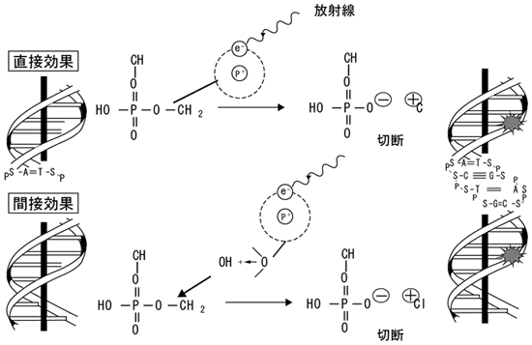
Direct effect and Indirect effect of irradiation
In living cells, free radicals are produced by the indirect effect of irradiation and free radicals attack DNA double strand to break it.
Irradiation
Direct effect
Break
Indirect effect
Break

Slide 29
Low dose and low dose-rate irradiation
Small amount of Reactive oxygen species (ROS) are formed,
But they will be rapidly reduced to water by antioxidant activity
in living cells.
DNA damages are not induced. Even if DNA was damaged, it will be repaired rapidly.
No increase of cancer risk
However, this does not mean that there are no biological effects.

Slide 30
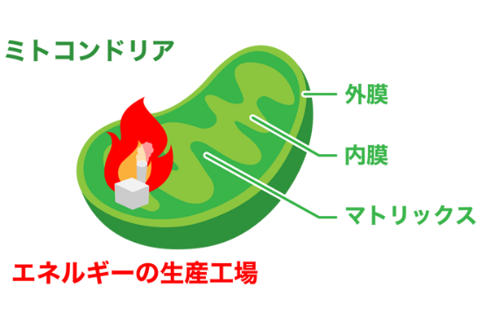
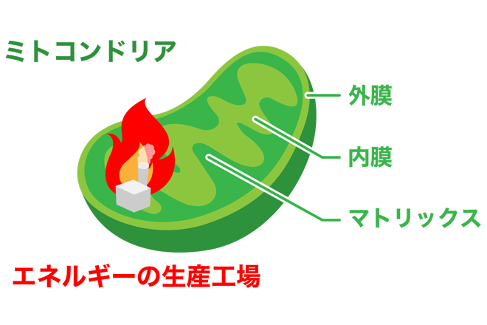
A small amount of free radicals are generated even in low dose rate irradiation, however, antioxidative activity of cells would quench the free radicals and no biological effects will be induced.
Anti-oxidant power (= reducing power) of living cell
NADPH (Nicotinamide Adenine Dinucleotide Phosphate)
Ascorbic acid (Vitamin C)
a- Tocopherol (Vitamin E)
Glutathione
SOD (SuperOxide Dismutase)
Thioredoxin
The inside of living cells are maintained reduced, not oxidized.
Living cell has the anti-oxidant activities
to protect themselves from free radials,
those are come from oxidative phosphorylation
(respiration) in mitochondria.
https://antioxidantres.jp/column010/

Slide 31
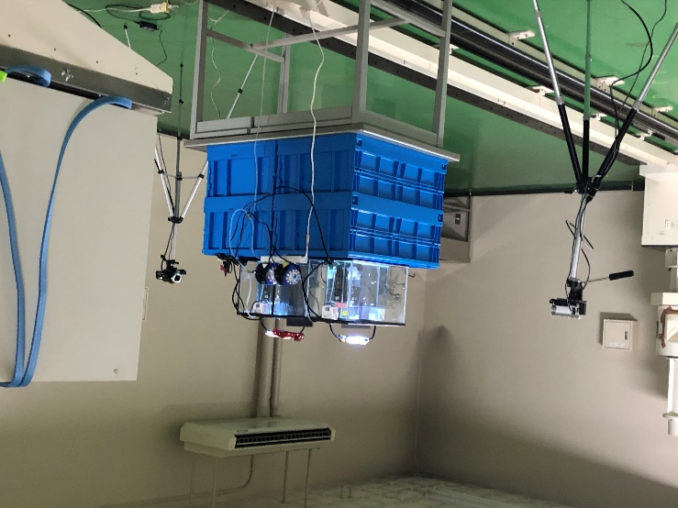
Expose medaka to low dose and low dose-rate
Gamma-rays chronically in Kyoto University.
low dose irradiation = less than 100 mSv
Namie-machi, Fukushima （2021年12月）
under 3 µGy/h
26 mGy/year
X 200
Radiation Biology Center, Kyoto University
100 mGy/ 7 days =
595 µGy/h
5,214 mGy/year
X 100,000
Gamma-cell, Seimeitou, Kashiwa, UT
1 Gy/ 1 min =
60,000,000 µGy/h
525,600 mGy/year
525 Gy/year

Slide 32
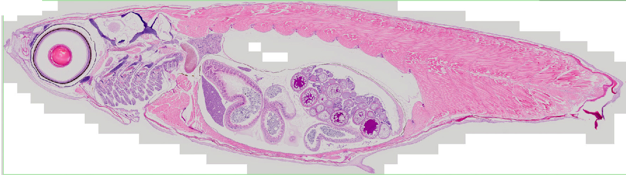
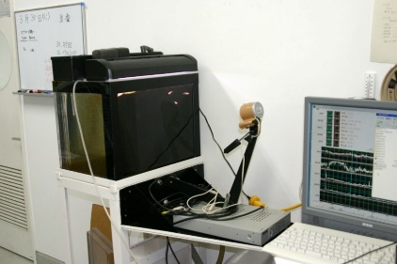
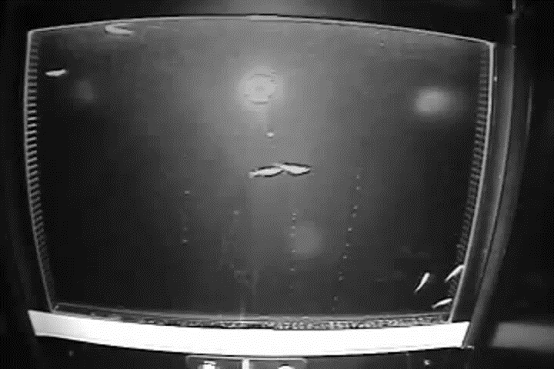
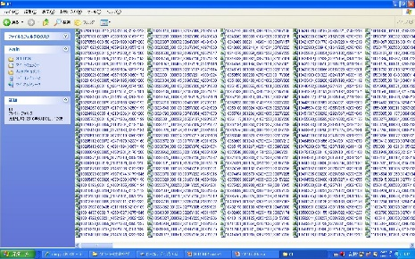
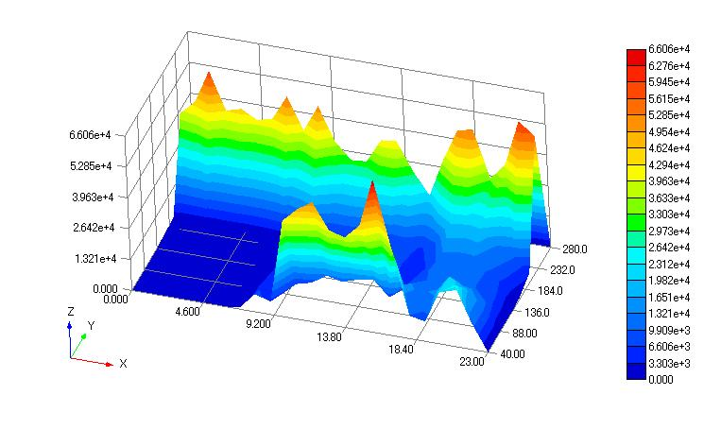
We conducted low dose and low dose-rate irradiation of γ-rays to adult medaka to evaluate the pjysiological effects of low dose rate irradiation.
Serial sectioning of whole body
Transcriptome analysis in whole body
Recoding and Digitization of whole swimming behavior of Medaka

Slide 33
We have found that, low dose-rate irradiation induces
Unquestionable suppression of spermatogenesis
(but still produce enough amount of sperm to fertilize spawned eggs)
Even without histological abnormalities, gene expression spectra in the tissues/organs are changed largely, indicating that the cells respond against low dose-rate irradiation.
Glycolysis is suppressed and pentose-phosphate-pathway is activated to enhance the production of NADPH, the most common antioxidant molecules in living cells. Consequently, the cells are in ATP shortage.
Moreover,
the radiation effects of low dose-rate irradiation are masked by the repair systems, such as p53-dependens, antioxidants.

Slide 34
To repair DNA damages, cells have to arrest cell cycle.
Expose to radiation
DNA damage induction
Cyclins
DAPI
γH2AX
Cell cycle arrest
= phosphorylated H2AX
ATM
（ataxia telangiectasia mutated）
p53
DNA Repair
Apoptotic cell death
DNA-PKcs
Ku70/80
Caspase 3
NBS1
BRCA1
Defects in DNA repair-related genes are often associated with defects in spermatogenesis.

Slide 35
P53-deficient
?
Wild type
?
Rate of carcinogenesis (%)
Increase due to radiation exposure
100
Naturally occurred = BG
0
Dose (mSv)
0.1
1
2
3
しきい値無し直線仮説（Linear Non-Threshold : LNT仮説）
UNSCARE report 1993

Slide 36
In addition, we also have to evaluate the impacts on the ecosystem.
Significant impacts to the Ecosystem
Severe damages for living organisms which DNA repair activity is low.
Reduced reproducibility will result in
Decrease of population, decrease of genetic variation, and
Instability of ecosystem, Increase in risk of extinction in future
There is no other way than to wash out radioactivity and decontaminate the ecosystem.
Consumption of the anti-oxidant power in the cells
= load to the health by chronic oxidation stress
Reducing of oxidation stress by fresh foods

