Slide 1
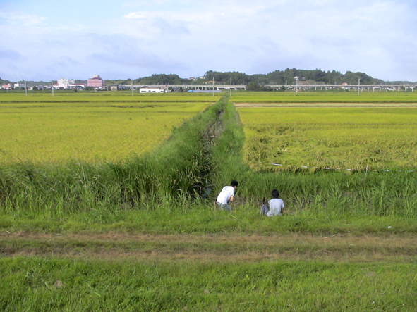
Genomic Instability
2023.11.29 by Shoji Oda
2023_11_29 Period 4
“Natural History of Medaka”

Slide 2
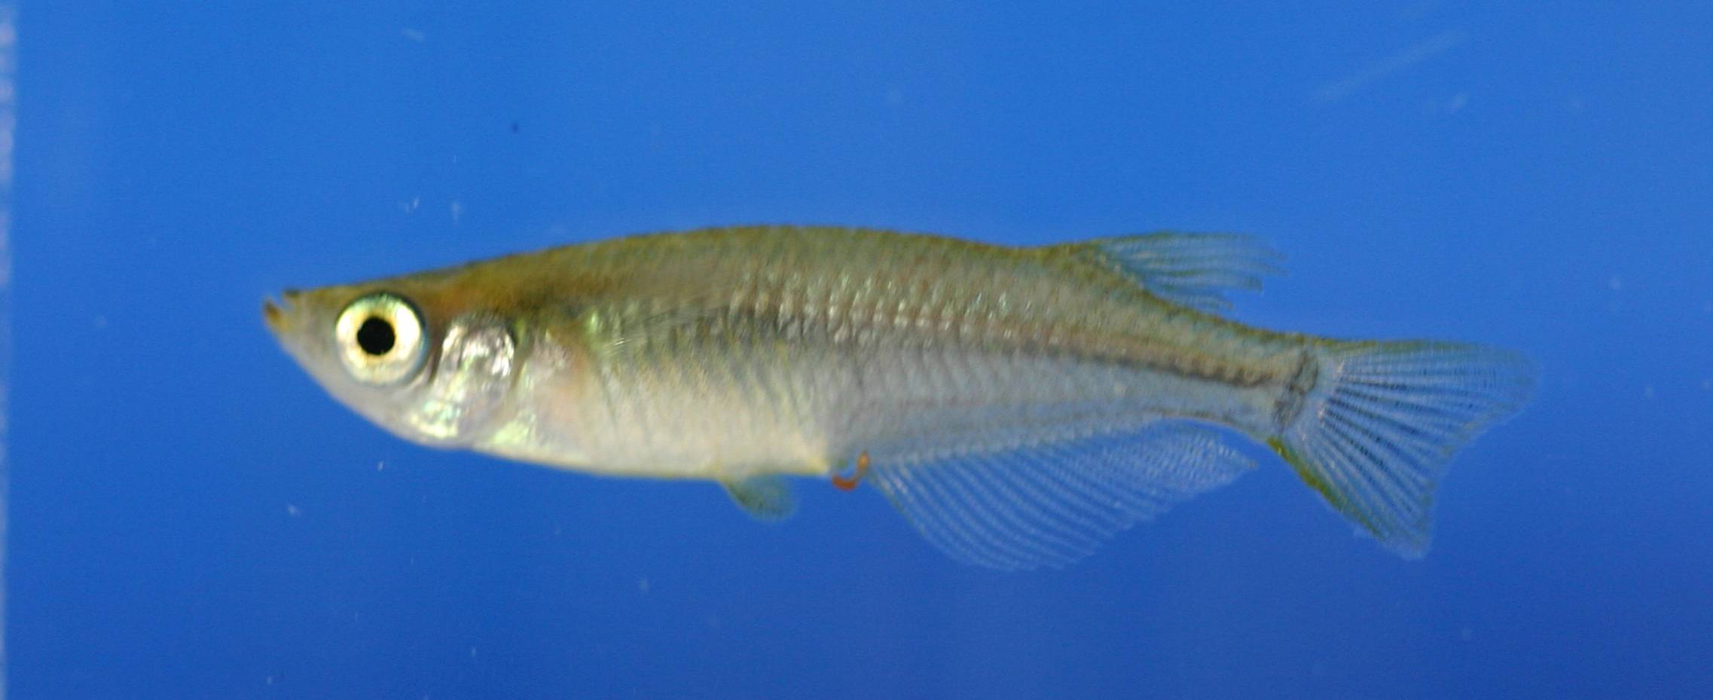
What is medaka ?
♀
♂

Slide 3
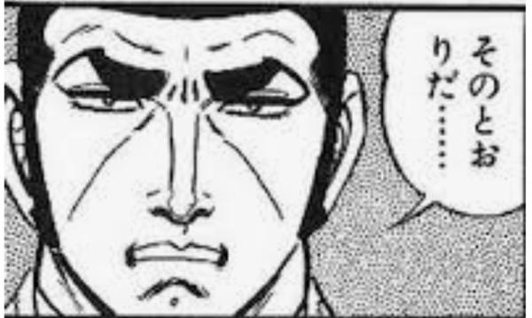
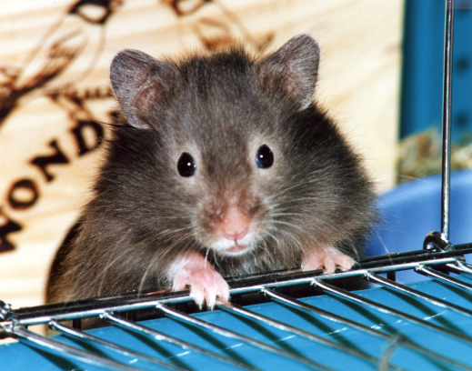
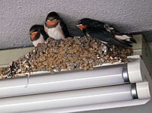
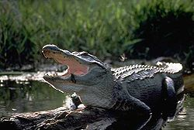

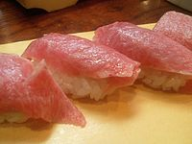
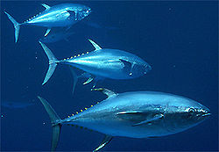
Medaka is fish.
Vertebrates
Animals with backbone
Mammals
Birds
Reptiles
Amphibians
Fishes

Slide 4
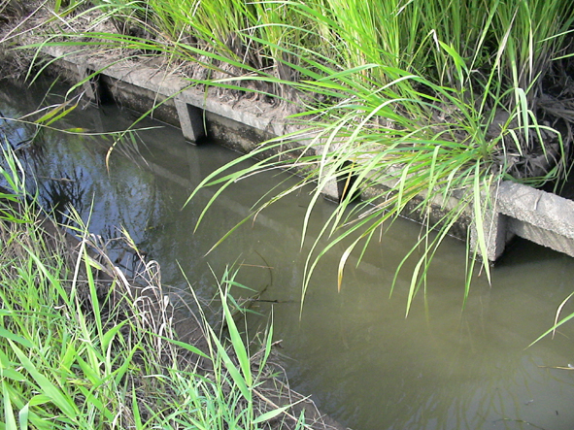
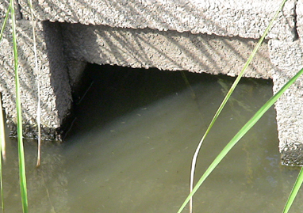
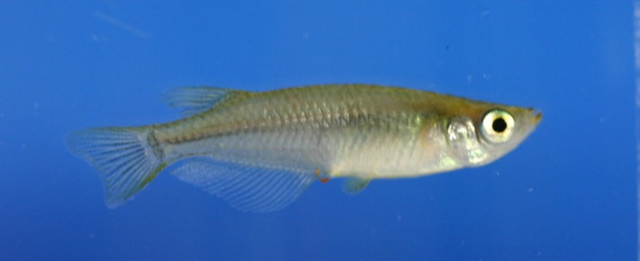
Medaka loves rice garden
Rice = Oryza sativa
Medaka = Oryzias latipes
Both botanical and animal food are available.
（Omnivorous 雑食性）
茨城県某所

Slide 5
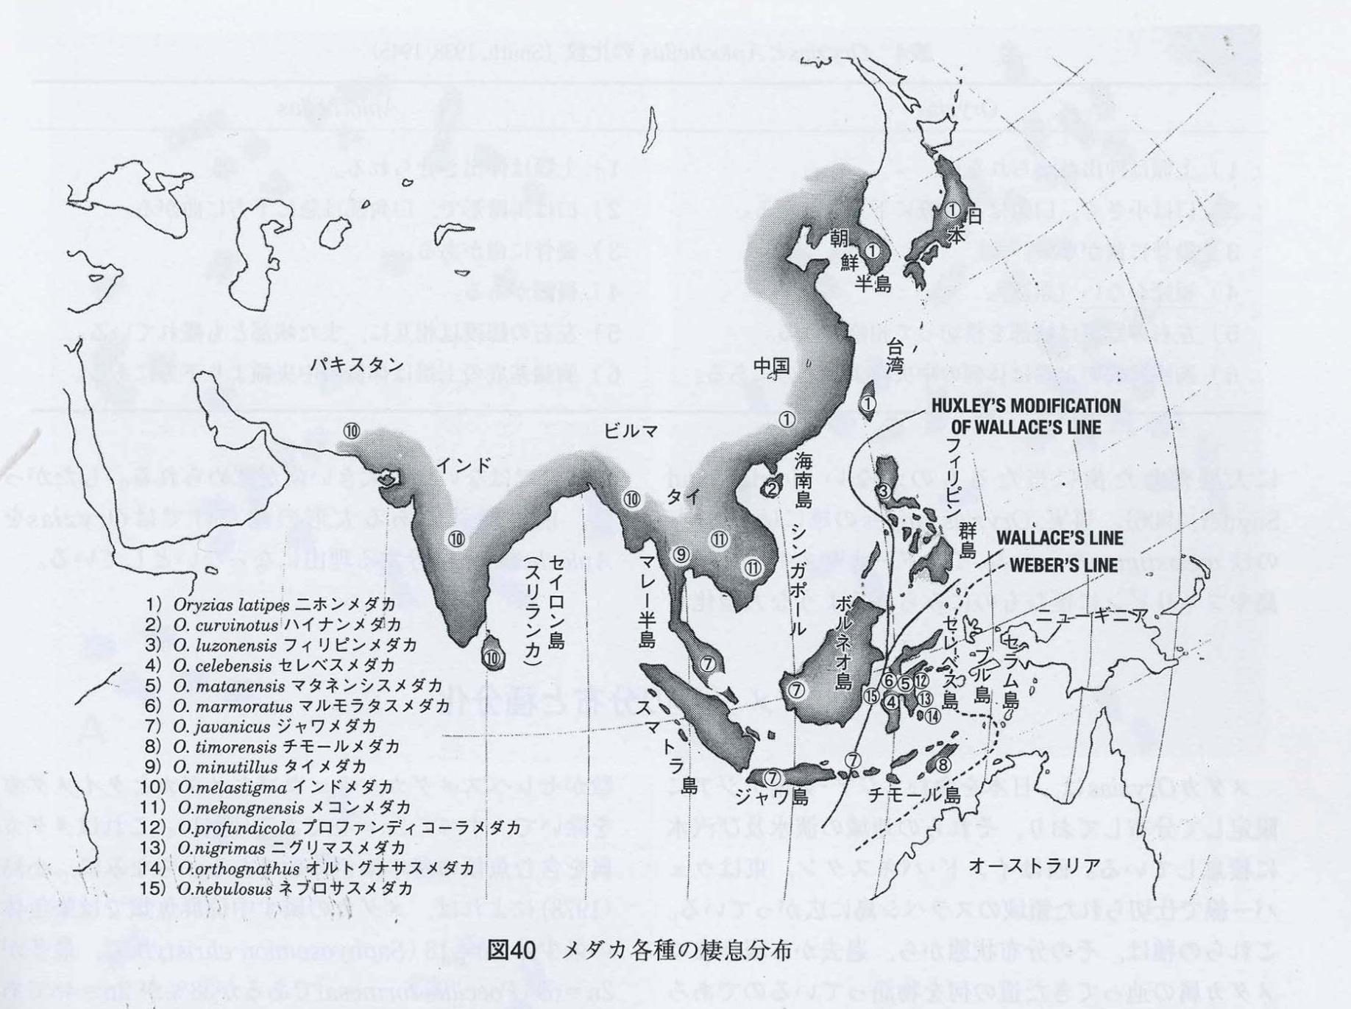
Medaka is freshwater fish habitat in Southeast Asia
日本

Slide 6
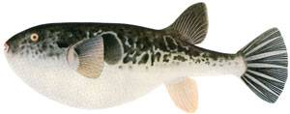
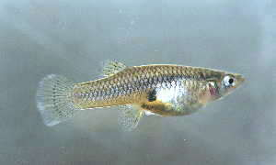
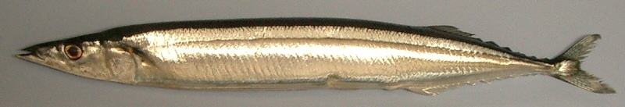

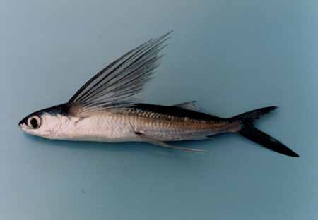
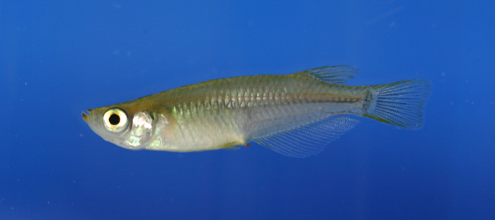
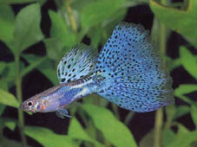
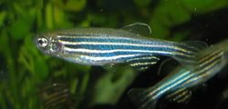
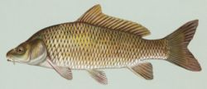
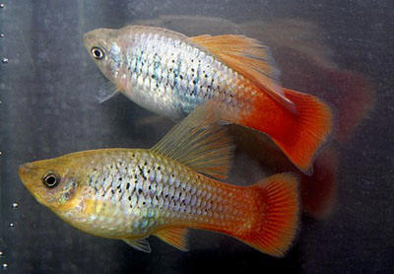
Medaka is closer to saury than carp, topminnow
Fugu
Topminnow
Saury 秋刀魚
Flying fish 飛魚
Medaka
Guppy
Platy
Zebrafish
Carp
Cyprinidae

Slide 7
Medaka came from sea
Oreder Belonidae
Strongylura anastomella
carp
They can still adapt to saltwater.
Day1
Day2
Day3

Slide 8
Medaka is freshwater fish habitat in Southeast Asia
日本

Slide 9
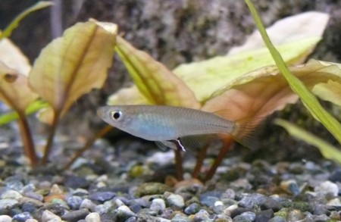

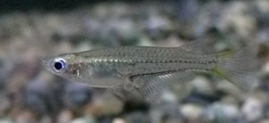
Medaka is tropical fish
日本
ハイナンメダカ
ジャワメダカ
セレベスメダカ

Slide 10
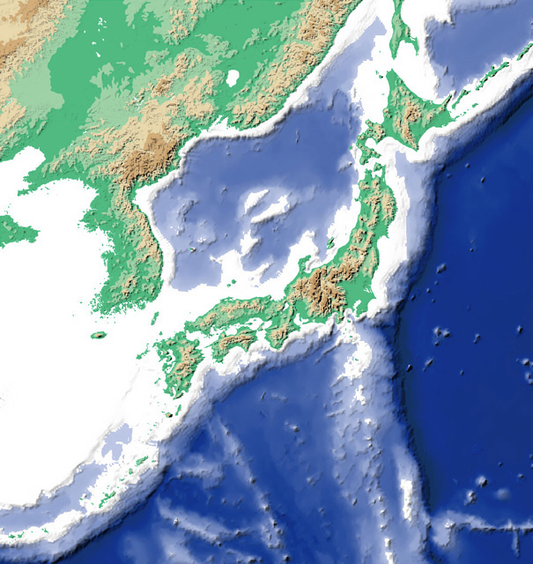
Medaka is habitat in Japan (excluding Hokkaido)
Maps of places where the 81 colonies reared in Kashiwa campus were collected

Slide 11
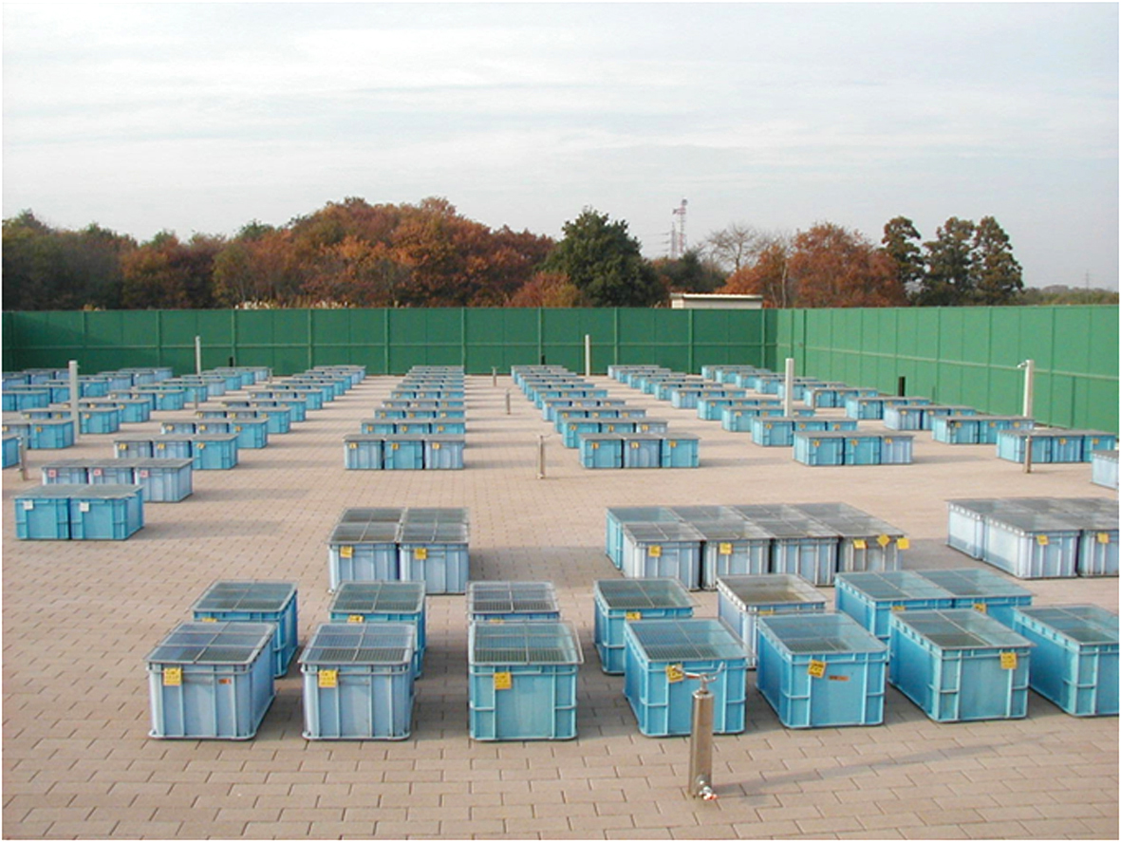

Slide 12
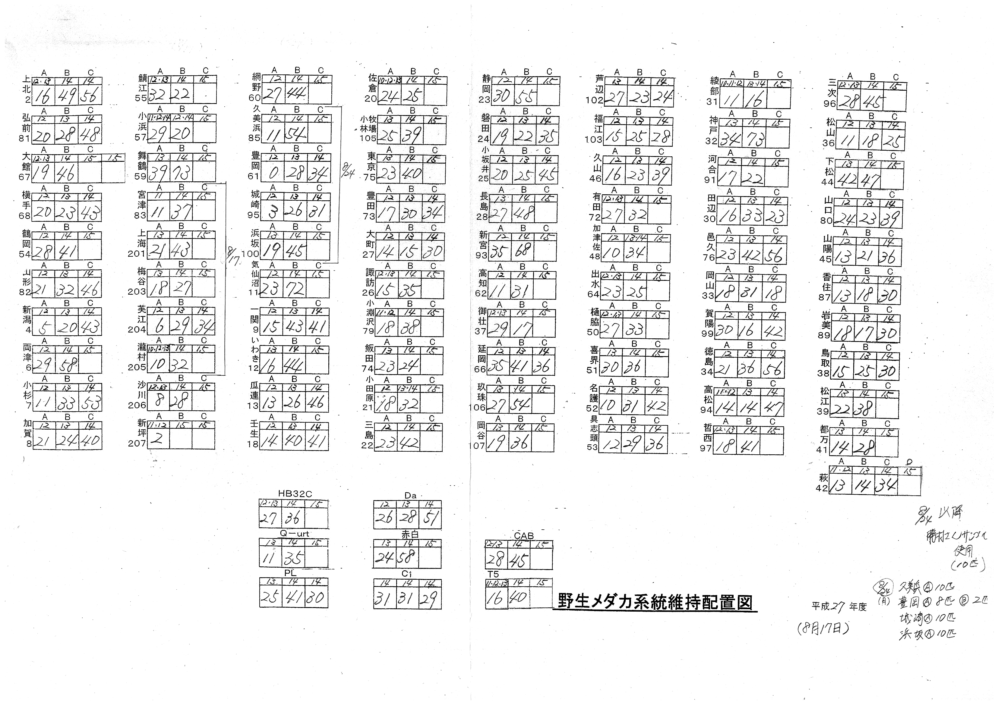

Slide 13
Medaka is habitat in Japan (excluding Hokkaido)
Maps of places where the 81 colonies reared in Kashiwa campus were collected

Slide 14
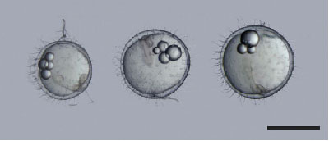
A large variation in egg size
HNI
F1
HSOK

Slide 15
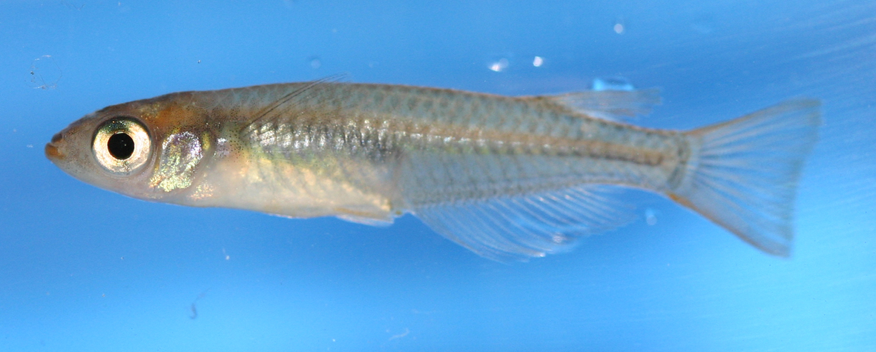
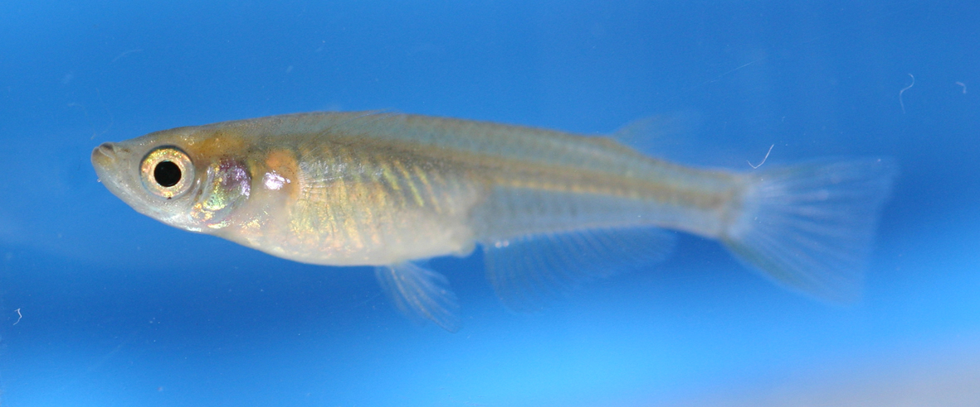
Variation in adult face
Hagi
“Normal”

Slide 16
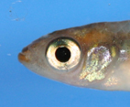
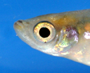
Hagi
“Normal”

Slide 17
Hagi
= Baby face !
Fry of medaka
http://www3.famille.ne.jp/~ochi/medaka/medaka_ph/seicho/shigyo-01.jpg
“Normal”
Adult flying fish
http://pmamacook.blog.fc2.com/blog-entry-525.html

Slide 18
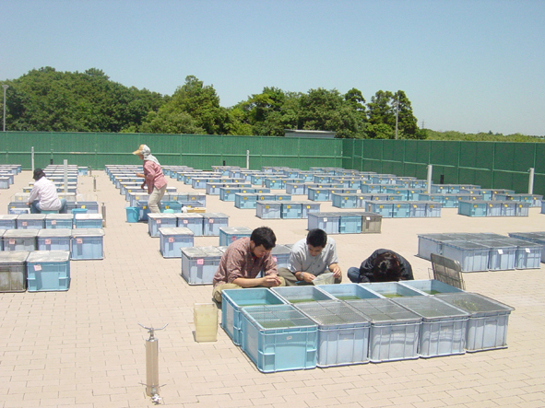
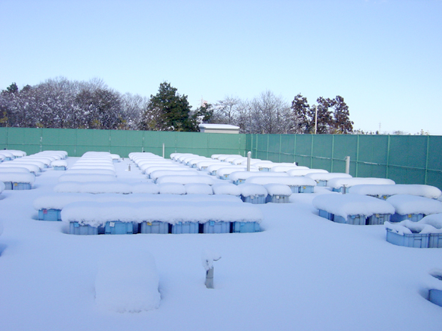
Spawning season starts at the end of April and continued up to middle of September.
Outdoor medaka keeping facility
Medaka is adapted to the wide range of temperature (4 – 40ºC)

Slide 19
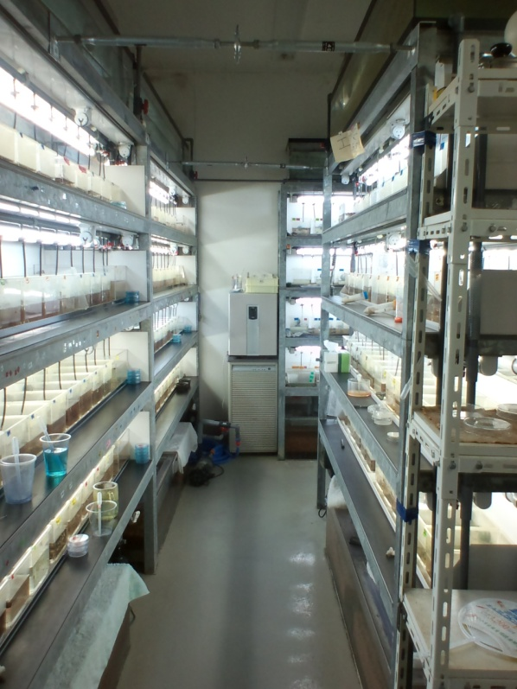
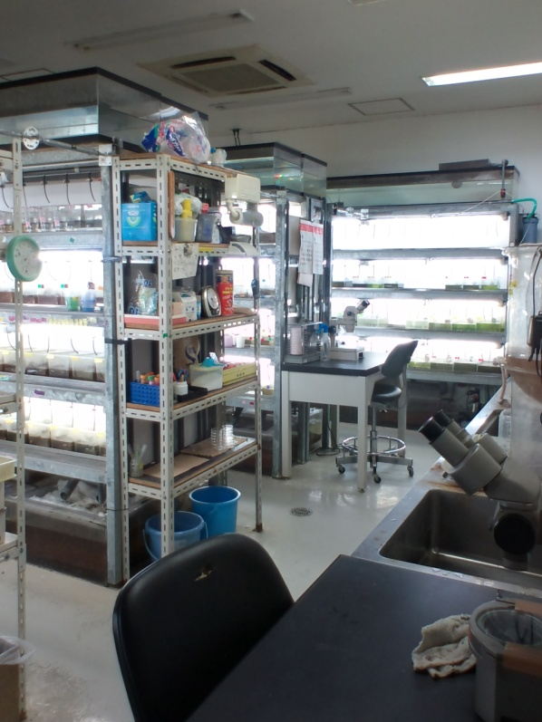
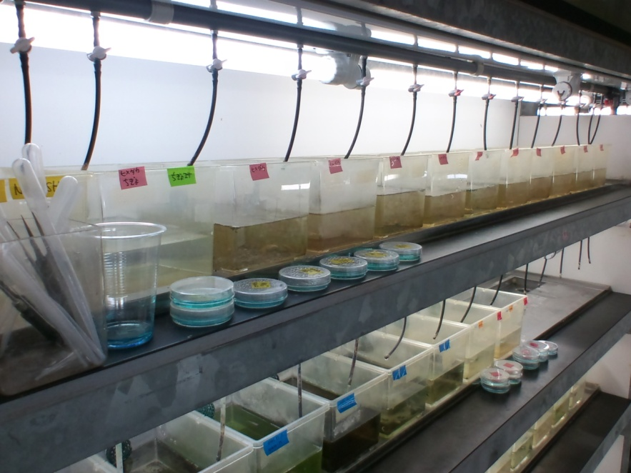
Female medaka spawn 15-20 eggs every morning through the year, when they are kept at 26ºC and fed with enough food and cared with love.
Indoor medaka keeping facility

Slide 20

26ºC
Tropical world
World of four seasons
Outdoor facility
Indoor facility
Molecular mechanisms of environment adaptation
Molecular mechanisms of radiation responses
Study of Health
What is life ?
Medaka endure the coldness for most of the year

Slide 21
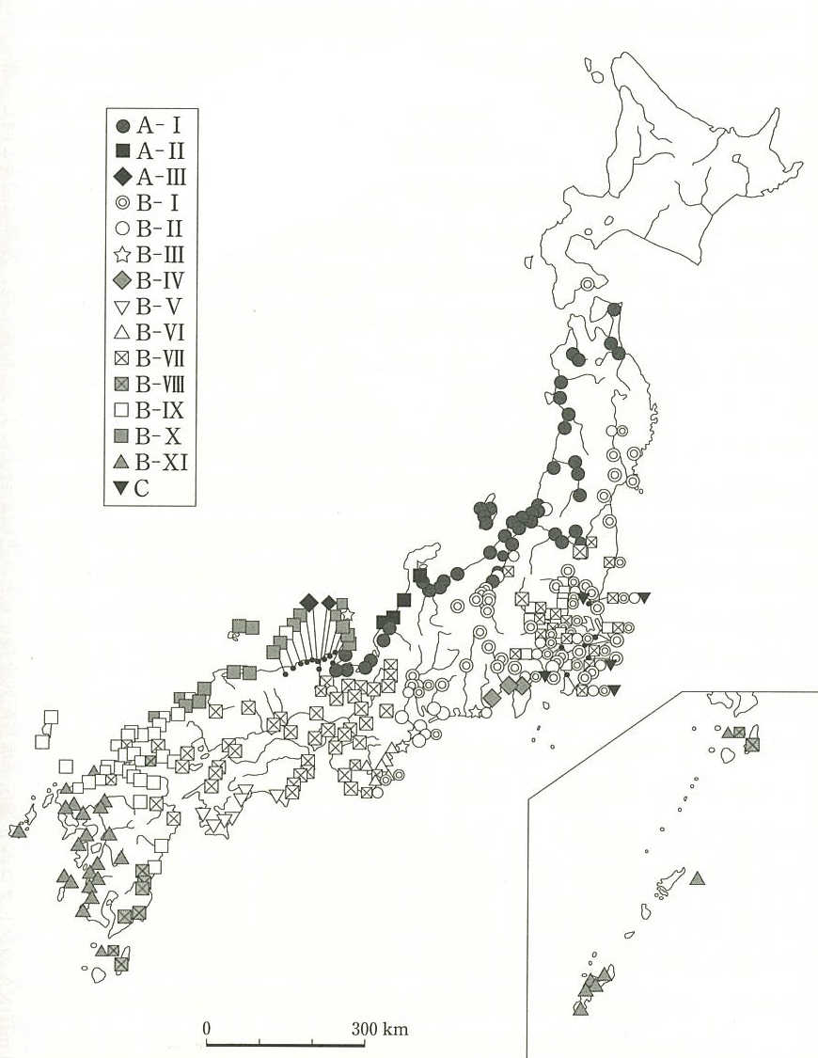
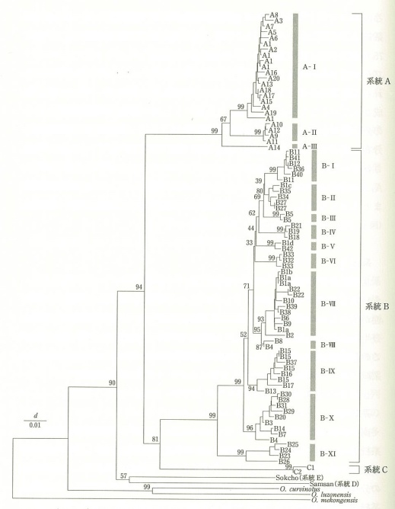
Phylogenic tree of Japanese medaka
Japanese medaka is composed of three groups: the Northern Japan group, which inhabits the Sea of Japan side of eastern Japan; the Southern Japan group, which inhabits the Pacific coast of Honshu, Shikoku and Kyushu; and the C group, which inhabits only the Kanto region.
Northern Japan group
“O. sakaizumii”
Southern Japan group
O. latipes
Takehana et al., 2003

Slide 22
Phylogenic tree of Japanese medaka
Japanese medaka is composed of three groups: the Northern Japan group, which inhabits the Sea of Japan side of eastern Japan; the Southern Japan group, which inhabits the Pacific coast of Honshu, Shikoku and Kyushu; and the C group, which inhabits only the Kanto region.
Northern Japan group
“O. sakaizumii”
Southern Japan group
O. latipes
Takehana et al., 2003

Slide 23
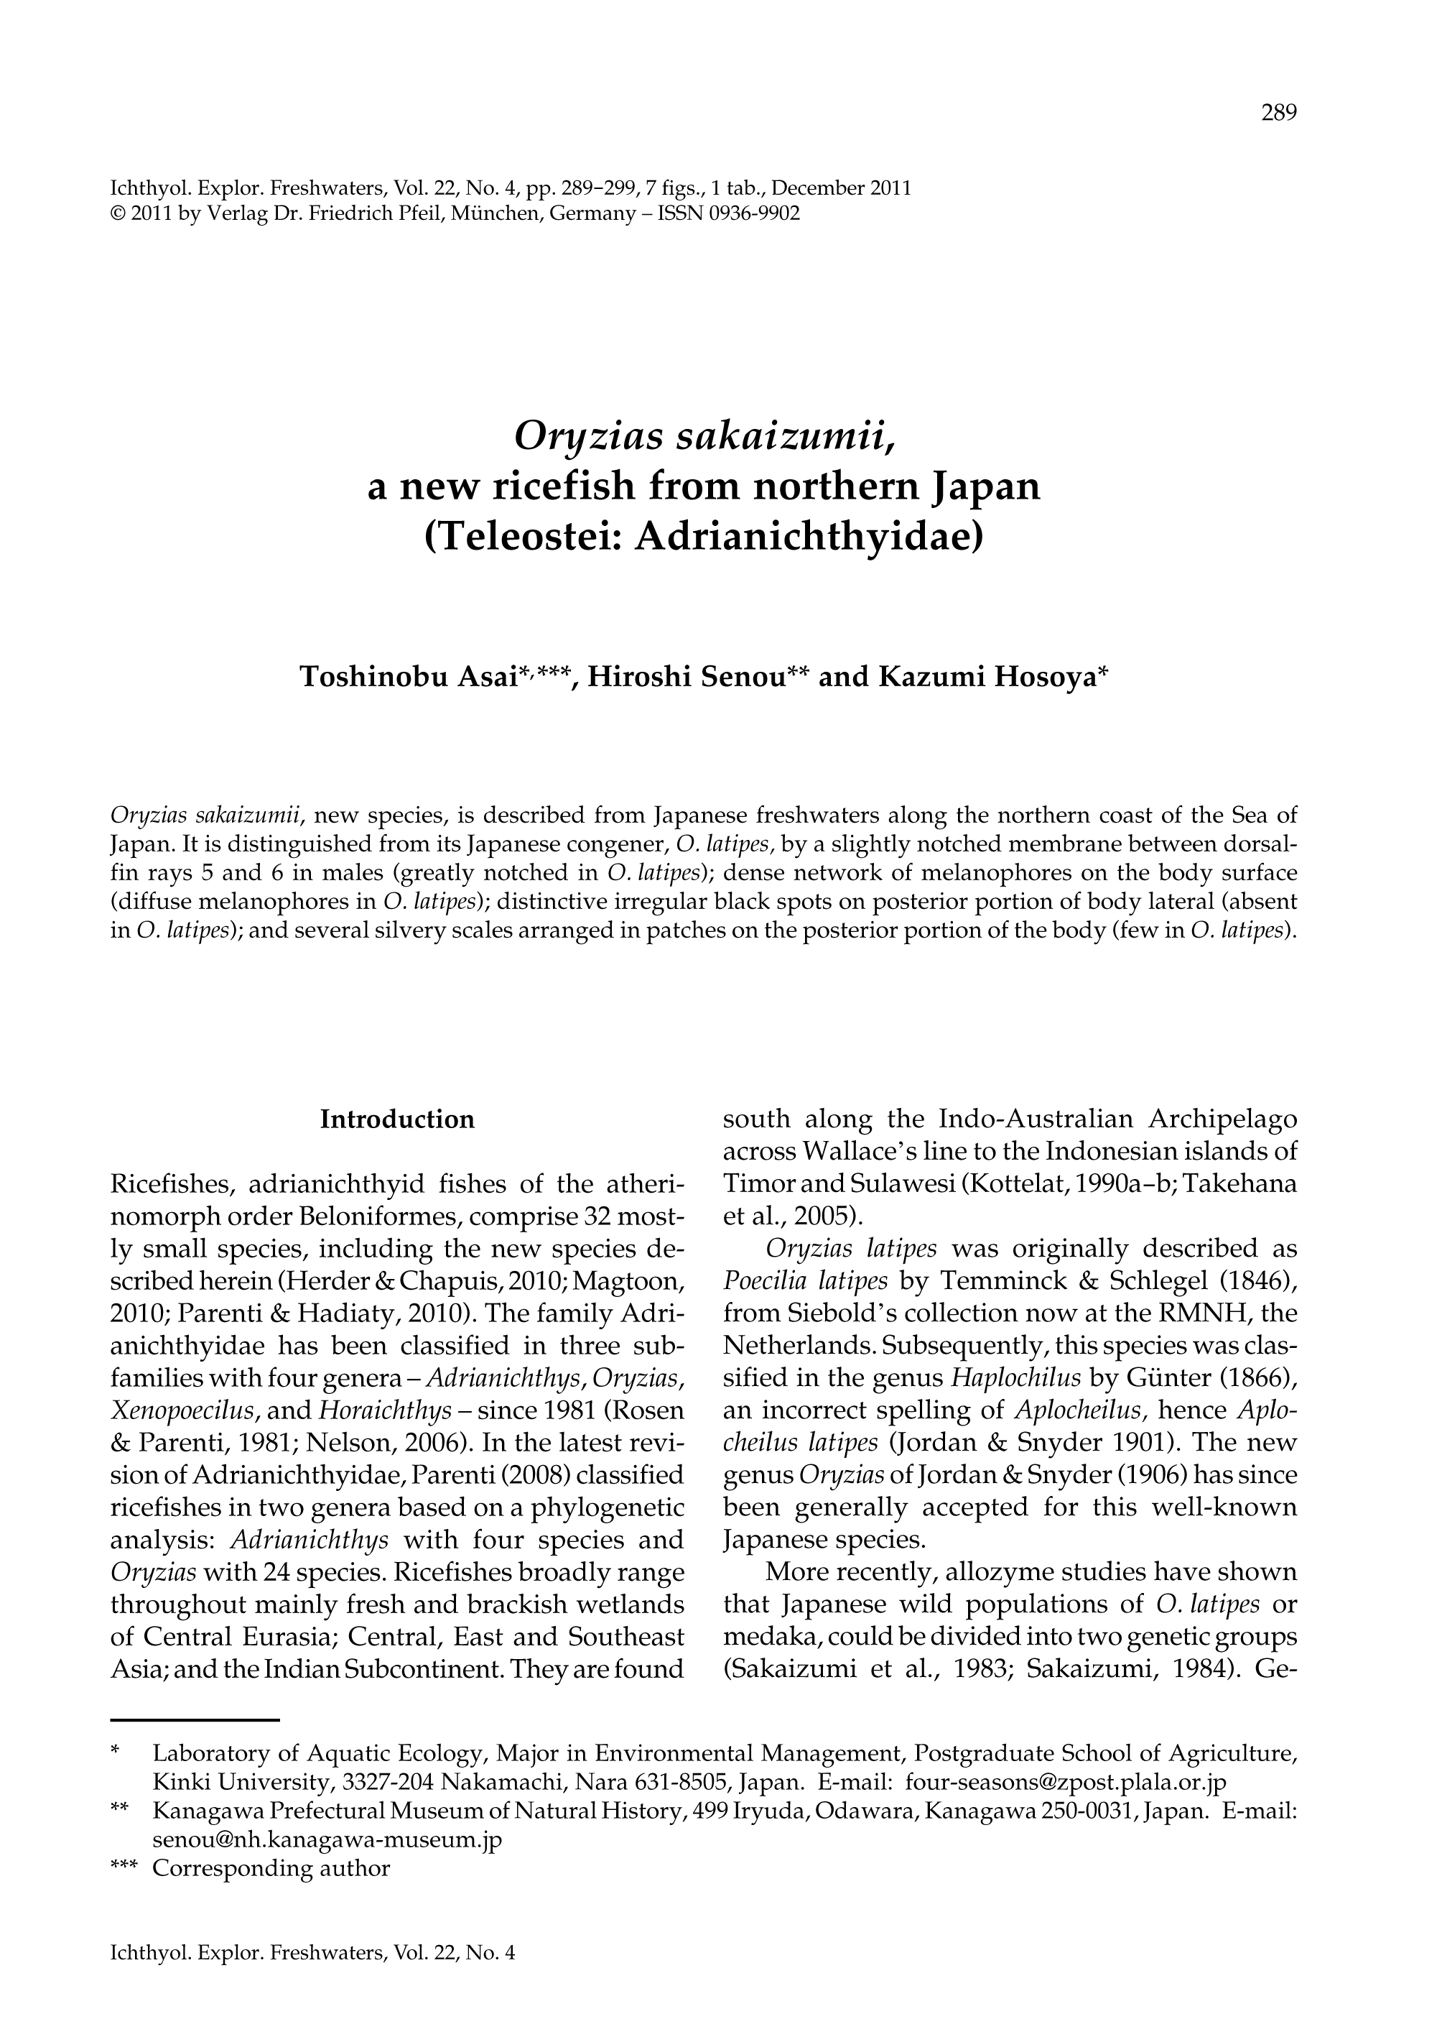
Japanese medaka is composed of
2 different species !?
１．There is no "pure-blooded" medaka.
２．O.sakaizumii and O. latipes are geographic subspecies.

Slide 24
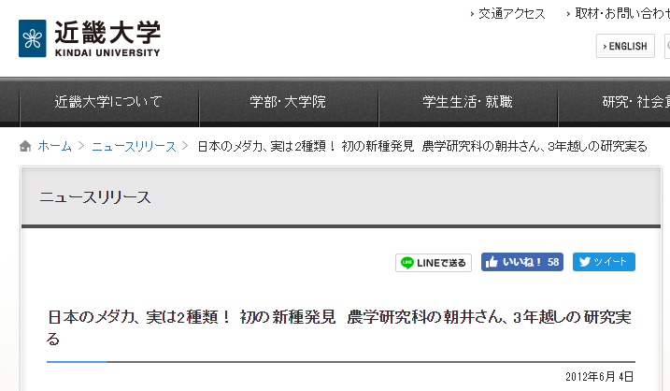
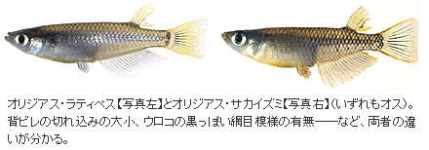

Slide 25
I felt strong disagree with the idea that the Northern Japan group is a new species.
1. Differences in morphology have long been well known.
2. Physiological differences have been known for a long time, and many studies have been conducted on the mechanisms of environmental adaptation using this diversity.
Low / high temperature tolerance, seawater tolerance, personality, egg size, etc.
3. A large genetic diversity of the Northern and Southern Japanese populations was well known, and has been regarded as intraspecific diversity.
Analysis of mitochondrial genes reveals that the Northern and Southern Japanese separated about 4 million Years Ago. (Takehana et al., 2003)
4. In the laboratory, the two medaka can interbreed, and their offspring are fully fertile. There is no clear reproductive disorder such as sexual preference between the two medaka.
5. I can't help but believe that they will definitely interbreed if we release them into a pond.
I can't think of any necessity why two groups of medaka that can interbreed, would need to be separated into different species.

Slide 26
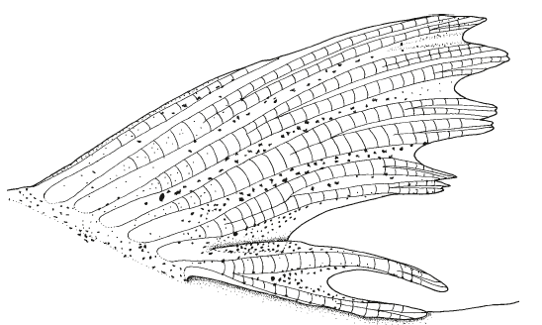
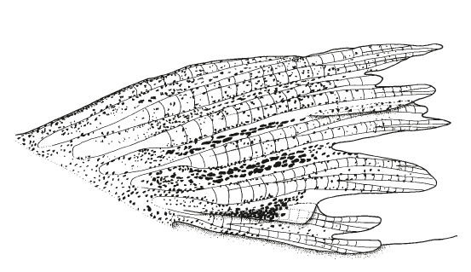
Morphological identification between O .latipes and O. sakaizumii proposed by Asai et al.（2011）
depth of the notch in the membrane between the dorsal-fin rays 5 and 6
2. dense network of melanophores along each scale margin on body side
3. distinctive irregular black spots present on the posterior portion of body
4. 10-23 silvery scales in patches on the posterior portion of body
depth of the notch in the membrane between the dorsal-fin rays 5 and 6
2. dense network of melanophores along each scale margin on body side
3. distinctive irregular black spots present on the posterior portion of body
4. 10-23 silvery scales in patches on the posterior portion of body
O .latipes ♂
O. Sakaizumii ♂
(Asai et al., 2011)

Slide 28
Morphological identification between O .latipes and O. sakaizumii proposed by Asai et al.（2011）
depth of the notch in the membrane between the dorsal-fin rays 5 and 6
2. dense network of melanophores along each scale margin on body side
3. distinctive irregular black spots present on the posterior portion of body
4. 10-23 silvery scales in patches on the posterior portion of body
depth of the notch in the membrane between the dorsal-fin rays 5 and 6
2. dense network of melanophores along each scale margin on body side
3. distinctive irregular black spots present on the posterior portion of body
4. 10-23 silvery scales in patches on the posterior portion of body
O .latipes ♂
O. Sakaizumii ♂
(Asai et al., 2011)

Slide 29
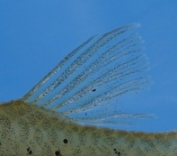
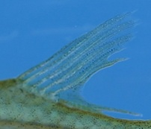
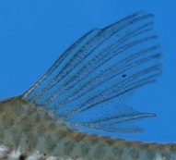
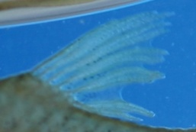
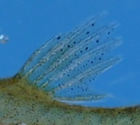
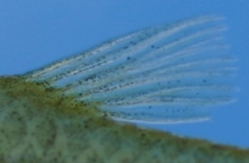
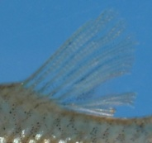









































































沙川
上海
新坪
瀧村
梅谷
芙江
鯖江
加賀
両津
舞鶴
宮津
鶴岡
大館
弘前
山形
小杉
小浜
新潟
具志頭
名護
北上
横手
網野
久美浜
城崎
浜坂
豊岡
岩美
三次
いわき
芦辺
一関
瓜連
高松
高知
壬生
三島
延岡
岡谷
下松
喜界
山口
香住
出水
加津佐
河合
賀陽
佐倉
小坂井
小林牧場
田辺
気仙沼
久山
玖珠
山陽
御荘
静岡
綾部
小田原
小淵沢
松江
松山
樋脇
福江
鳥取
磐田
諏訪
大町
長島
豊田
新宮
哲西
邑久
都万
東京
徳島
萩
飯田
有田
神戸

Slide 30

(dorsal fin of male HNI）
( A – B )
B
A
B
( A – B )
B
O. sakaizumii tends to have a shallower slit than O. latipes, but its distribution falls within the range of variation of O. latipes, so it is not possible to distinguish between the two on the basis of slit depth.
→ Impossible to distinguish between O. latipes and O,sakaizumii

Slide 31
Morphological identification between O .latipes and O. sakaizumii proposed by Asai et al.（2011）
depth of the notch in the membrane between the dorsal-fin rays 5 and 6
2. dense network of melanophores along each scale margin on body side
3. distinctive irregular black spots present on the posterior portion of body
4. 10-23 silvery scales in patches on the posterior portion of body
depth of the notch in the membrane between the dorsal-fin rays 5 and 6
2. dense network of melanophores along each scale margin on body side
3. distinctive irregular black spots present on the posterior portion of body
4. 10-23 silvery scales in patches on the posterior portion of body
O .latipes ♂
O. Sakaizumii ♂
(Asai et al., 2011)

Slide 32


O. latipes ♂
“Tiled pattern”
O. Sakaizumii ♂
“Mesh pattern”
(Asai et al., 2011)

Slide 33


O. latipes ♂
“Tiled pattern”
O. Sakaizumii ♂
“Mesh pattern”
(Asai et al., 2011)

Slide 34







































































沙川
上海
新坪
瀧村
梅谷
芙江
北上
弘前
鶴岡
大館
鯖江
山形
小杉
横手
加賀
両津
宮津
舞鶴
小浜
新潟
神戸
久美浜
城崎
浜坂
豊岡
網野
壬生
河合
加津佐
賀陽
三島
三次
小坂井
小林牧場
高知
飯田
小田原
小淵沢
田辺
出水
福江
瓜連
いわき
都万
大町
長島
豊田
新宮
邑久
山口
東京
高松
磐田
徳島
萩
有田
香住
気仙沼
久山
玖珠
御荘
静岡
綾部
具志頭
延岡
岡谷
下松
岩美
芦辺
一関
名護

Slide 35

沙川
上海
新坪
瀧村
梅谷
芙江
北上
弘前
鶴岡
大館
鯖江
山形
小杉
横手
加賀
両津
宮津
舞鶴
小浜
新潟
神戸
久美浜
城崎
浜坂
豊岡
網野
壬生
河合
加津佐
賀陽
三島
三次
小坂井
小林牧場
高知
飯田
小田原
小淵沢
田辺
出水
福江
瓜連
いわき
都万
大町
長島
豊田
新宮
邑久
山口
東京
高松
磐田
徳島
萩
有田
香住
気仙沼
久山
玖珠
御荘
静岡
綾部
具志頭
延岡
岡谷
下松
岩美
芦辺
一関
名護

Slide 36


O. latipes ♂
“Tiled pattern”
壬生
O. Sakaizumii ♂
“Mesh pattern”
大館
In O. sakaizumii, melanophores distribute along the edges of individual scales and form a dense mesh-like pattern, whereas in O. latipes, melanophores distribute in the center of the scales and form a cobblestone pattern.
→ Possible to distinguish between O. latipes and O,sakaizumii

Slide 37
Morphological identification between O .latipes and O. sakaizumii proposed by Asai et al.（2011）
depth of the notch in the membrane between the dorsal-fin rays 5 and 6
2. dense network of melanophores along each scale margin on body side
3. distinctive irregular black spots present on the posterior portion of body
4. 10-23 silvery scales in patches on the posterior portion of body
depth of the notch in the membrane between the dorsal-fin rays 5 and 6
2. dense network of melanophores along each scale margin on body side
3. distinctive irregular black spots present on the posterior portion of body
4. 10-23 silvery scales in patches on the posterior portion of body
O .latipes ♂
O. Sakaizumii ♂
(Asai et al., 2011)

Slide 38
弘前
横手
鶴岡
山形
新潟
加賀
北上
両津
大館
舞鶴
鯖江
宮津
小杉
小浜

Slide 39
Morphological identification between O .latipes and O. sakaizumii proposed by Asai et al.（2011）
depth of the notch in the membrane between the dorsal-fin rays 5 and 6
2. dense network of melanophores along each scale margin on body side
3. distinctive irregular black spots present on the posterior portion of body
4. 10-23 silvery scales in patches on the posterior portion of body
O. latipes ♂
I was not able to distinguish the identification points 3 and 4.
O. Sakaizumii ♂
→ We did not know whether it was possible to distinguish between O. latipes and O. sakaizumii.
(Asai et al., 2011)

Slide 40
Morphological identification between O .latipes and O. sakaizumii proposed by Asai et al.（2011）
depth of the notch in the membrane between the dorsal-fin rays 5 and 6
2. dense network of melanophores along each scale margin on body side
3. distinctive irregular black spots present on the posterior portion of body
4. 10-23 silvery scales in patches on the posterior portion of body
In the analysis of the wild populations maintained in the Kashiwa campus, it was possible to distinguish O. latipes from O. sakaizumii by the pattern formed by the black pigment vesicles on the lateral portion of the body.

Slide 41
I felt strong disagree with the idea that the Northern Japan group is a new species.
1. Differences in morphology have long been well known.
2. Physiological differences have been known for a long time, and many studies have been conducted on the mechanisms of environmental adaptation using this diversity.
Low / high temperature tolerance, seawater tolerance, personality, egg size, etc.
3. A large genetic diversity of the Northern and Southern Japanese populations was well known, and has been regarded as intraspecific diversity.
Analysis of mitochondrial genes reveals that the Northern and Southern Japanese separated about 4 million Years Ago. (Takehana et al., 2003)
4. In the laboratory, the two medaka can interbreed, and their offspring are fully fertile. There is no clear reproductive disorder such as sexual preference between the two medaka.
5. I can't help but believe that they will definitely interbreed if we release them into a pond.
I can't think of any necessity why two groups of medaka that can interbreed, would need to be separated into different species.

Slide 42
What is species ?
A population of organisms surviving in the ecosystem that shares traits such as morphology and shows discontinuities in these traits with other populations (= different species).
“To share a trait” means “to share genetic information”, and “to have a discontinuity in a trait” means “not to share genetic information”.
A species is a population that can interbreed without reproductive isolation, whereas complete reproductive isolation is achieved between different species.
While reproductive isolation is incomplete and there is a possibility of genetic exchange in the future, it is not a separate species, but a subspecies.
The Norther and Southern medaka are geographic subspecies, since they are just geographically isolated (Traditional thinking).

Slide 43
Northern Japan
Population
“O. sakaizumii”
Tango・Tajima area
Southern Japan
Population
O. latipes
Takehana et al., 2003

Slide 44

丹後
久美浜
香住
網野
浜坂
竹野
岩美
伊根
鳥取
城崎
大宮
豊岡
宮津
舞鶴
綾部
福知山

Slide 45

Mitochondrial genome
Southern Japan Population
Northern Japan Population
丹後
竹野
網野
浜坂
香住
城崎
岩美
伊根
大宮
鳥取
宮津
小浜
久美浜
舞鶴
豊岡
福知山
綾部
（Google より）
(Takehana et al., 2003; Uono et al., 2011)

Slide 46
Southern Japan Population
Nuclear genome
Northern Japan Population
網野
浜坂
香住
城崎
岩美
鳥取
宮津
小浜
久美浜
舞鶴
豊岡
綾部
（Google より）
(Sakaizumi, 1984; Katsumura et al, unpublished)

Slide 47
Nuclear genome
Southern Japan Population
Mitochondrial genome
Northern Japan Population
丹後
網野
浜坂
香住
網野
浜坂
城崎
岩美
城崎
伊根
大宮
鳥取
宮津
小浜
久美浜
舞鶴
久美浜
豊岡
豊岡
“Boundary populations”
綾部
With the Northern genome and the Southern mitochondria
→ The population originated from the interbreeding of the
North and South medaka.
（Google より）
(Sakaizumi, 1984; Takehana et al., 2003; Katsumura et al, unpublished)

Slide 48
Southern Japan Population
Nuclear genome
Northern Japan Population
網野
浜坂
香住
城崎
岩美
鳥取
宮津
小浜
久美浜
舞鶴
豊岡
綾部
（Google より）
(Sakaizumi, 1984; Sakaizumi et al., unpublished; Katsumura et al, unpublished)

Slide 49
Mitochondrial genome
Southern Japan Population
Northern Japan Population
丹後
B-IX
竹野
網野
浜坂
香住
城崎
岩美
伊根
A-II
大宮
鳥取
B-X
宮津
小浜
久美浜
舞鶴
豊岡
A-III
綾部
B-VII
（Google より）
(Takehana et al., 2003)

Slide 50
Nuclear genome
Southern Japan Population
Mitochondrial genome
Northern Japan Population
丹後
網野
浜坂
香住
城崎
岩美
伊根
大宮
鳥取
宮津
小浜
久美浜
舞鶴
豊岡
綾部
（Google より）
(Sakaizumi, 1984; Takehana et al., 2003;
Sakaizumi, et al., unpublished; Katsumura et al, unpublished)

Slide 51
Southern Japan Population
Nuclear genome
Northern Japan Population
Tsushima stream
丹後
B-IX
網野
浜坂
香住
城崎
岩美
A-II
大宮
鳥取
B-X
宮津
小浜
久美浜
舞鶴
豊岡
A-III
綾部
B-VII
How populations with Norther genome and Southern mitochondria can be formed?
（Google より）
(Sakaizumi, 1984; Takehana et al., 2003;
Sakaizumi, et al., unpublished; Katsumura et al, unpublished)

Slide 52
B-X
B-IX

Slide 53
Southern Japan Population
Nuclear genome
Northern Japan Population
Tsushima stream
丹後
B-IX
網野
浜坂
香住
城崎
岩美
A-II
大宮
鳥取
B-X
宮津
小浜
久美浜
舞鶴
豊岡
A-III
綾部
B-VII
How populations with Norther genome and Southern mitochondria can be formed?
（Google より）
(Sakaizumi, 1984; Takehana et al., 2003;
Sakaizumi, et al., unpublished; Katsumura et al, unpublished)

Slide 54




One day, the Southern medaka moved into the habitat of the Northern medaka…
Cross-bred F1
If cross-bred F1 medaka were isolated,
A population with a mixed nuclear genome of Northern and Southern genomes and a mixture of individuals with Northern mitochondria and individuals with Southern mitochondria would be formed and maintained.

Slide 55

The majority of the progeny group will be the northern Japan population,
if the crossbred progeny group is not isolated.
F1

Slide 56


F2
Since the population of Northern medaka is much larger than that of the crossbred individuals, most of the individuals are descendants of Northern medaka.
The offspring of the crossbred individuals will also interbreed with Northern medaka, so the genome will become increasingly Northern genome.
Mitochondria are not recombined, so they are maintained intact in some individuals.

Slide 57


Fn1
Nuclear genome from Southern medaka are diluted by ½ in each generation and the genome of the "crossbred group" becomes Northern medaka genome, whereas a small number of individuals carrying mitochondria of southern medaka are maintained in the population, since mitochondria are maternally inherited without recombination.

Slide 58

Fn2
1
10
(
)
= 1,024
After 20 generations (20 years for medaka), the genes from the Southern medaka will be lost (below the detection limit of the current measurement method).
A small number of individuals with mitochondria derived from Southern medaka are maintained.
2
1
20
(
)
= 1,048,576
2

Slide 59
Mitochondria of Northern medaka seem to be involved in cold climate adaptation (Hirayama et al., 2010)
Fn2
1
10
If individuals with mitochondria of Southern medaka are advantageous, the mitochondria from Southern medaka will dominate in the population.
The offspring of the crossbred population should be dominated by a population with the genome of Northern medaka and mitochondria from Southern medaka.
(
)
= 1,024
2
1
20
(
)
= 1,048,576
2

Slide 60
Southern Japan Population
Nuclear genome
Northern Japan Population
Tsushima stream
丹後
B-IX
網野
浜坂
香住
城崎
岩美
A-II
大宮
鳥取
B-X
宮津
小浜
久美浜
舞鶴
豊岡
A-III
綾部
B-VII
（Google より）

Slide 61
Summary
Medaka populations in the boundary area are the descendants of cross-bred between Norther medaka and migrated Southern medaka into them.
The distribution pattern of the hybrid population in the boundary area (Tango-Tajima region) strongly suggests that the Southern Japanese medaka is now in the process of moving into the Northern Japanese medaka habitats.

Slide 62
Southern Japan Population
Nuclear genome
Northern Japan Population
Tsushima stream
丹後
B-IX
網野
浜坂
香住
城崎
岩美
A-II
大宮
鳥取
B-X
宮津
小浜
久美浜
舞鶴
豊岡
A-III
綾部
B-VII
（Google より）

Slide 63

Northern Japan Population
Southern Japan Population
B-IX
B-X
Takehana et al., 2003

Slide 64
Summary
Medaka populations in the boundary area are the descendants of cross-bred between Norther medaka and migrated Southern medaka into them.
The distribution pattern of the hybrid population in the boundary area (Tango-Tajima region) strongly suggests that the Southern Japanese medaka is now in the process of moving into the Northern Japanese medaka habitats.
According to the above hypothesis, the time of hybridization that caused the formation of the hybrid population should be after the separation of mitochondrial subtypes B-IX and B-X and at least two times.

Slide 65
Southern Japan Population
Nuclear genome
Northern Japan Population
Tsushima stream
丹後
B-IX
網野
浜坂
香住
城崎
岩美
A-II
大宮
鳥取
B-X
宮津
小浜
久美浜
舞鶴
豊岡
A-III
綾部
B-VII
Yura River
（Google より）

Slide 66

天の橋立
豊岡盆地
宮津
福知山
綾部
水分かれ公園
Watershed
神戸

Slide 67


Japan Sea
福知山（Yura river）
sedimentary plain 堆積平野
To south coastline
To north coastline
水分かれ公園
Watershed
The lowest elevation watershed in Japan !
高砂（Kako river）
（Wikipedia より）
Setouchi Sea (Pacific Ocean)
https://ja.wikipedia.org/wiki/%E6%B0%B4%E5%88%86%E3%82%8C%E5%85%AC%E5%9C%92

Slide 68
Southern Japan Population
Nuclear genome
Northern Japan Population
Tsushima stream
丹後
B-IX
If something doesn't add up, dig deeper.
網野
浜坂
香住
城崎
岩美
A-II
大宮
鳥取
B-X
宮津
小浜
久美浜
舞鶴
Tyooka basin
豊岡
A-III
Yura river area
綾部
B-VII
Yura River
（Google より）

Slide 69




We drove to Saga Prefecture to collect wild medaka.

Slide 70
Deme Sampling
＊
＊
広島北部
n = 48
＊
広島南部
n = 48
＊
佐賀北部
n = 48
茨城北部
n = 83
＊
佐賀南部
n = 48
＊
千葉
n = 124
岡山
n = 95
茨城南部
n = 90
＊： 発表者自身が実際にサンプリングに訪れた場所
Notes:
70

Slide 71
Genetic diversity in populations
青森 （水田）
n = 94
緑 ： gene diversity (Gd)
沖縄（池）
： nucleotide diversity(Nd)
n = 149
佐賀北部 （水田）
佐賀南部 （水田）
n = 48
n = 48
岩手赤生津 （水田）
岩手古城 （水田）
岩手川内 （水田）
n = 41
n = 47
n = 61
広島北部 （池）
広島南部 （水田）
岡山 （水田）
茨城北部 （水田）
茨城南部 （湖）
千葉 （水田）
n = 48
n = 48
n = 95
n = 83
n = 90
n = 124
Notes:
71

Slide 72
関東
岡山・広島
北九州

Slide 73

Out of Northern Kyushu
関東
岡山・広島
北部九州・佐賀
North Kyushu
North
Kyushu
Katsumura et al. (2011)
Anthropol. Sci.
The diversity of the Southern Japan medaka suggests that Southern Japan medaka originated in northern Kyushu.
Notes:
73

Slide 74
関東
岡山・広島
北九州

Slide 75
関東
X
X
X
X
岡山・広島
X
X
X
X
北九州
X
X

Slide 76

Phylogenic tree of Japanese medaka
Northern Japan group
“O. sakaizumii”
Southern Japan group
O. latipes
Takehana et al.,
Zool. Sci., 20, 1279-1291, 2003

Slide 77
Genetic relatedness is roughly consistent with geographic distribution.
“ God in the details.”
「神は細部に宿る。」
Ludwig Mies van der Rohe （ architect ）
東
西
Takehana et al.,
Zool. Sci., 20, 1279-1291, 2003

Slide 78
“ God in the details.”
「神は細部に宿る。」
Ludwig Mies van der Rohe （ architect ）

Slide 79
“ God in the details.”
「神は細部に宿る。」
Ludwig Mies van der Rohe （ architect ）

Slide 80
“ God in the details.”
「神は細部に宿る。」
Ludwig Mies van der Rohe （ architect ）

Slide 81
“ God in the details.”
「神は細部に宿る。」
Ludwig Mies van der Rohe （ architect ）

Slide 82
“ God in the details.”
「神は細部に宿る。」
Ludwig Mies van der Rohe （ architect ）

Slide 83
Branching age
Old
New
B-IX
B-VII, VIII
B-I ~ VI

Slide 84
Medaka is tropical fish
日本
ハイナンメダカ
ジャワメダカ
セレベスメダカ

Slide 85
26ºC
Tropical world
World of four seasons
Outdoor facility
Indoor facility
Medaka endure the coldness for most of the year

Slide 86

Southern origin medaka would have a hard time
during the Ice Age.
https://ja.wikipedia.org/wiki/%E6%B0%B7%E6%9C%9F

Slide 87

Northern
medaka
“O. sakaizumii”
Southern
medaka
O. latipes

Slide 88

Northern
medaka
“O. sakaizumii”
Southern
medaka
O. latipes

Slide 89
Branching age
Old
New
B-IX
B-VII, VIII
B-I ~ VI
Kanto region is the largest depositional plain in Japan archipelago.

Slide 90
Medaka have been rising and falling all over Japan (except Hokkaido) since 4 million years ago (or even longer).
Drought, severe winter, flood,
tsunami etc
Yet, again and again, medaka produced offspring, never giving up, and have survived and sustained their population to this day.

Slide 91
Japanese medaka is composed of
2 different species !?
１．There is no "pure-blooded" medaka.
２．O.sakaizumii and O. latipes are geographic subspecies.
We have to consider the history of climate and geology
to correctly understand the history of the species.
If there is even the slightest discrepancy, dig deeper.
You'll discover something that you never thought.

Slide 92
Back to “Sperm story”,
Sentan-kun

Slide 93

In the Kashiwa Wild Medaka Collection,
I searched for "diversity" in PLCZ genes and other fertilization-related genes, looking for the beginning of reproductive isolation at the fertilization level.

Slide 94

However！！！
95%
95%
98%
がびょーーん (￣□￣;)!!
PLCZ is strictly conserved in medaka populations！！！！

Slide 95
PLCZ is strictly conserved in medaka populations！！！！
Nucleotide sequences of PLCZ are almost identical among Japanese medaka (Oryzias latipes), different species in 海南 (O. curvinotus ), India (O. nigelicus) and Cerebes in Indonesia (O. cerebensis).
Why ?
I am thinking.
Honestly, I am holding up.
＼(￣＾￣)／

Slide 96


Slide 97
Plasticity (可塑性)
Southern medaka
Long gut in summer and short gut in winter (plastic)
Epigenetics (changes in gene expression without changes in sequence) controls gut length plastically.
Northern medaka
Long gut through seasons (no plasticity)
Loss of epigenetic control resulted in mutation that lengthened the gut.
The gut of the ancestor became plastic, adapting to the four-season environment in Japan.
Mutations in Northern medaka caused the loss of plasticity.
A mutation of long gut, which was minor, spread in Northern medaka.

Slide 98

Why do giraffes have long necks?
In Books,
A mutation was born that lengthens the neck.
Giraffe needs more mutations, to be alive with long neck
Long-necked giraffes that can eat leaves from tall trees and advantageous, so they survived the competition for survival.

Slide 99


A third design feature is the ‘wonder net’, a spongy tissue filled with numerous small blood vessels located near the base of the giraffe brain. The arterial blood first flows through this net of vessels before it reaches the brain. When the giraffe stoops to drink, the wonder net controls the blood flow so that the full pressure is not exerted on the brain
(https://just2amazing.wordpress.com/2011/03/18/the-amazing-giraffe/)
Wonder net
https://www.facebook.com/sangulae/photos/a.149864886360041/508869647126228/?type=3

Slide 100
Why do giraffes have long necks?
Ancestral giraffes stretched their necks long and long to eat the leaves from the tall trees.
A mutation was born that lengthens the neck.
His neck grew longer plastically.
Blood pressure rose plastically.
“Successful monsters” can not be alive with just one mutation in nature, but they can in simulations.
Endured high blood pressure plastically, etc
Mutations that lengthened the neck became advantageous.
Mutations that rise blood pressure became advantageous.
Long-necked giraffes that can eat leaves from tall trees and advantageous, so they survived the competition for survival.
Mutations that could withstand hypertension became advantageous. etc
Neck of giraffe got longer and longer.

Slide 101

The mutation that lengthened the neck of giraffe was advantageous, because the giraffe's ancestors (stretched their necks and) ate leaves from high places.
Whether a mutation is advantageous or not
depends on the life style of the organisms.
It is the organism's will that determines
which mutations are advantageous.

Slide 102
95%
95%
98%
がびょーーん (￣□￣;)!!
PLCZ is strictly conserved in medaka populations！！！！

Slide 103
My original hypothesis
New species
Geographical isolation
Reproductive isolation
New mating behavior
New sperm activating molecule
New fertilization-related gene
Mutations related to successful fertilization are important for the establishment of new species,
since the mutation cannot be inherited unless fertilization, and a new population (a new species) with that mutation cannot be created.
In other words, a new species can arise simply by change in the machinery of fertilization !

Slide 104
(￣□￣；)
New species
Reproductive isolation
completed
New mating behavior
“Change in fertilization machinery” can induce speciation (evolution) ! ?
New sperm activating molecule
New fertilization-related gene
Reversible separation of a population
by geographical, life style, cultural, etc

Slide 105
New species
Reproductive isolation
completed
New mating behavior
Variation in the fertilization mechanism is not the driving force of speciation (evolution), but reproductive isolation is the last step to fix the speciation.
New sperm activating molecule
New fertilization-related gene
Reversible separation of a population
by geographical, life style, cultural, etc

Slide 106
Fertile and mate
Definitely same species
Fertile but not mate
Grayzone
Definitely different species
Fertile and Sterile
Unfertile

Slide 107
Reproductive isolation
completed
= New species
New mating behavior
New sperm activating molecule
New fertilization-related gene
Reversible separation of a population
by geographical, life style, cultural, etc
Definitely
"different species”
Separation is
reversible.
Fixation of difference
in genome by mutation
Plasticity
by epigenetics
Separation become irreversible.

Slide 108
sperm and egg are single cells (and haploids),
The cell physiological functions and behaviors of sperm and eggs
can be attributed to the functions of individual genes
much more easily than in the case of individuals, which are multicellular systems.
Physiological functions and behavior of sperm and eggs are under huge selective pressure.
Not-fertilizable = reproductive-isolated
Fertilizable under special environment = Habitat expansion

Slide 109
PLCZ is strictly conserved in medaka populations！！！！
Nucleotide sequences of PLCZ are alomost identical among Japanese medaka (Oryzias latipes) and different species in 海南 (O. curvinotus ), India (O. nigelicus) and Cerebes in Indonesia (O. cerebensis).
Reproductive isolation is not a driving forces of speciation.
Why ?
I am thinking.
Variations in the fertilization mechanism might complete speciation.
＼(￣＾￣)／
Honestly, I am holding up.

Slide 110
What is species ?
A population of organisms surviving in the ecosystem that shares traits such as morphology and shows discontinuities in these traits with other populations (= different species).
“To share a trait” means “to share genetic information”, and “to have a discontinuity in a trait” means “not to share genetic information”.
A species is a population that can interbreed without reproductive isolation, whereas complete reproductive isolation is achieved between different species.
While reproductive isolation is incomplete and there is a possibility of genetic exchange in the future, it is not a separate species, but a subspecies.
The Norther and Southern medaka are geographic subspecies, since they are not going to break up now.

Slide 111

PLCZ was very strictly conserved in medaka !!!
95%
95%
98%
Why ?
ｽｯｷﾘ ヽ(*´ｖ`*)ﾉ
I am thinking.
＼(￣＾￣)／
Honestly, I am holding up.
種って、思ったよりもフクザツなものだったんですね。

