Slide 1
Genomic Instability
2021.12.14 by Shoji Oda
2021_12_14 Period 3
“Physiology of Fertilization ”
Recommendable text book
Molecular Biology of The Cell
Chapter 20 “Germ cells and fertilization”
By Alberts, Bray, Lewis, Raff, Roberts, and Watson
For further reading,
Knobil and Neill’s Physiology of Reproduction
Vol 1,2 Editor-in-Chief Jimmy D. Neill
ISBN-13: 978-0-12-515401-7, ISBN-10: 0-12-515401-1

Slide 2
百聞は一見にしかず
Seeing is believing
Sentan-kun

Slide 3
At first,
Watch the MOVs of fertilization.
Sentan-kun

Slide 4
oogenesis
spermatogenesis
oocyte maturation
maturation
ovulation
mating, copulation
Receive the baton
from Prof. Suzuki G.
Apacitation, hyper-activation
chemo-attraction of sperm by egg
Binding to zona pellucidae
fertilization
acrosome reaction
Binding to egg plasma membrane
fertilized egg
fusion
Calcium waves / oscillations
embryo
Restart of Egg cell cycle
Pronucleus formation
pass the baton
to Prof. Aoki
Syngamy = “nuclear fusion”

Slide 5
Fertilization
Chemo-attraction of sperm by egg
Binding with egg (egg shell = zona pellucidae) and sperm
Acrosome reaction
Binding with sperm and egg
Fusing with sperm and egg
Calcium oscillations in egg
Re-strat of miosis II in egg
Formation of female and male pronuclei
Fusion between female and male pronuclei （syngamy）

Slide 6
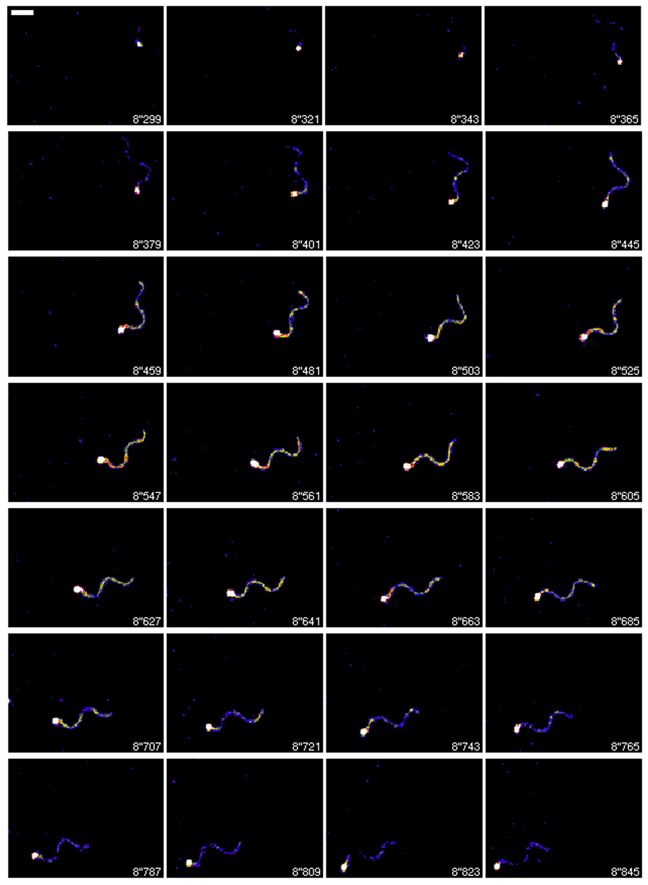
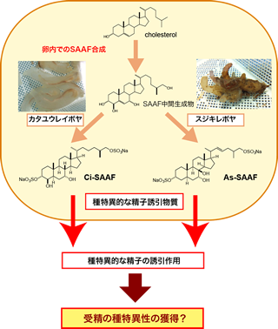
Chemo-attraction of sperm by egg
Acidian
(Ciona intestinalis)
http://www.mmbs.s.u-tokyo.ac.jp/research/Yoshida/yoshida_research.html
https://www.s.u-tokyo.ac.jp/ja/press/2008/25.html

Slide 7
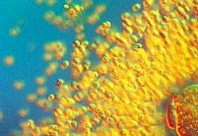
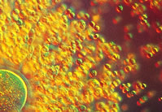
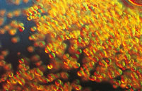
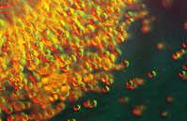
Matured mouse oocyte (at Metaphase of Meiotic division II)
Zona pellucida
Follicle cells
or
Cumulus cells
First polar body
Spindle

Slide 8
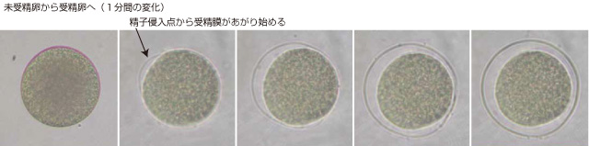
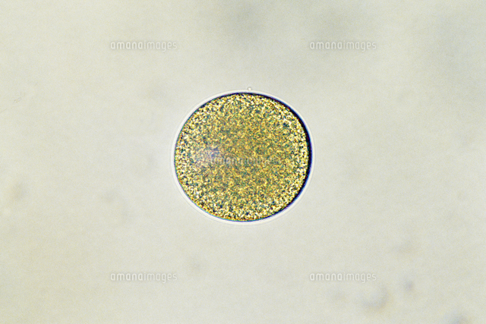
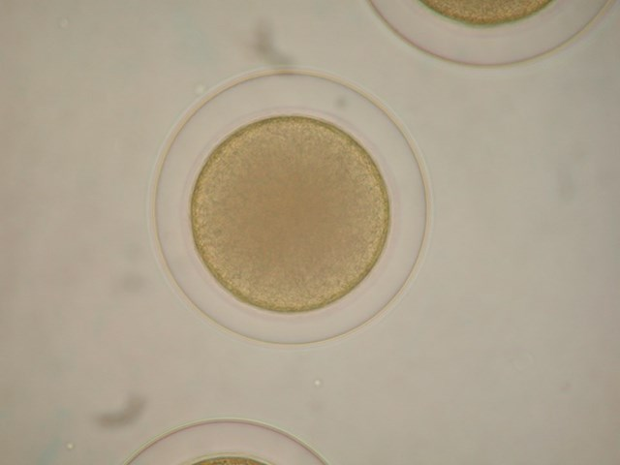
Fertilization in sea urchin
http://sec-kaiyo.cf.ocha.ac.jp/material.html
Unfertilized egg
Fertilized egg
Perivitelline space
Fertilization envelop
https://cdn.amanaimages.com/cen3tzG4fTr7Gtw1PoeRer/32105000781.jpg
http://www2s.biglobe.ne.jp/~nkazu/jugyou/image/uni_jusei/Resized800/s-DSCN0925.jpg

Slide 9
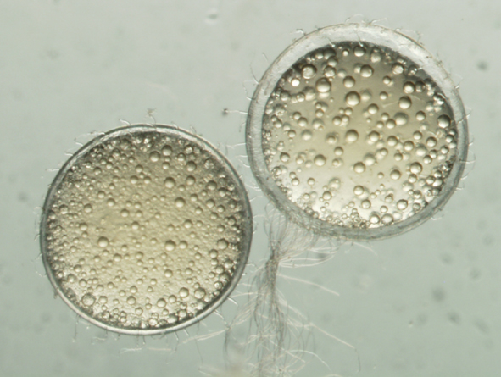
Eggs of medaka (fish)
Fertilized
Not-fertilized

Slide 10
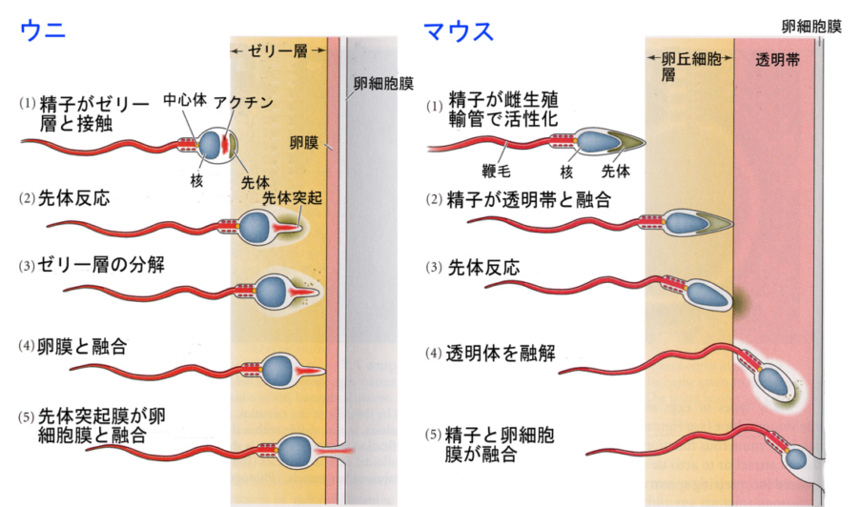
PM of egg
PM of egg
Sea urchin
Jelly layer
Mouse
Cumulus cells
ZP
Binding
Binding
Acrosome reaction
Digestion of JL
Acrosome reaction
Binding and Fusion
Digestion of ZP
Binding and Fusion
http://www.seibutsushi.net/blog/wp-content/uploads/%E7%B2%BE%E5%AD%90%E3%81%A8%E5%8D%B5%E5%AD%90%E3%81%AE%E7%B5%90%E5%90%88.jpg

Slide 11
Ca
2+
による卵活性化機構
ZP modification
Fertilization potential
Sperma
Egg
formation
CGBD
Fertilization
1PB
2PB
First cleavage
Ca
2+
Egg
Cortical
Granule
increase
PKC
CaM/CaMKⅡ
？
？
Egg maturation
Ca
2+
oscillations
1PB
2PB
CGBD
ubiquitin
？
Pronucleus
formation
/ proteosome
Non-fertilized eggs
Fertilized egg
1st PB
formation
1PB
Active MPF
MPF degeneration
1PB
2PB
Ovulation
cdc2
cdc2
cdc2
CSF
Cyclin B
CyclinB
サイ
クリ
ンＢ
2nd PB
formation
U
Ubiquitination
of cyckin B
U
U
1PB
U
1PB
U
Ｍ
Ⅱarrest
Release from Ｍ
Ⅱarrest

Slide 12
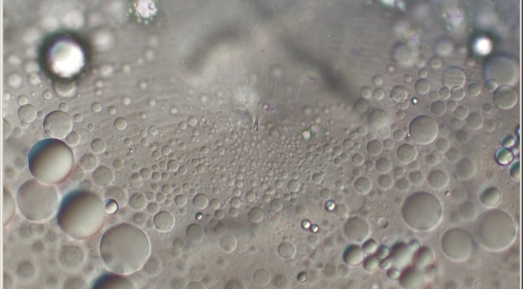
Cortical Granule Break Down
卵門 Micropyle

Slide 13
Calcium waves in egg of sea urchin
https://www.youtube.com/watch?v=MHWkltLbJp0
https://www.youtube.com/watch?v=BH06WgFua_4
Calcium wave in egg
of hamster at the time
of fertilization
(Miyazaki et al., 1993)

Slide 14
Calcium wave
Calcium oscillations
Calcium oscillations in mouse egg at the time of fertilization

Slide 15
Ca
2+
による卵活性化機構
ZP modification
Fertilization potential
Sperma
Egg
formation
CGBD
Fertilization
1PB
2PB
First cleavage
Ca
2+
Egg
Cortical
Granule
increase
PKC
CaM/CaMKⅡ
？
？
Egg maturation
Ca
2+
oscillations
1PB
2PB
CGBD
ubiquitin
？
Pronucleus
formation
/ proteosome
Non-fertilized eggs
Fertilized egg
1st PB
formation
1PB
Active MPF
MPF degeneration
1PB
2PB
Ovulation
cdc2
cdc2
cdc2
CSF
Cyclin B
CyclinB
サイ
クリ
ンＢ
2nd PB
formation
U
Ubiquitination
of cyckin B
U
U
1PB
U
1PB
U
Ｍ
Ⅱarrest
Release from Ｍ
Ⅱarrest

Slide 16
How sperm activate egg?
=
How sperm induce Ca²⁺ release in egg?
1. Sperm receptor
2. Sperm factor = Soluble Ca²⁺ releasing factor in sperm

Slide 17
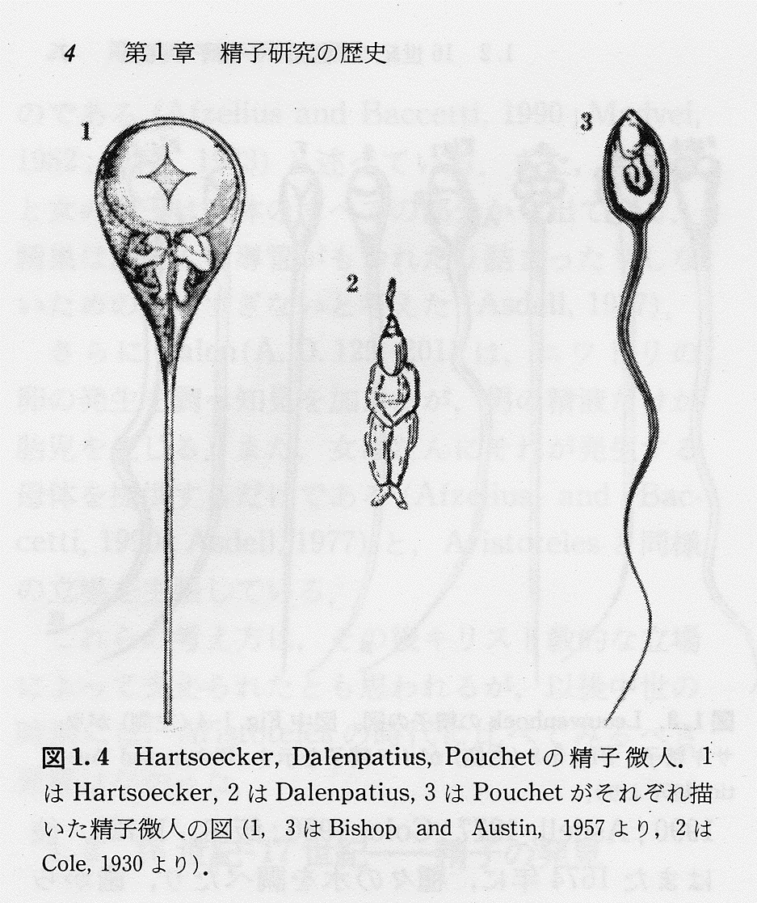
“Homunculus”
Fertilizer = 肥料
Formally (= Classically)
The subject of “Fertilize” is sperm (or Male).
A spermatozoon fertilizes an egg.

Slide 18
Sperm factor
Endoplasmic reticulum (ER)
IP3 receptor

Slide 19
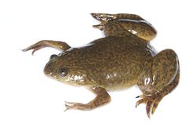
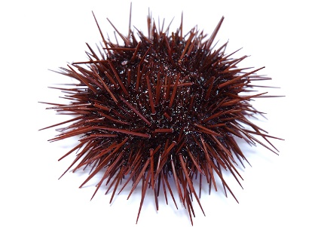
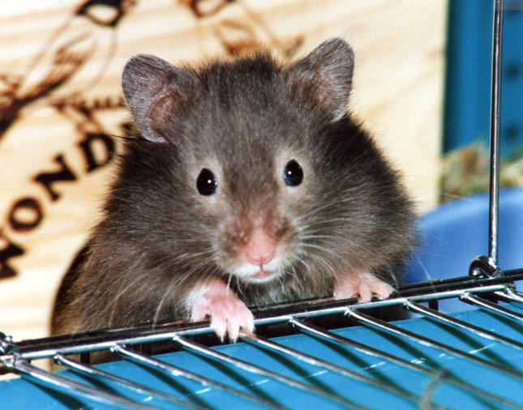
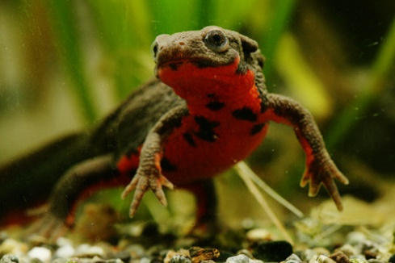
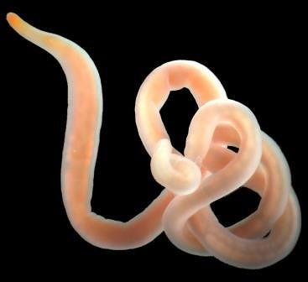
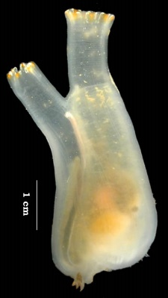
How sperm activate egg?
=
How sperm induce Ca²⁺ release in egg?
1. Sperm receptor
2. Sperm factor = Soluble Ca²⁺ releasing factor in sperm
Xenopus, sea urchin
Mammals, newt, ascidians, Nemertea , sea urchin

Slide 20
Evidences for “Sperm Factor” Theory in mammals
1.Calcium oscillations strikingly resemble to fertilization are induced by Intra-Cytoplasmic Sperm Injection (ICSI).
2. Calcium oscillations strikingly resemble to fertilization are induced
by injection of protein fraction extracted from sperm.
3. Calcium oscillations at the time of fertilization are disturbed
by suppression/disturvance of sperm-egg fusion.
(Cd9 KO mouse, Clostridium difficile Toxin B, Cytochalasin D)

Slide 21
Injection of sperm extract (SE)
Cibacron Blue
affinity chromatography
sperm
sonication
centrifugation
IRL
SE
labeled with Cy3.5
Argon laser 488 nm
CLSM
1/1000 egg volume
He-Ne laser 544 nm
Cy3.5
blight field image
diffusion of SE
Calcium Green
increase of [Ca²⁺]_{i}

Slide 22
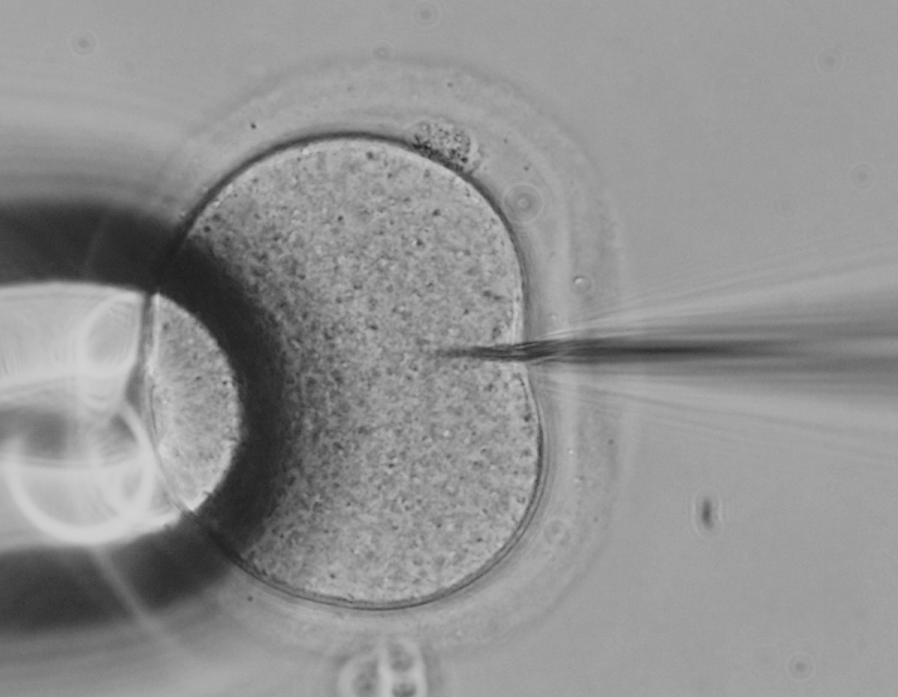
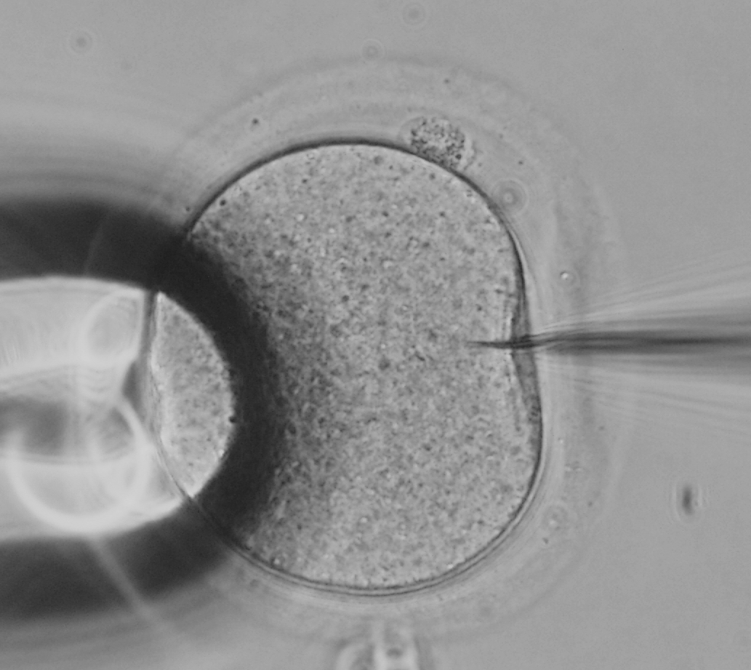
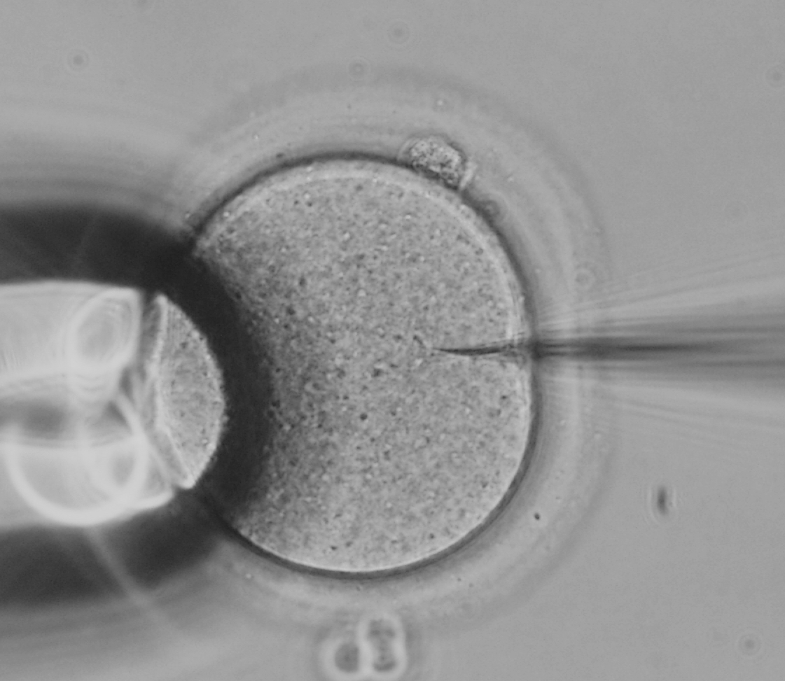

Slide 23
Ca ²⁺ oscillations induced by sperm extract injection into mouse egg
Ratio (FCGD/FTRD)
Time (min)

Slide 24
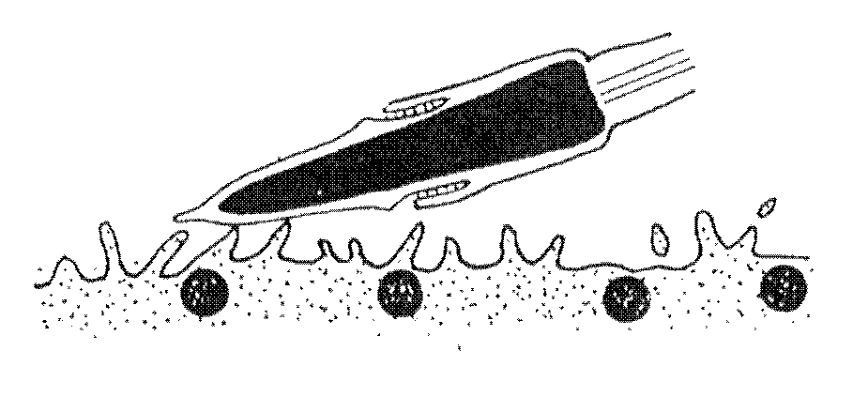
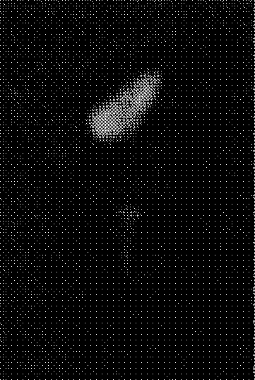
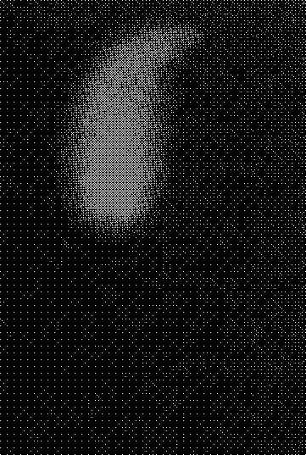
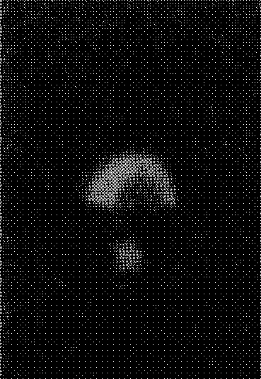
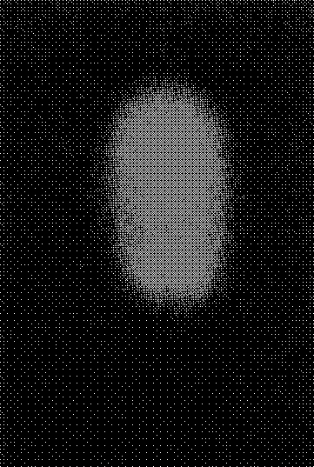
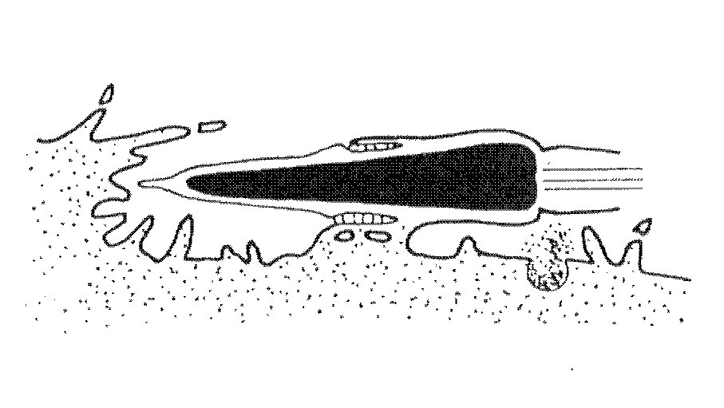
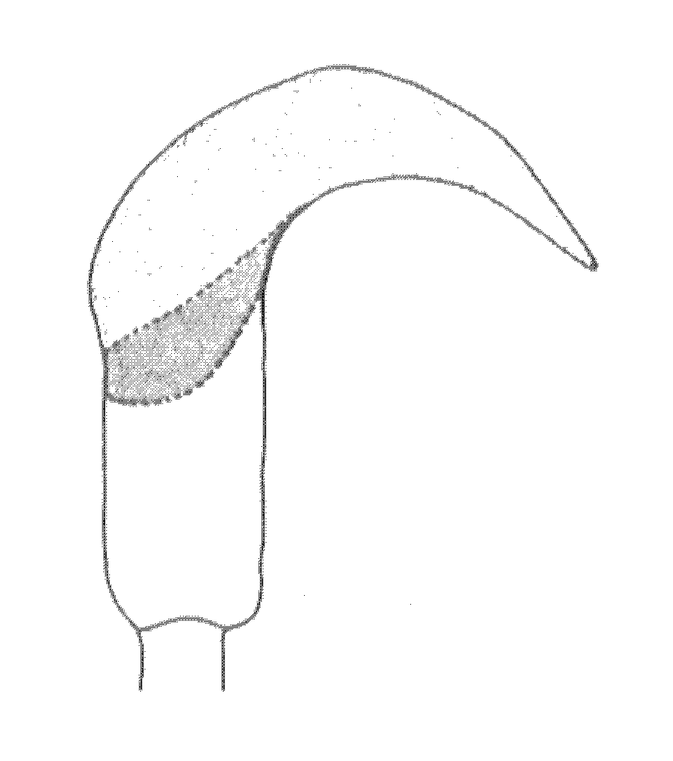
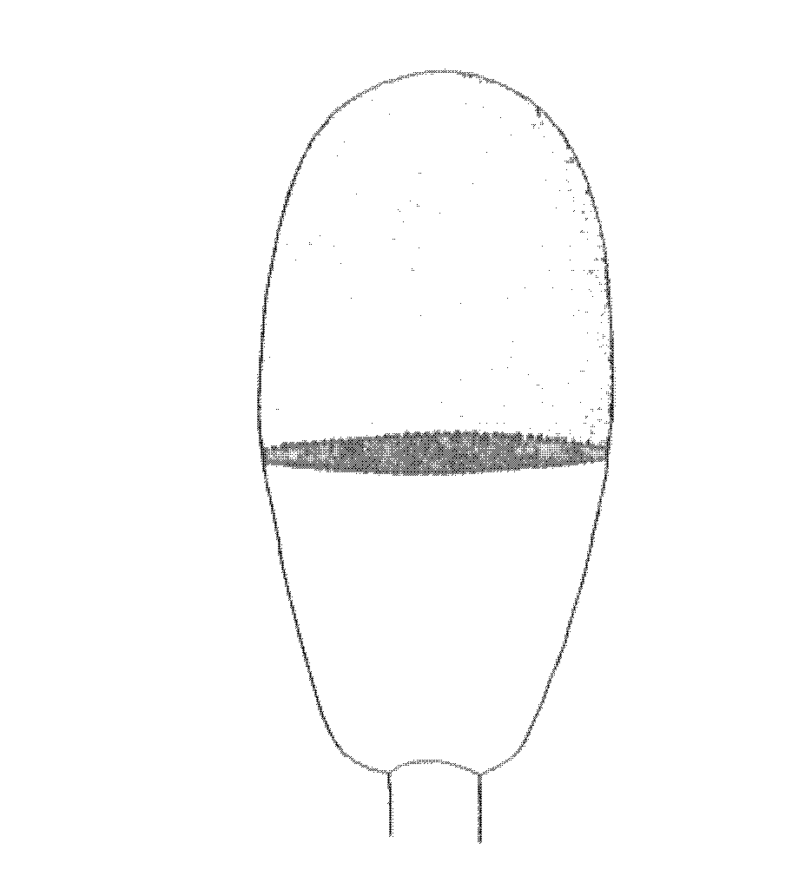
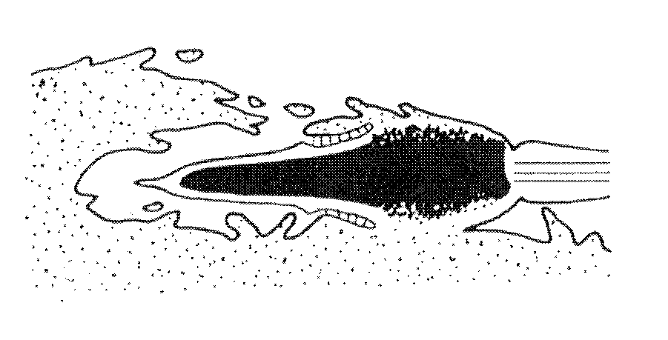
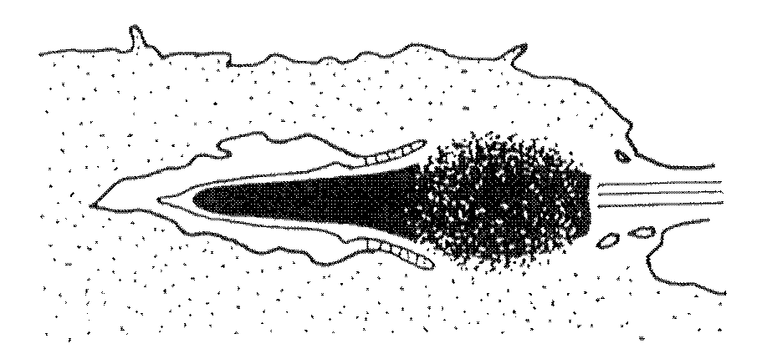
oscilline
1.
Oscillin
Sperm extract
中の活性を担う因子として
1996
年に報告された。
Glucosamine -6-phosphate deaminase
である。
哺乳類の精子では最初に精子
-
卵の融合が起る
equatorial segment
に局在する。
ES
IAM
CG
抗
33k
DAPI
抗
33k
DAPI
Equatorial
segment
Hamster sperm
Rabbit sperm
(Parrington et al., 1996)
(Yanagimachi and Noda, 1970)

Slide 25
Sperm
Nucleus
Plasma membrane
Egg

Slide 26
Injection of sperm extract (SE)
Cibacron Blue
affinity chromatography
sperm
sonication
centrifugation
IRL
SE
labeled with Cy3.5
Argon laser 488 nm
CLSM
1/1000 egg volume
He-Ne laser 544 nm
Cy3.5
blight field image
diffusion of SE
Calcium Green
increase of [Ca²⁺]_{i}

Slide 27
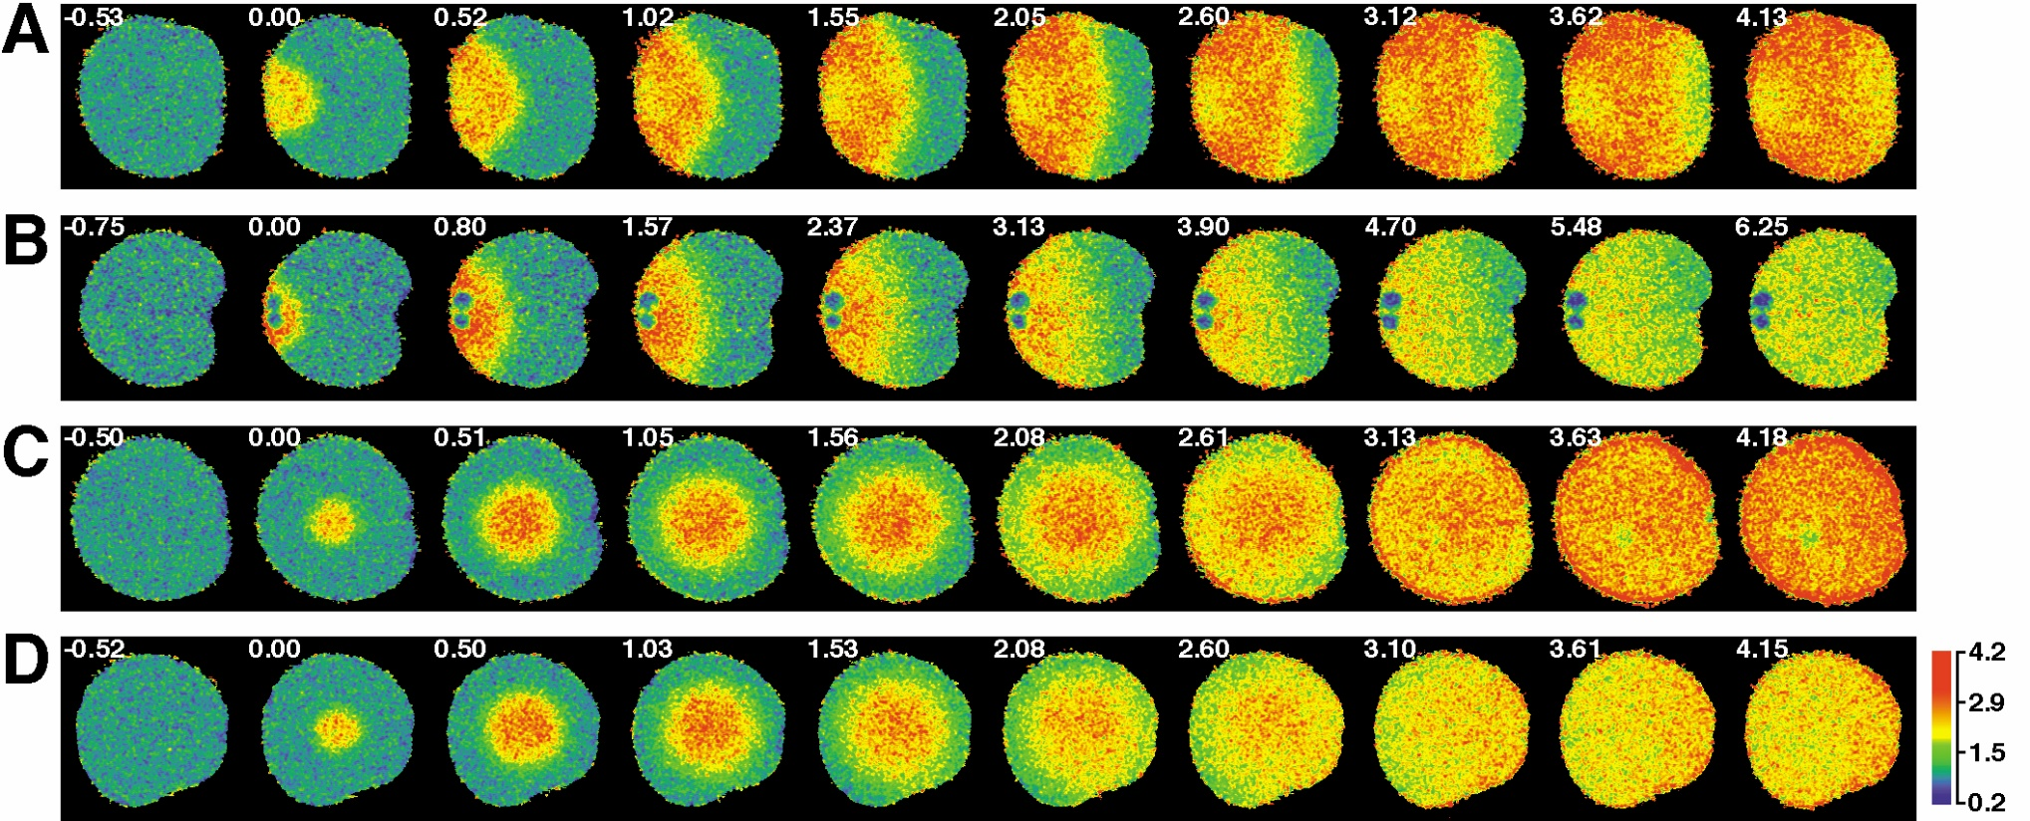
Calcium waves in hamster eggs induced
by Sperm-Extract injection

Slide 28
PLC isoforms
β1
1
β3
3
Specific in testis
β2
2
β4
4
ε
PLC β1, γ1, γ2, δ1, δ4
ε
γ1
γ
1
γ2
2
δ1
δ
1
δ3
3
δ2
2
δ4
4
ζ

Slide 29
Injection of PLCζ RNA
RNA concentration (in pipette)
1 ng/μl
5 ng/μl
10 ng/μl
50 ng/μl
Time after RNA injection (min)

Slide 31
PLCzeta-Venus
FLAG-PLCzeta
PLCzeta + IVF

Slide 32
Sperm factor
Endoplasmic reticulum
IP3 receptor

Slide 33
Fertilizer
“Homunculus” is not in a spermatozoon,
However, “egg activator” is in a spermatozoon.

Slide 34
Matured mouse oocyte (at Metaphase of Meiotic division II)
Zona pellucida
Follicle cells
or
Cumulus cells
First polar body
Spindle

Slide 35
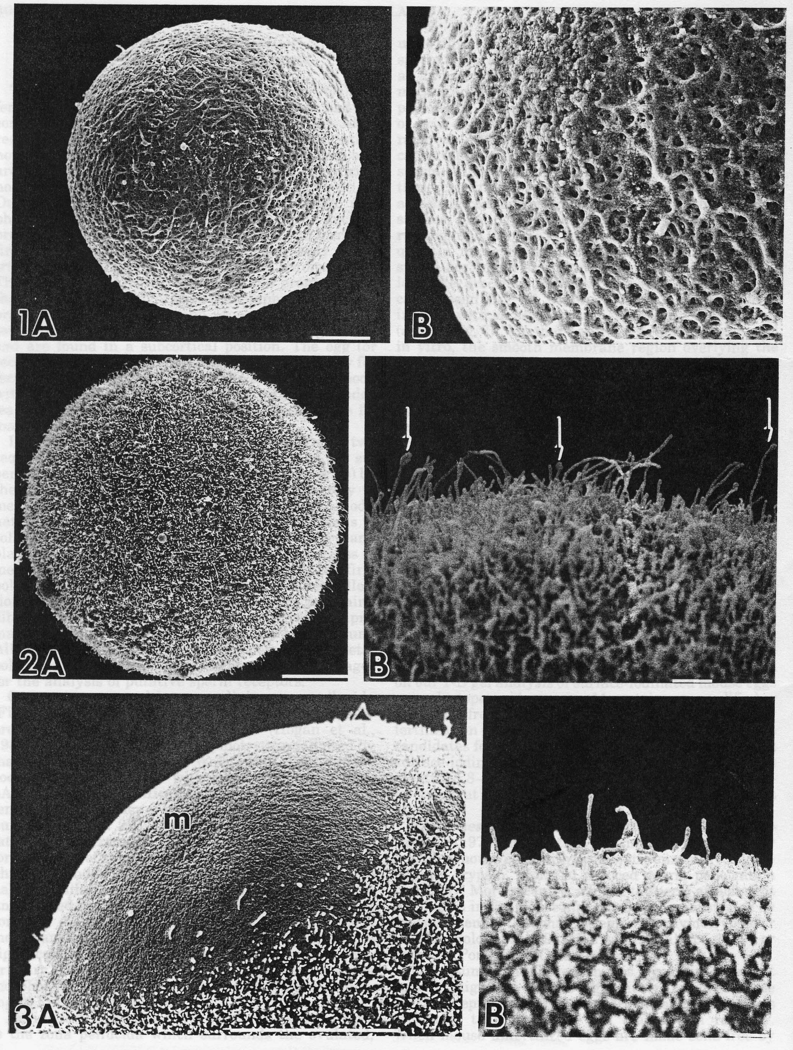

Slide 36
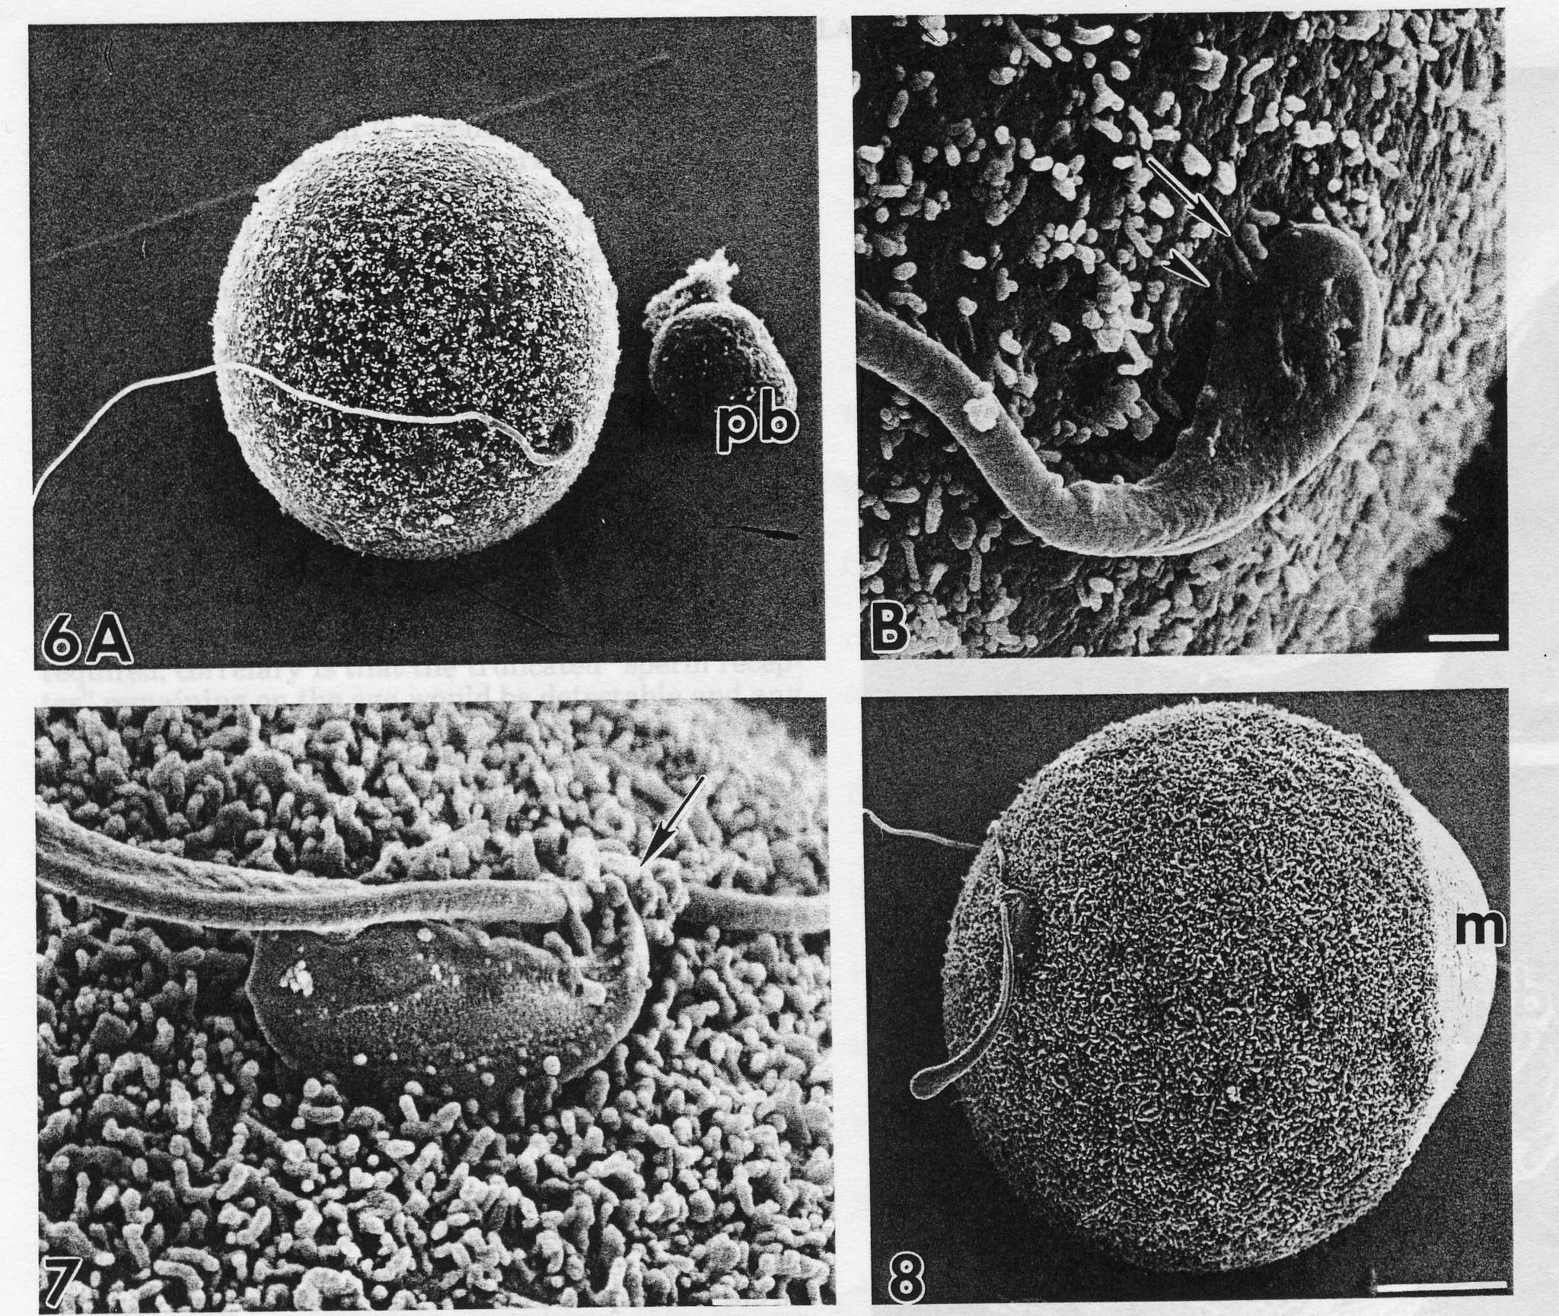

Slide 37
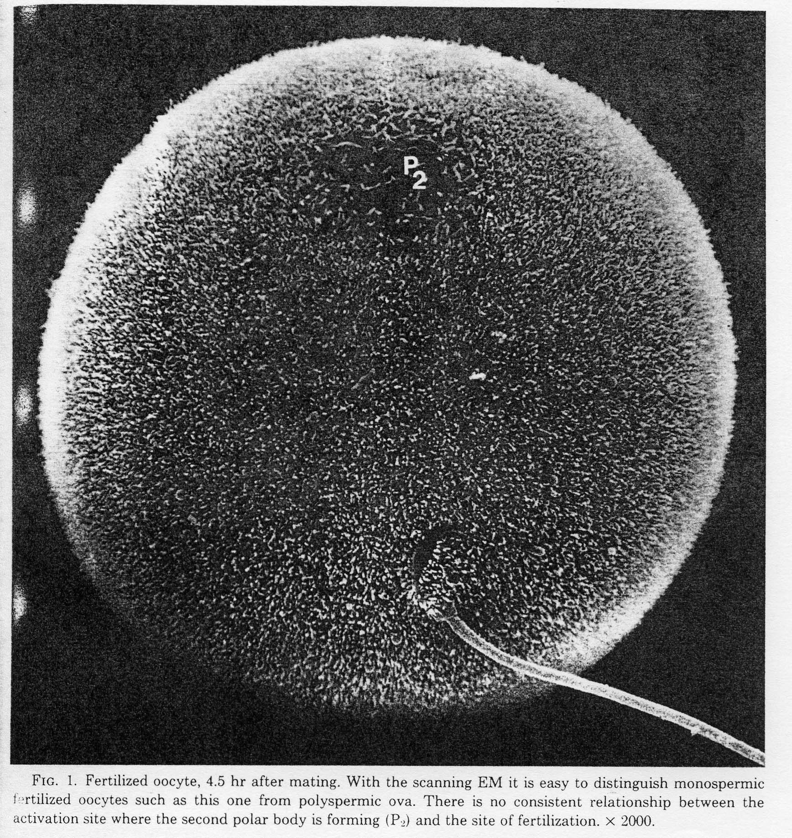

Slide 38
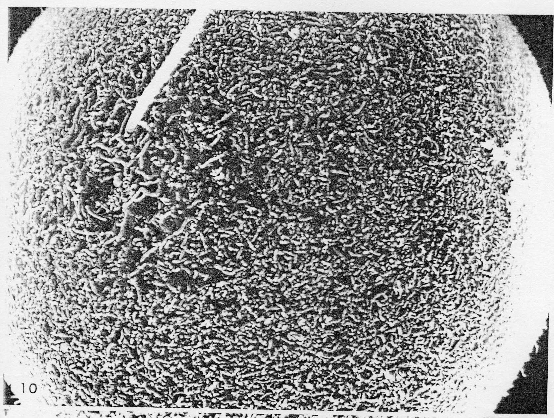

Slide 39
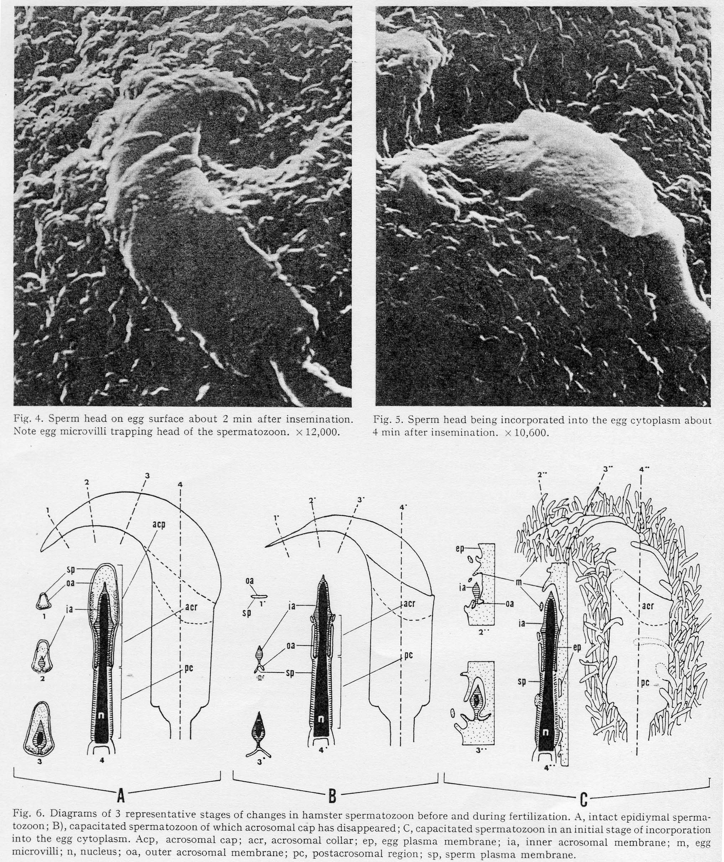

Slide 40
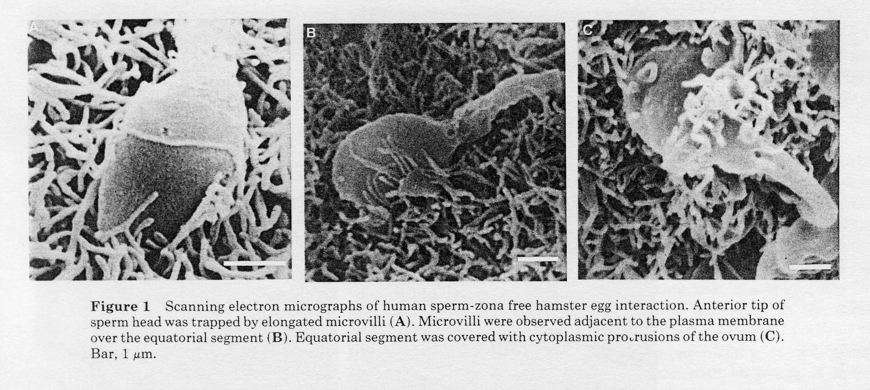

Slide 41
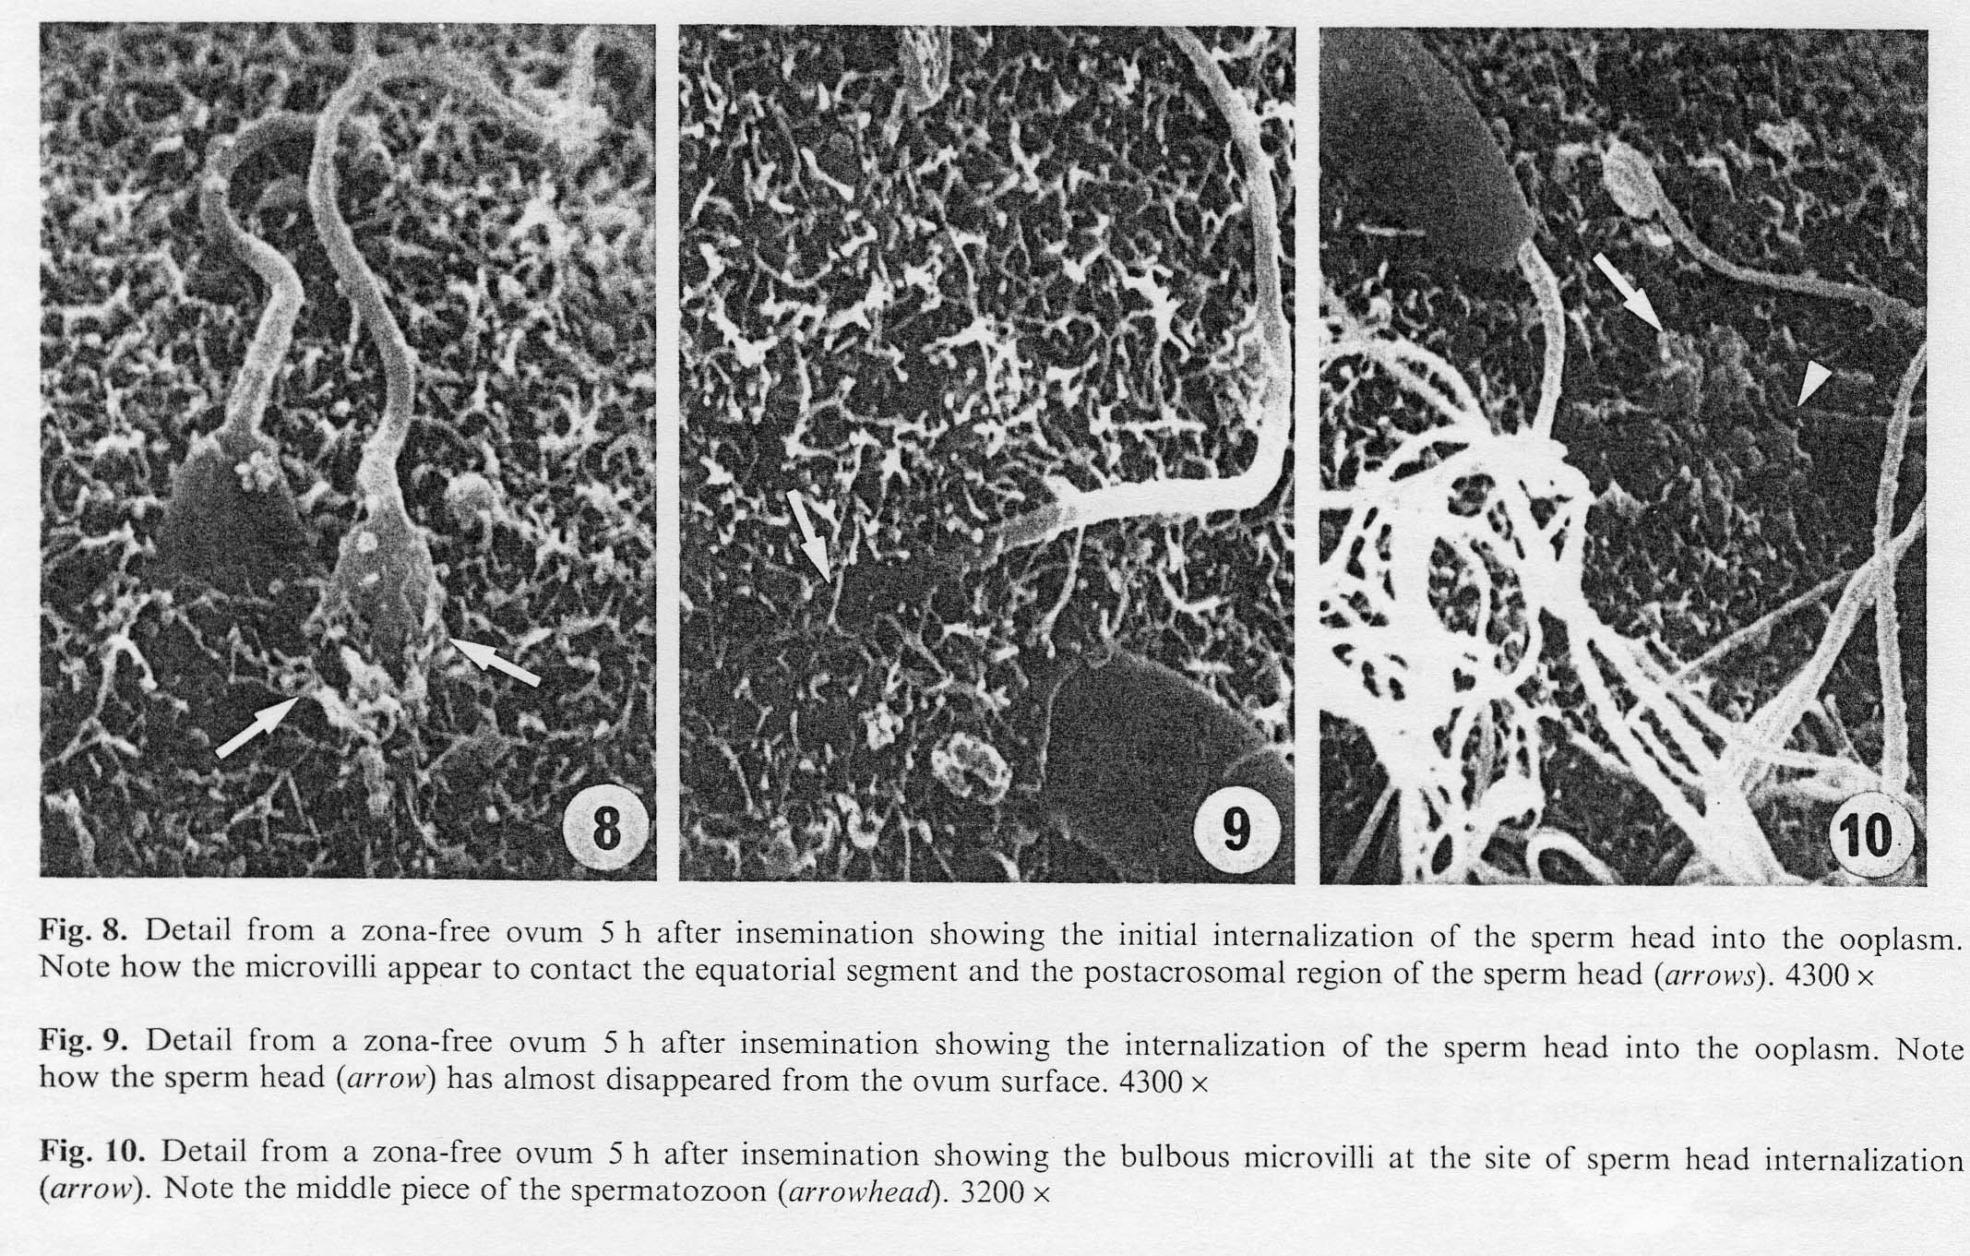

Slide 42
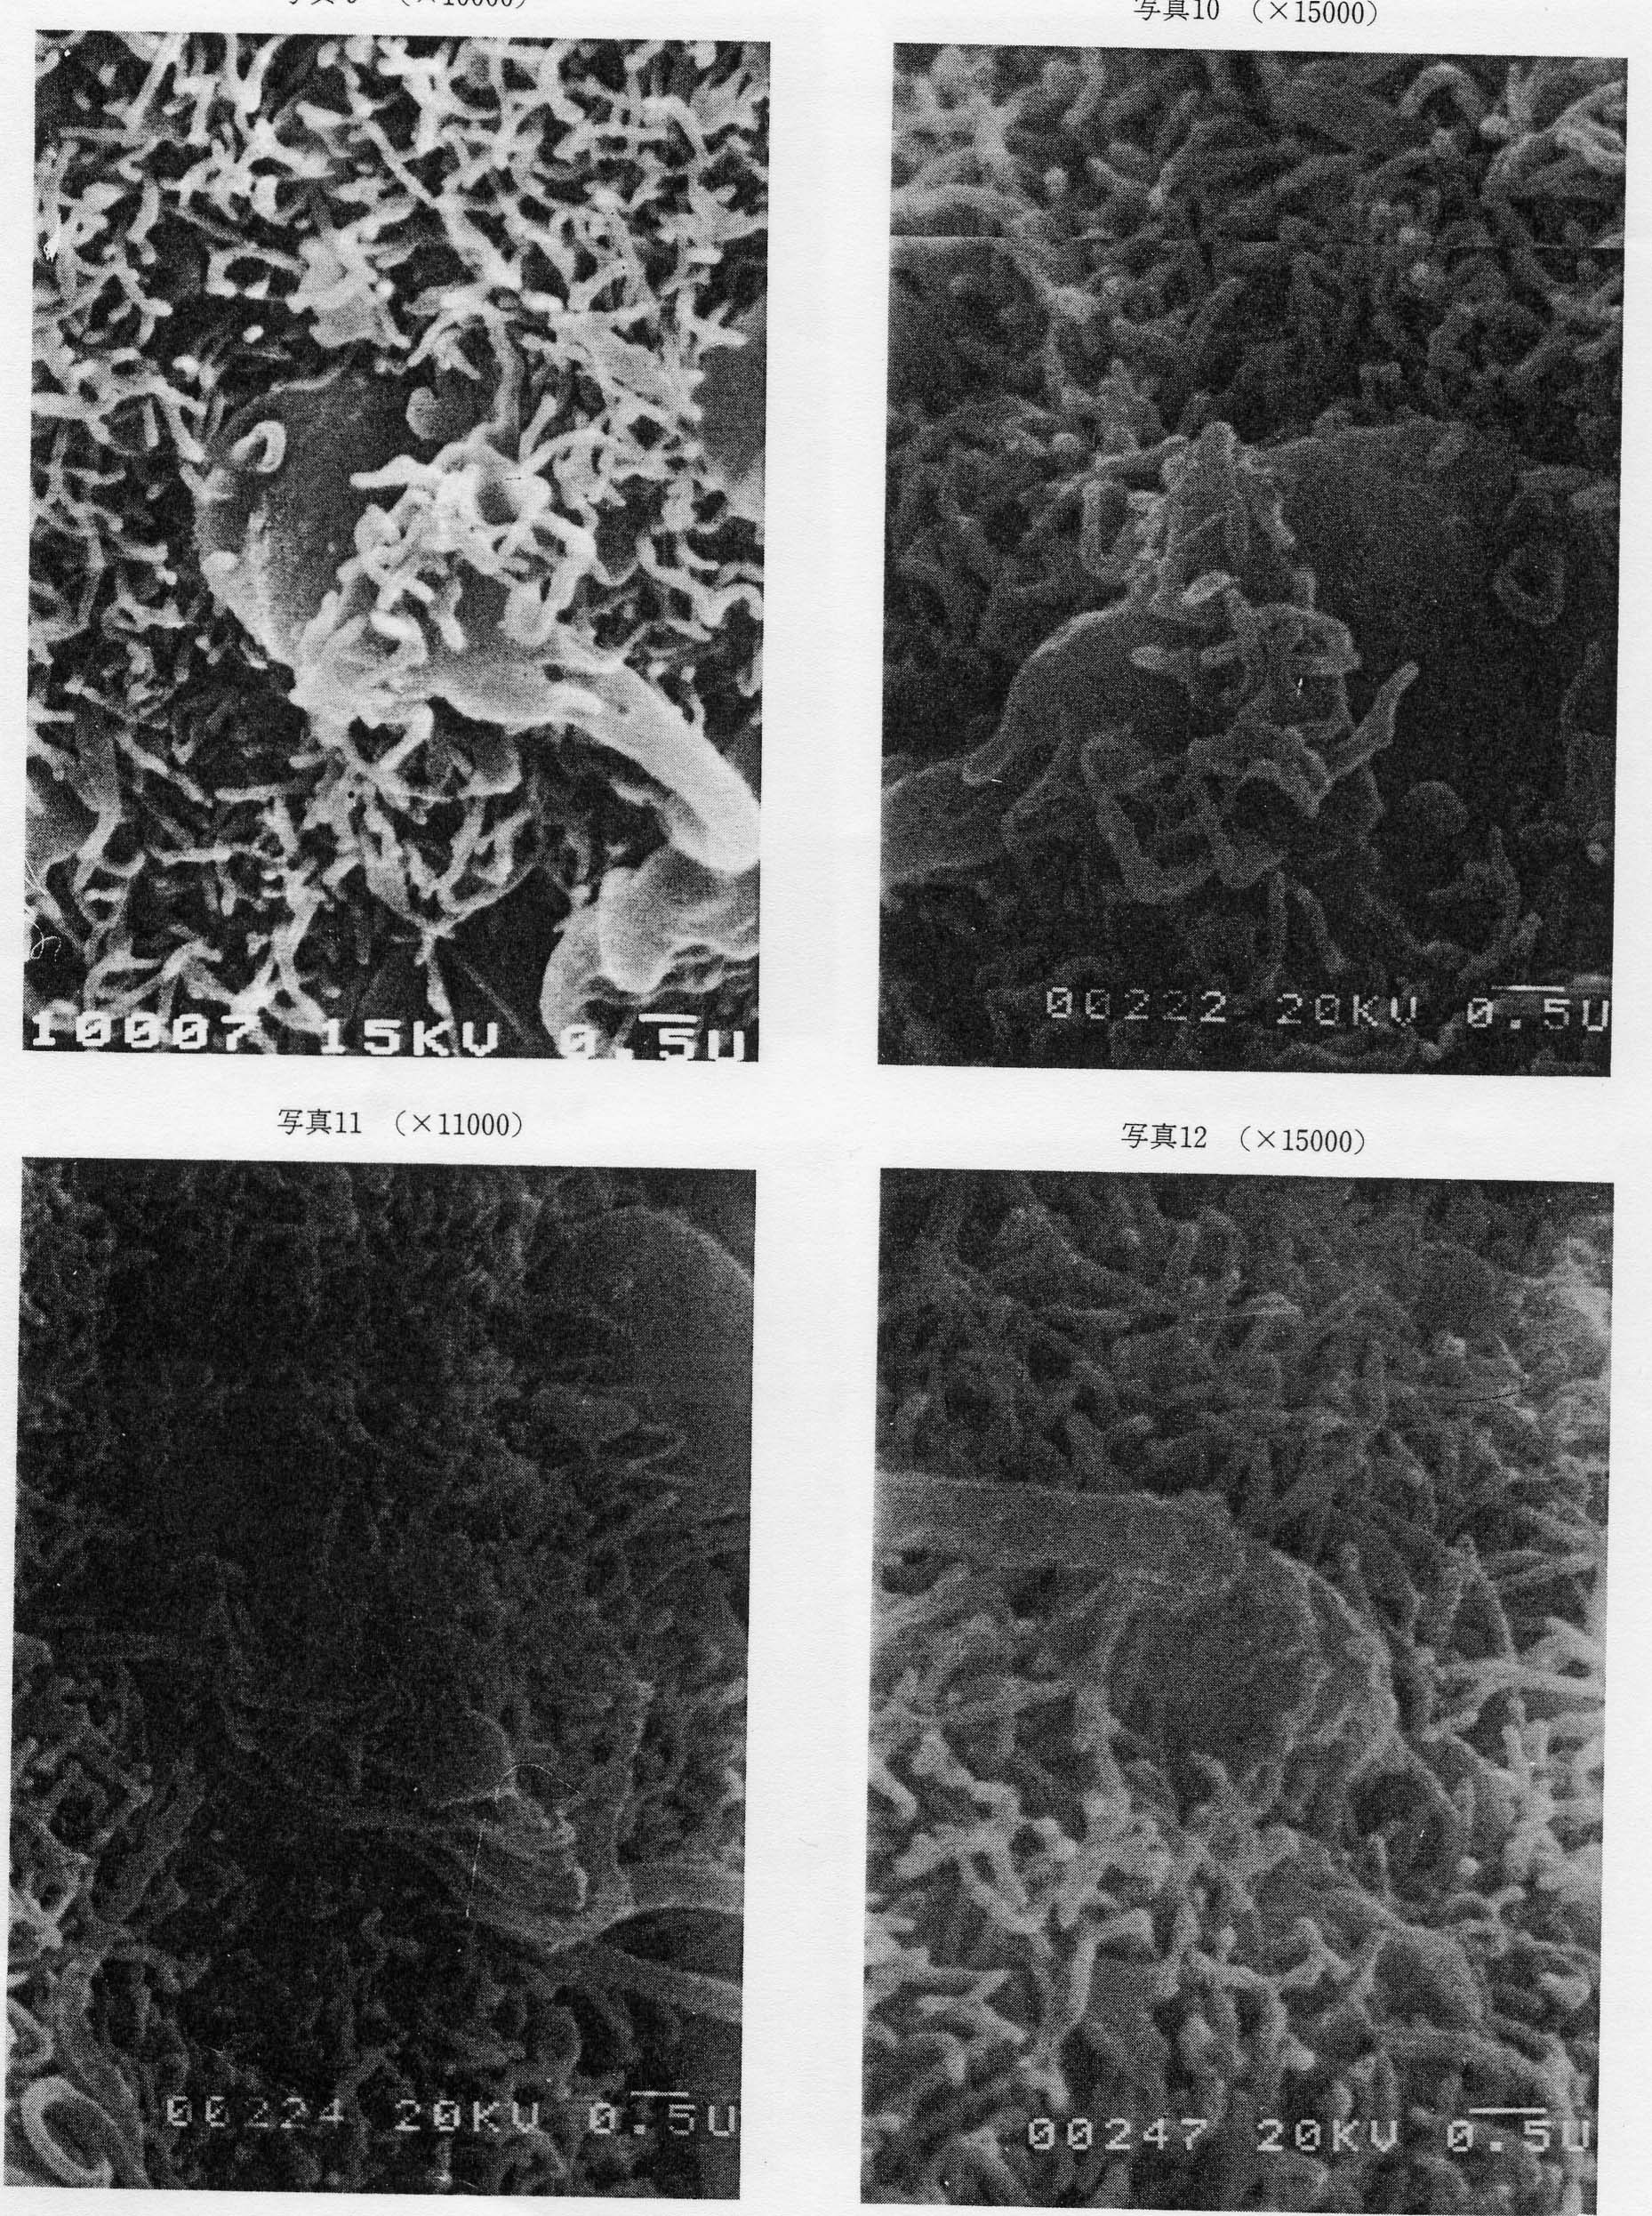

Slide 43
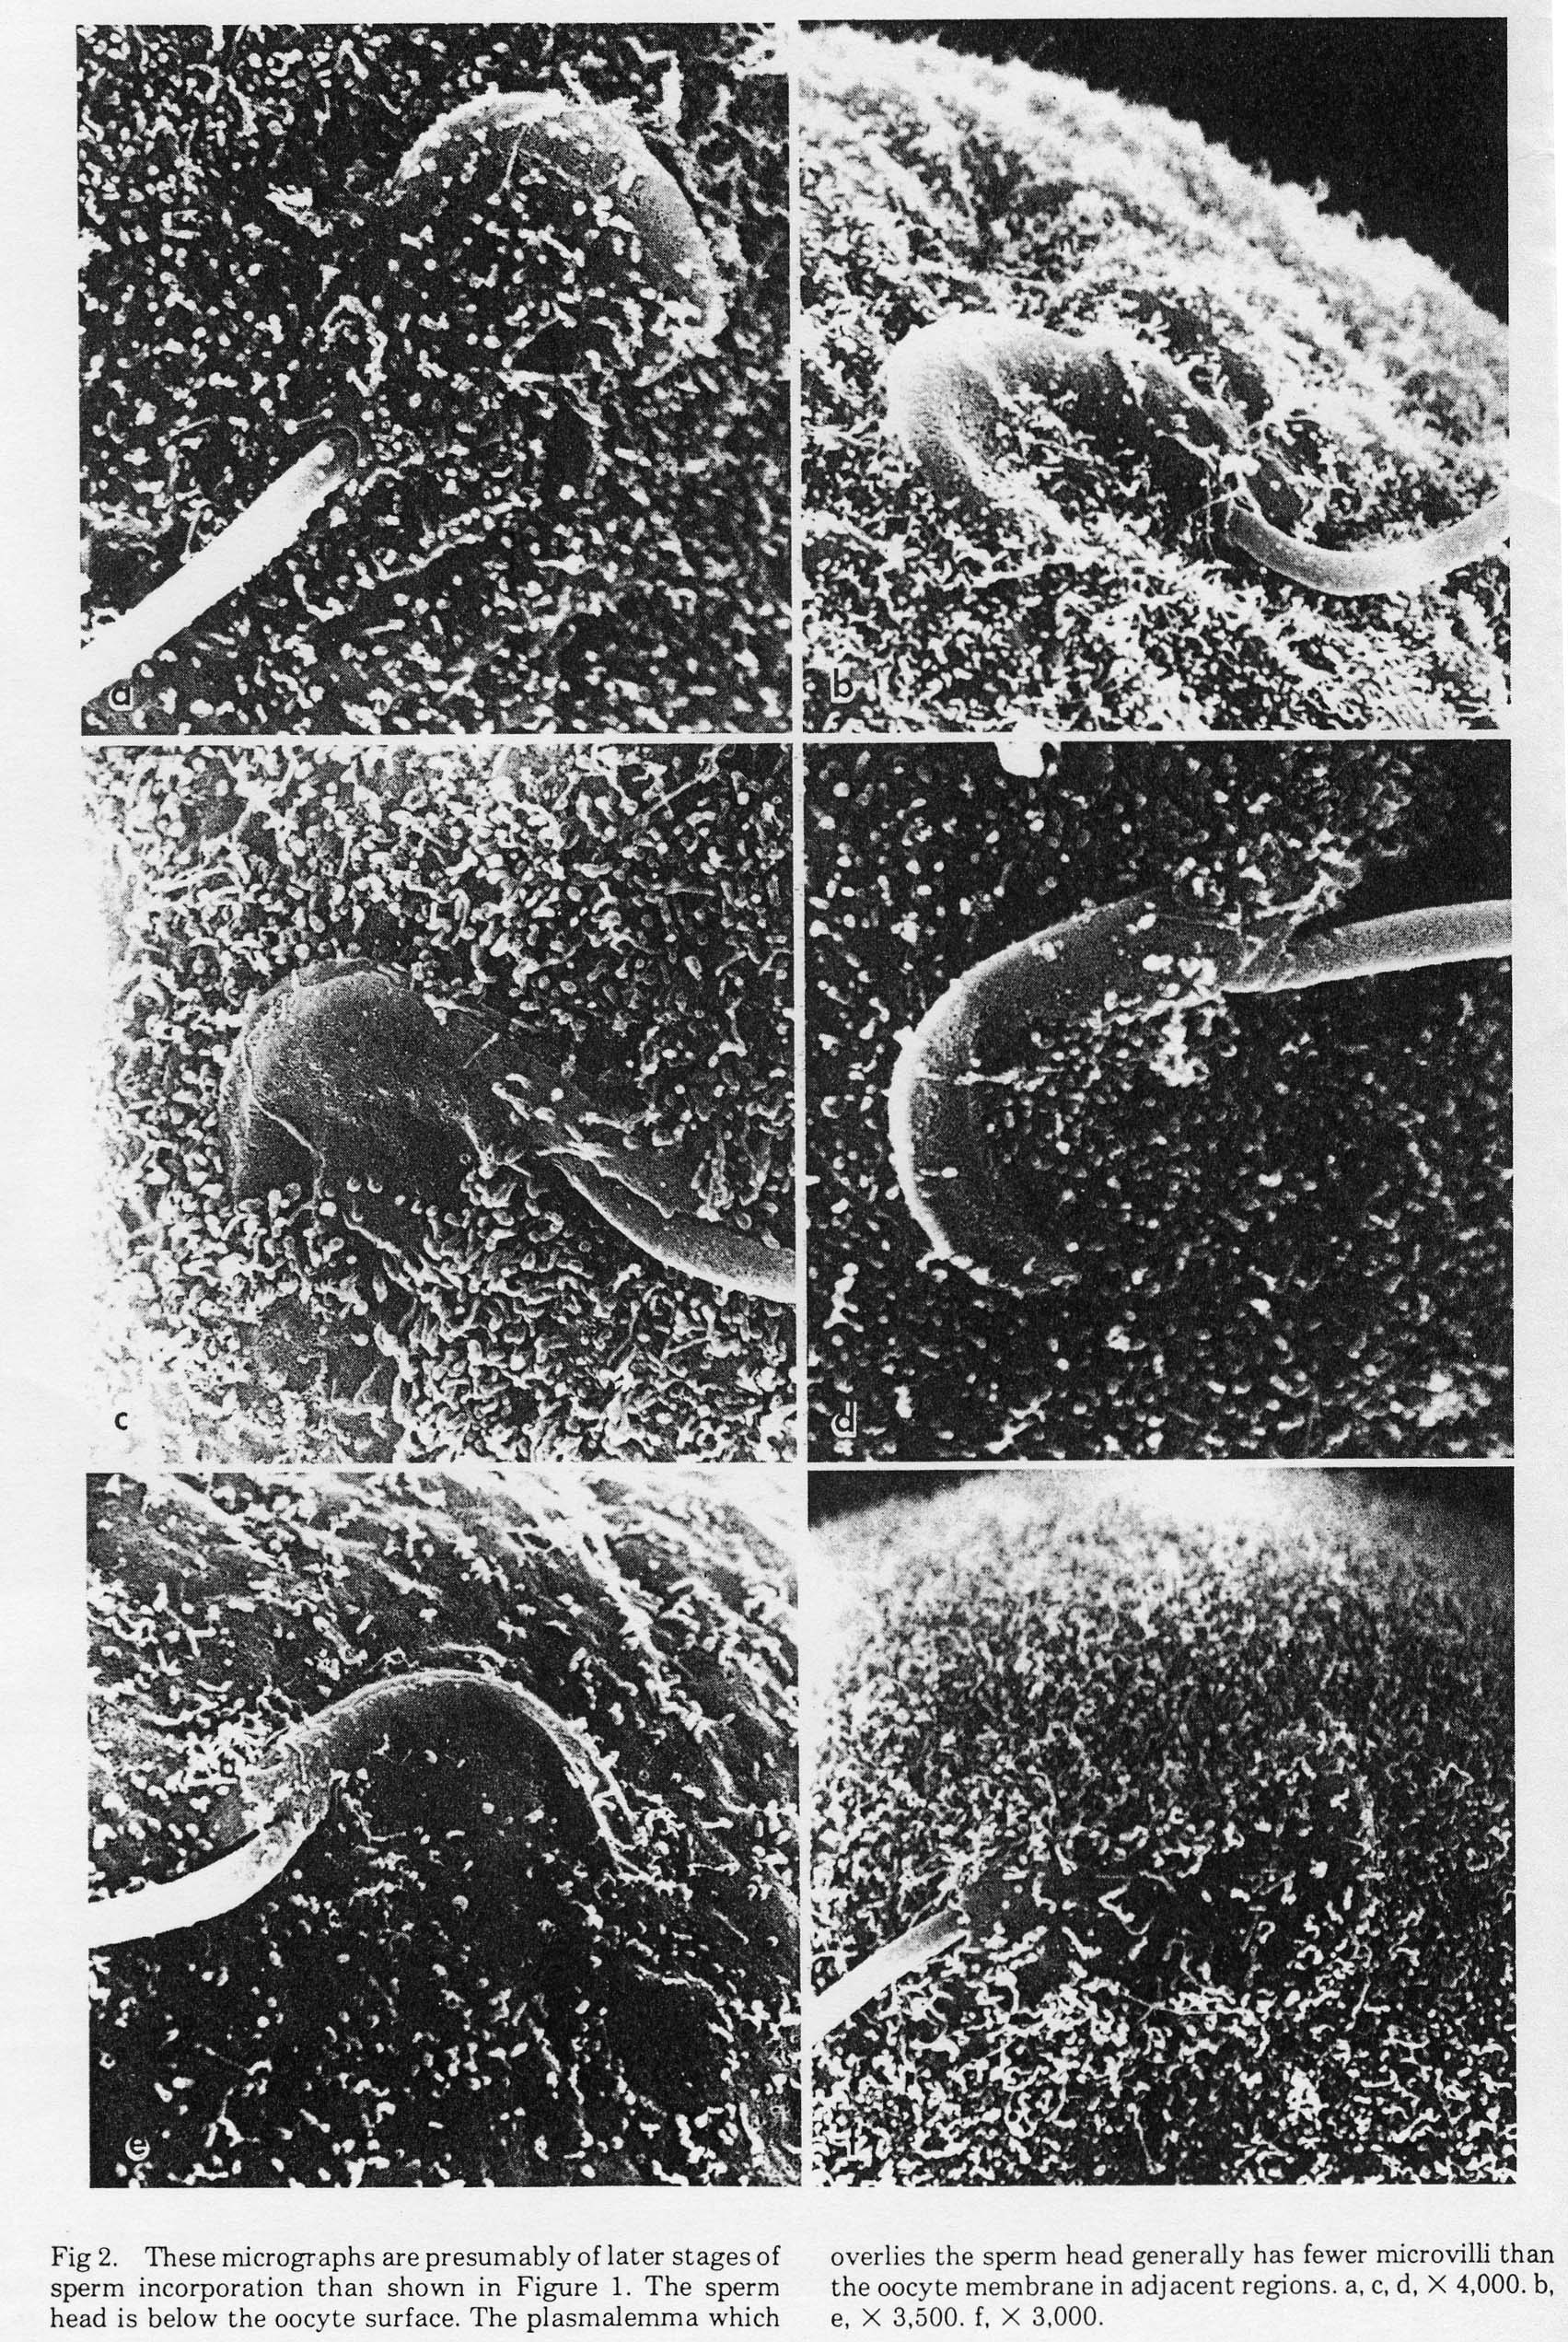

Slide 44
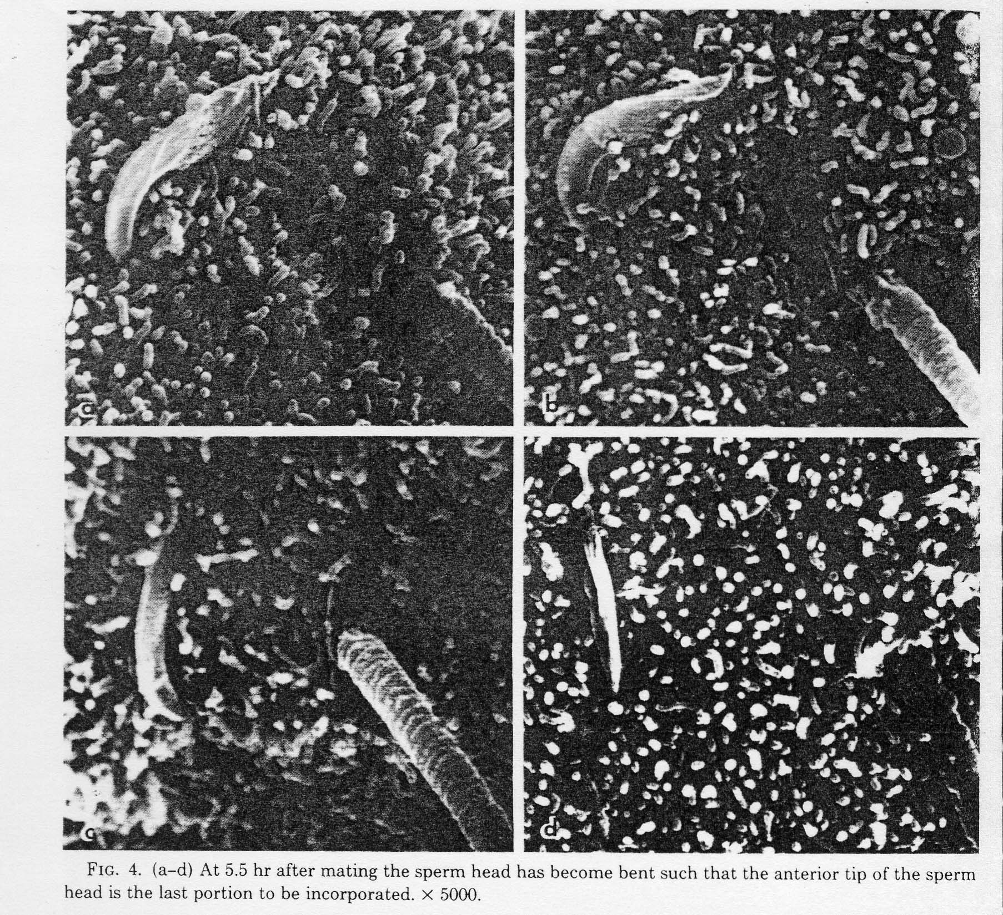

Slide 45
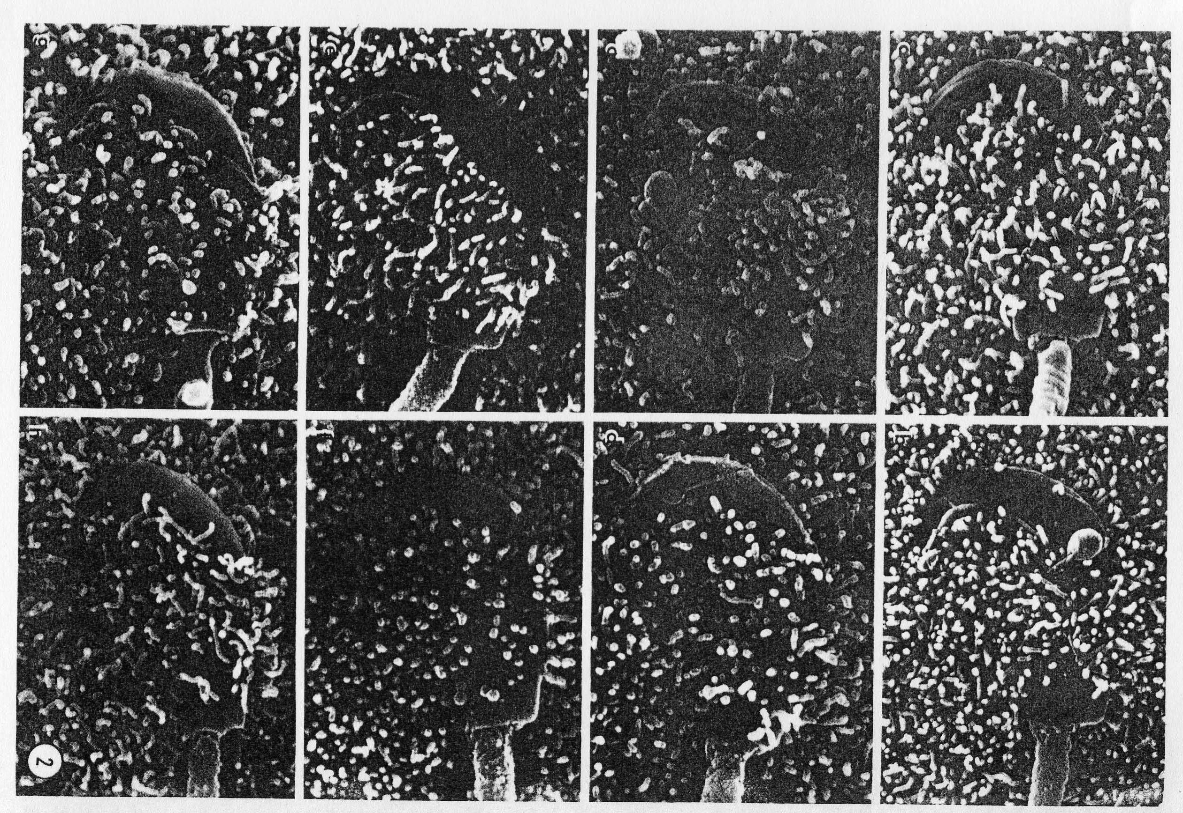

Slide 46
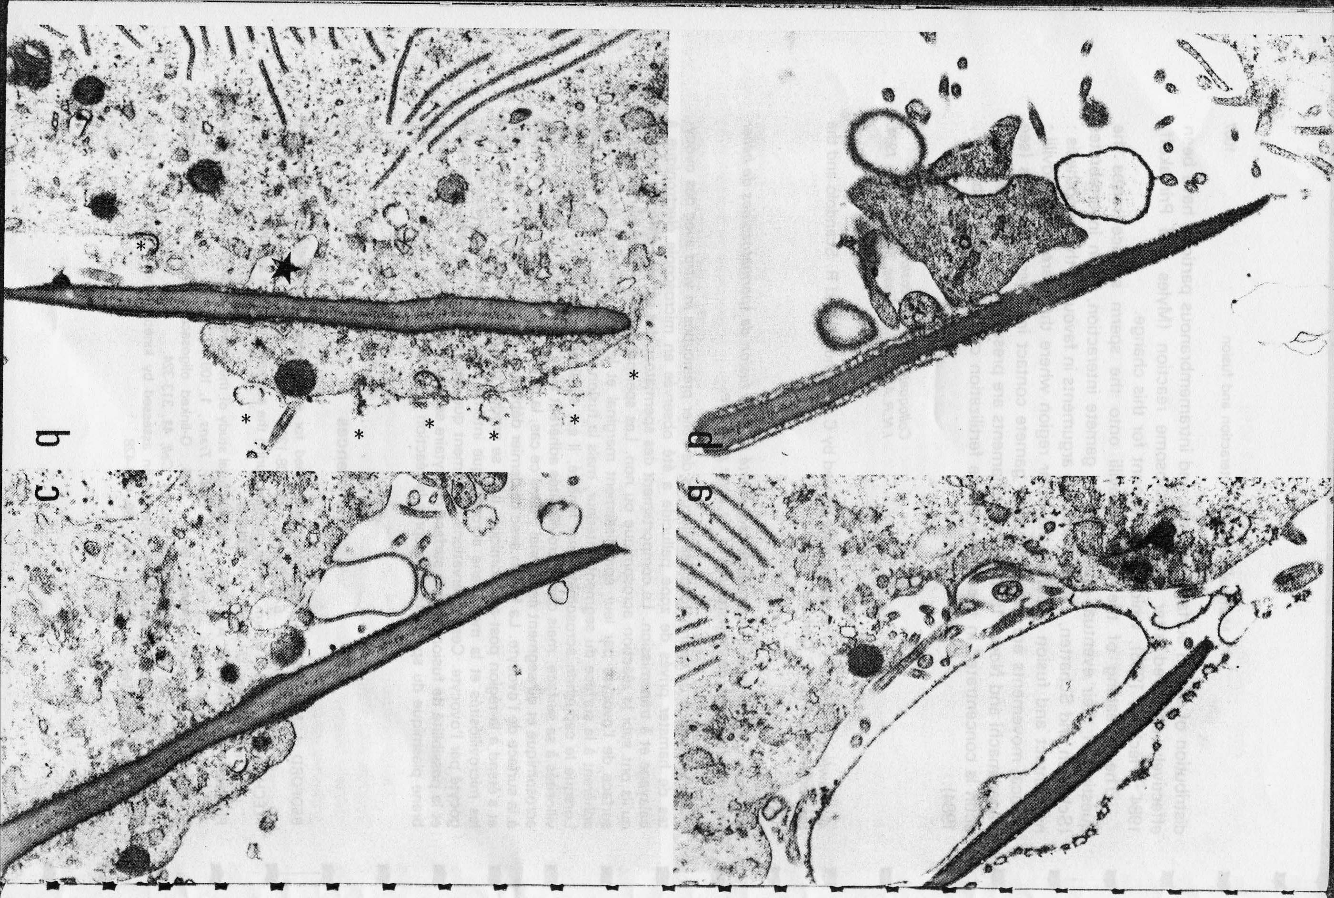

Slide 47
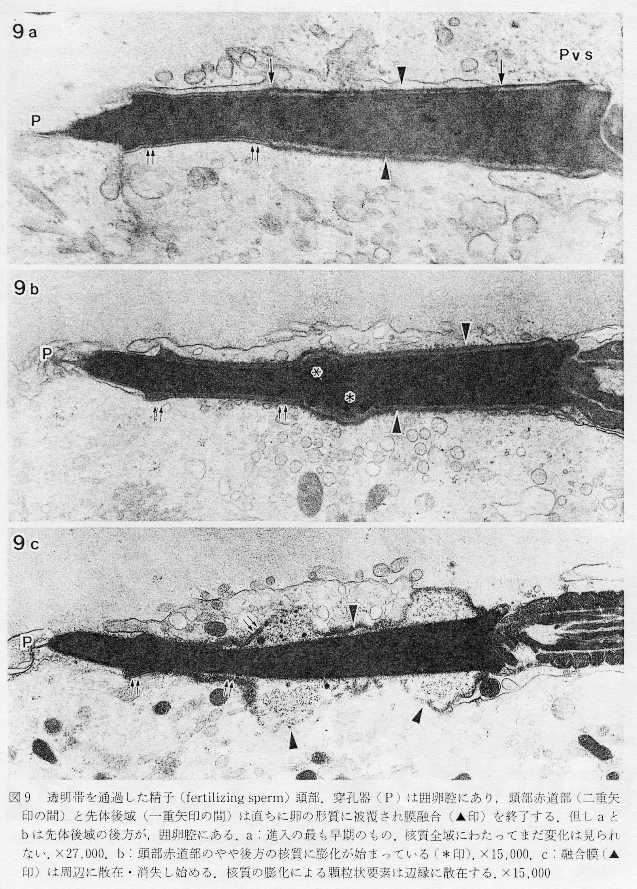

Slide 49
These findings very strongly suggest that
cytoplasmic skeleton in the egg surface
dynamically changes
at the time of fertilization

Slide 50
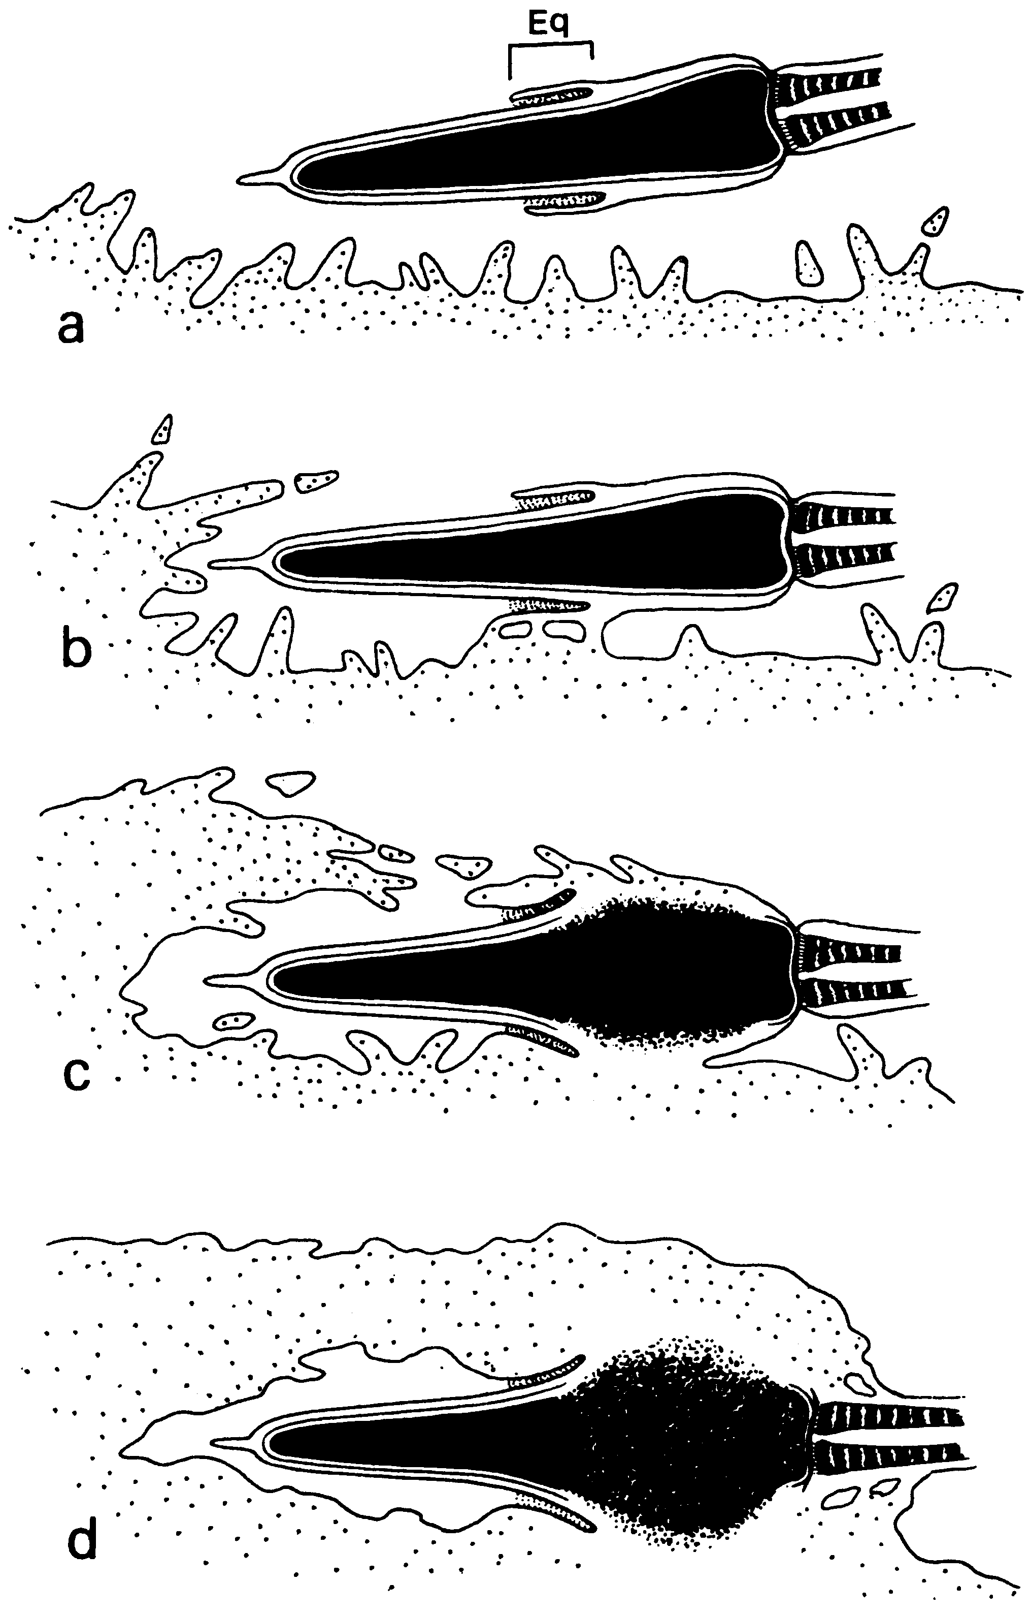
Sperm incorporation
Involvement of actin filament
Can be inhibition by cytochalasin
actin filaments
R. Yanagimachi, 1994

Slide 51

Cytochalasin From Wikipedia,
Cytochalasins are fungal metabolites that have the ability to bind to actin filaments and block polymerization and the elongation of actin. As a result of the inhibition of actin polymerization, cytochalasins can change cellular morphology, inhibit cellular processes such as cell division, and even cause cells to undergo apoptosis.[1] Cytochalasins have the ability to permeate cell membranes, prevent cellular translocation and cause cells to enucleate.[2] Cytochalasins can also have an effect on other aspects of biological processes unrelated to actin polymerization. For example, cytochalasin A and cytochalasin B can also inhibit the transport of monosaccharides across the cell membrane,[2] cytochalasin H has been found to regulate plant growth,[3] cytochalasin D inhibits protein synthesis[4] and cytochalasin E prevents angiogenesis.[5]

Slide 52
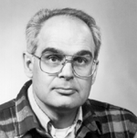
A report by Professor F.J. Longo (1978)
“Effects of cytochalasin B on sperm-egg interactions”
https://doi.org/10.1016/0012-1606(78)90197-5
Cytochalasin B was not effective in mouse fertilization.
So,
actin filaments may have little significance in mouse fertilization !?

Slide 53
Sperm incorporation
Involvement of Rho family small G proteins ?
Inhibition by Clostridium difficle toxin B
Involvement of actin filament ?
actin filaments ?
Inhibition by cytochalasin
R. Yanagimachi, 1994

Slide 54
Clostridium difficile toxin B is a bacterial protein toxin (about 250 kDa) which monoglucosylates and inhibits Rho family proteins using UDP-glucose as cosubstrate. Targets are all Rho family proteins (Rho, Rac, and Cdc42).
Clostridium boturinum C3 exoenzyme is a bacterial protein toxin (about 25 kDa) which monoglucosylates and inhibits RhoA, B, and C but not other GTPases of Rho family like Rac and Cdc42.

Slide 55
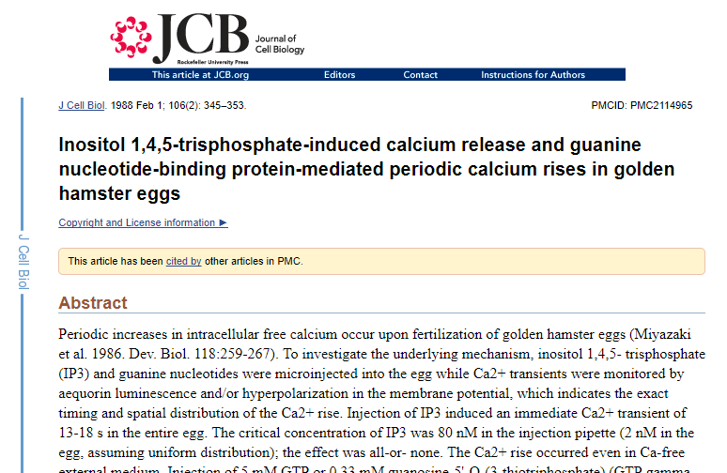
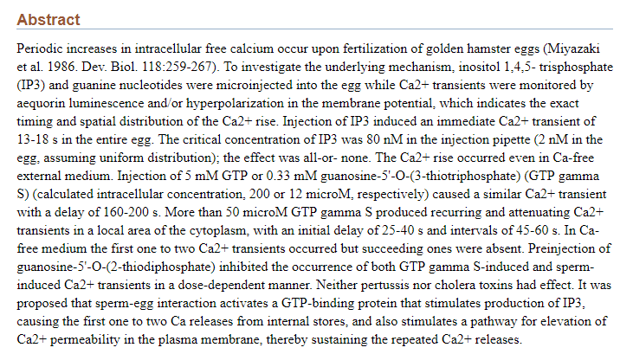
Miyazaki S. et al. , J.Cell Biol., 106, 345-353 (1988)

Slide 56

GTPγS induced calcium oscillations in hamster egg
Miyazaki S. et al. , J.Cell Biol., 106, 345-353 (1988)

Slide 57

GDPβS inhibited calcium oscillations in fertilized hamster egg
Miyazaki S. et al. , J.Cell Biol., 106, 345-353 (1988)

Slide 58

Miyazaki S. et al. , J.Cell Biol., 106, 345-353 (1988)
GTPγS induced calcium oscillations in hamster egg
GTPγS might activate G-protein coupled with “Sperm Receptor” and activated PLCβ induces calcium oscillations in an artificial way.
GDPβS inhibited calcium oscillations in fertilized hamster egg
GDPβS might inhibit G-protein coupled with “Sperm Receptor” at the time of fertilization.

Slide 59
Sperm factor
Endoplasmic reticulum (ER)
IP3 receptor

Slide 60
In “Sperm Receptor” story,
GTPγS induced calcium oscillations in hamster egg
GTPγS might activate G-protein coupled with “Sperm Receptor” and activated PLCβ induces calcium oscillations in an artificial way.
GDPβS inhibited calcium oscillations in fertilized hamster egg
GDPβS might inhibit G-protein coupled with “Sperm Receptor” at the time of fertilization.
Miyazaki S., J.Cell Biol., 106, 345-353 (1988)

Slide 61
In “Sperm Factor” story,
In “Sperm Receptor” story,
GTPγS induced calcium oscillations in hamster egg
GTPγS might activate G-protein coupled with “Sperm Receptor” and activated PLCβ induces calcium oscillations in an artificial way.
GTPγS might activate G-protein coupled with PLCβ and induce calcium oscillations in a non-specific way.
GDPβS inhibited calcium oscillations in fertilized hamster egg
GDPβS might inhibit G-protein coupled with “Sperm Receptor” at the time of fertilization.
? ? ? ? ? ? ? ? ?
Miyazaki S., J.Cell Biol., 106, 345-353 (1988)
The Professor (Dr. Shun-ichi Miyazaki) finally confessed that,
“At that time, We had not confirmed sperm-egg fusion exactly, just observed the cessation of flagellar movement of sperm and guessed that sperm fused with egg.”
GDPβS might suppressed sperm-egg fusion in hamster fertilization ! ?

Slide 62
Clostridium difficile toxin B is a bacterial protein toxin (about 250 kDa) which monoglucosylates and inhibits Rho family proteins using UDP-glucose as cosubstrate. Targets are all Rho family proteins (Rho, Rac, and Cdc42).
Clostridium boturinum C3 exoenzyme is a bacterial protein toxin (about 25 kDa) which monoglucosylates and inhibits RhoA, B, and C but not other GTPases of Rho family like Rac and Cdc42.

Slide 63

Ｃ
Detection of sperm fused to egg
Ｃ
H33343, H33258
PI, DAPI

Slide 64
Mouse fertilized eggs injected with PI
Fused sperm
Egg chromosomes
egg
♂
♀
♀
♂
♂
Fused sperm
Incorporated sperm

Slide 65
Clostridium difficile toxin B is a bacterial protein toxin (about 250 kDa) which monoglucosylates and inhibits Rho family proteins using UDP-glucose as cosubstrate. Targets are all Rho family proteins (Rho, Rac, and Cdc42).
Clostridium boturinum C3 exoenzyme is a bacterial protein toxin (about 25 kDa) which monoglucosylates and inhibits RhoA, B, and C but not other GTPases of Rho family like Rac and Cdc42.

Slide 67
Sperm factor
X
Endoplasmic reticulum (ER)

Slide 68
Effects of Toxin B on Sperm-Egg Interaction
Eggs with Ca response but without fused sperm !!!
Counterevidence against Sperm factor story！？
Percentage of egg (%)
Number of sperm (sperm/egg)
Egg with Ca response
Egg with fused sperm
Egg with fused sperm
Egg with decondenced sperm
Egg with decondenced sperm

Slide 69
Sperm factor
Endoplasmic reticulum (ER)
IP3 receptor

Slide 70
Ca²⁺ Responses at Fertilization in Eggs
Injected with 40 μg/ml Toxin B

Slide 71
Sperm-Egg Interaction and the Type of
Ca
2
+
Response in Eggs Injected with Toxin B
A
B
3
1
0
0
(
9
5
)
(
2
3
)
(
3
0
)
(
2
6
)
7
5
2
5
0
1
2
5
0
0
C
o
n
t
r
o
l
T
y
p
e
A
T
y
p
e
B
T
y
p
e
C
C
o
n
t
r
o
l
T
y
p
e
A
T
y
p
e
B
T
y
p
e
C
T
o
x
i
n
B
T
o
x
i
n
B

Slide 72
Loss of Sperm-Egg Cytoplasmic Continuity in the Toxin B-Injected Eggs
5% !!!
Sperm kiss egg!
42% !!
Chromosome of egg
Once fused and separated
Decondenced sperm head

Slide 73
Clostridium difficile toxin B is a bacterial protein toxin (about 250 kDa) which monoglucosylates and inhibits Rho family proteins using UDP-glucose as cosubstrate. Targets are all Rho family proteins (Rho, Rac, and Cdc42).
Clostridium boturinum C3 exoenzyme is a bacterial protein toxin (about 25 kDa) which monoglucosylates and inhibits RhoA, B, and C but not other GTPases of Rho family like Rac and Cdc42.

Slide 74
Immunostaining of Rho Family Proteins in Unfertilized Mature Eggs
(*´д`*)エー
(confocal images)
The reviewer “ The authors have to confirm that the antibody against cdc42 works
to suggest that Rac1 is the target of toxin B in mouse egg”

Slide 75
Immunostaining of Rho Family Proteins in Unfertilized Mature Eggs
Cdc42 over-
expressed !
(confocal images)
The reviewer “ The authors have to confirm that the antibody against cdc42 works
to suggest that Rac1 is the target of toxin B in mouse egg.”
(｀^´) エッヘン。

Slide 76
How to expression exogenous proteins in egg！
Inject RNA transcribed in vitro
Xenopus oocyte OK, highly useful in channel genes
mouse egg Impossible !
Why cyclin B1 is expressed in mouse oocyte/egg ?
In oocyte/egg, maternal RNA are de-adenylated to be dormant. Only mRNAs of cyclin B1 and the others are polyadenylated to be expressed.
You may be given detailed lecture by Prof. Aoki

Slide 77
Sub-cloning
In vitro transcription
In vitro polyadenylation

Slide 78
Study nature, not books.
By J. Agassiz

Slide 79





Slide 80
Study nature, not books.
Study nature, not only books.
By J. Agassiz
Modified by Shoji Oda

Slide 81
Sperm incorporation
Involvement of Rho family small G proteins
Inhibition by Clostridium difficle toxin B
Involvement of actin filament
actin filaments
Inhibition by cytochalasin
R. Yanagimachi, 1994

Slide 82
A report by Professor F.J. Longo (1978)
“Effects of cytochalasin B on sperm-egg interactions”
https://doi.org/10.1016/0012-1606(78)90197-5
Cytochalasin B was not effective in mouse fertilization.
So,
actin filaments may have little significance in mouse fertilization !?

Slide 83



Slide 84
Cytochalasin D inhibit sperm-egg fusion and calcium oscillations

Slide 85
F-actin in Unfertilized Eggs Stained with Rhodamine Phalloidin

Slide 86
Toxin B
B
Binding
i
n
d
i
n
g
F
Fusion
u
s
i
o
n
I
Incorporation
n
c
o
r
p
o
r
a
t
i
o
n
D
Decondensation
e
c
o
n
d
e
n
s
a
t
i
o
n

Slide 88
A report by Professor F.J. Longo (1978)
“Effects of cytochalasin B on sperm-egg interactions”
https://doi.org/10.1016/0012-1606(78)90197-5
Cytochalasin B was not effective in mouse fertilization.
So,
actin filaments may have little significance in mouse fertilization !?

Slide 89
Study nature, not books.
Study nature, not only books.
By J. Agassiz
Modified by Shoji Oda

