Slide 1
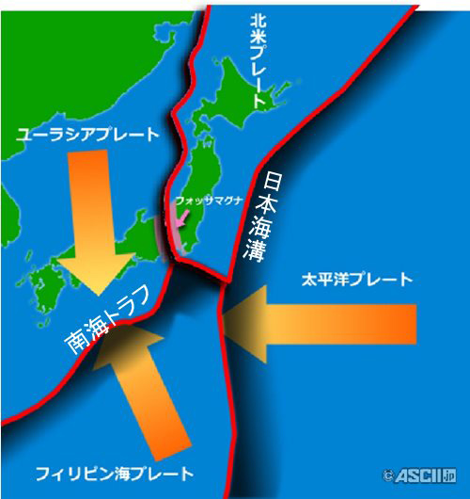
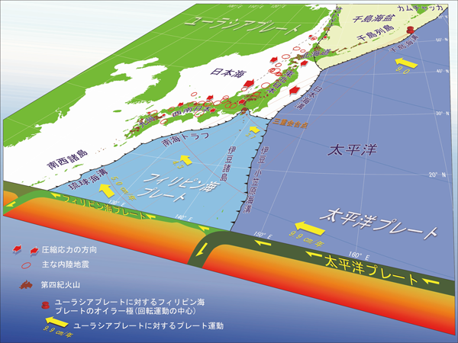
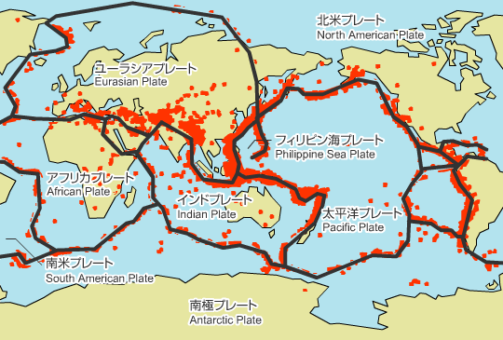

Slide 2
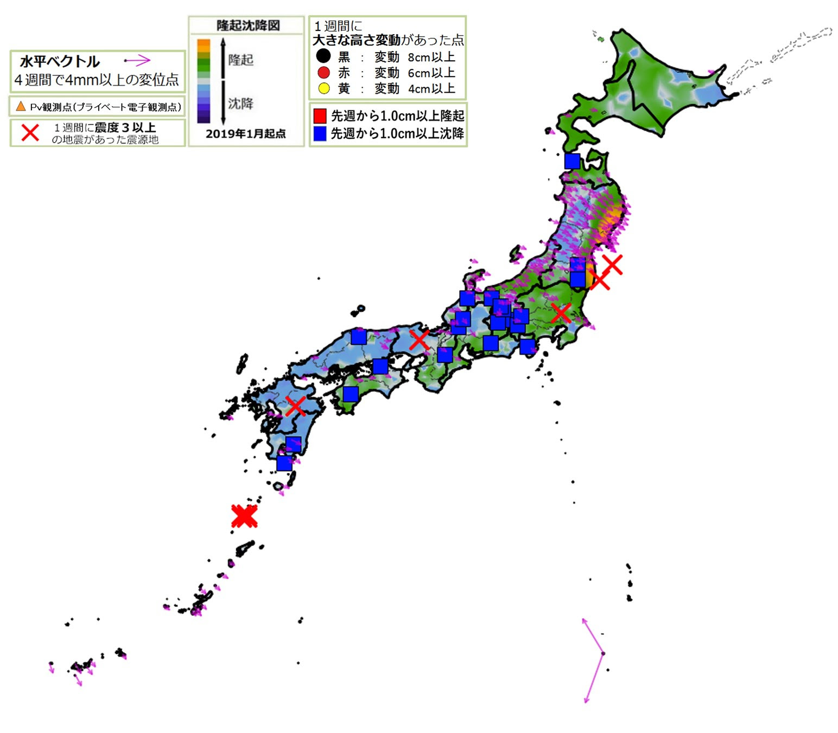
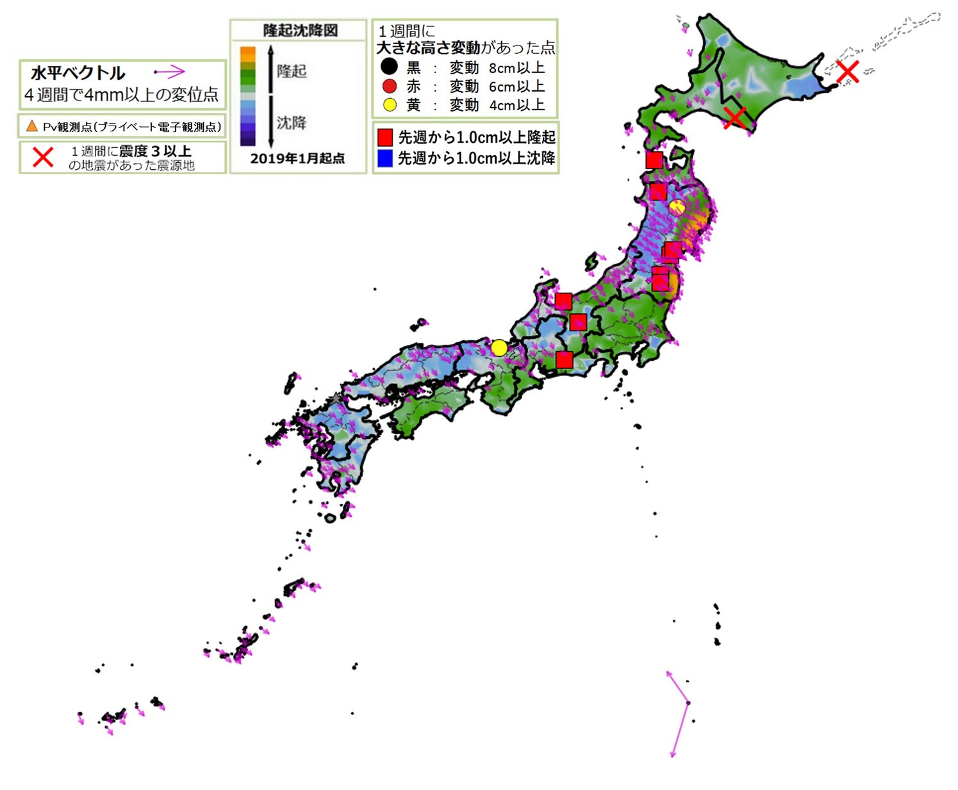
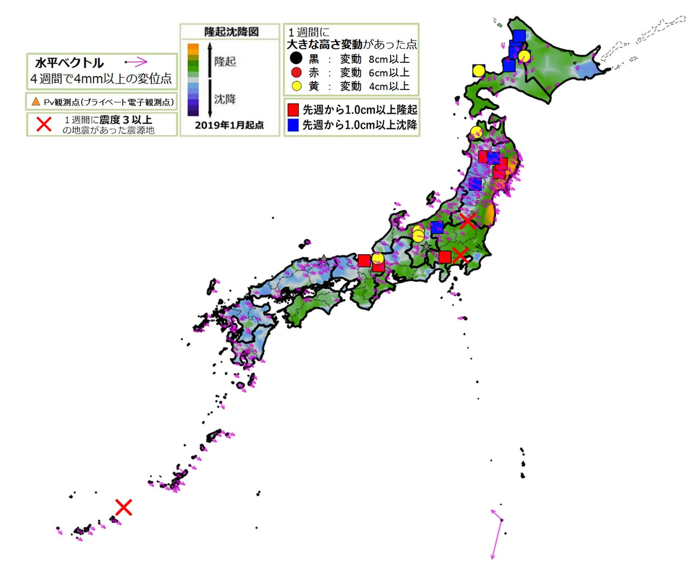
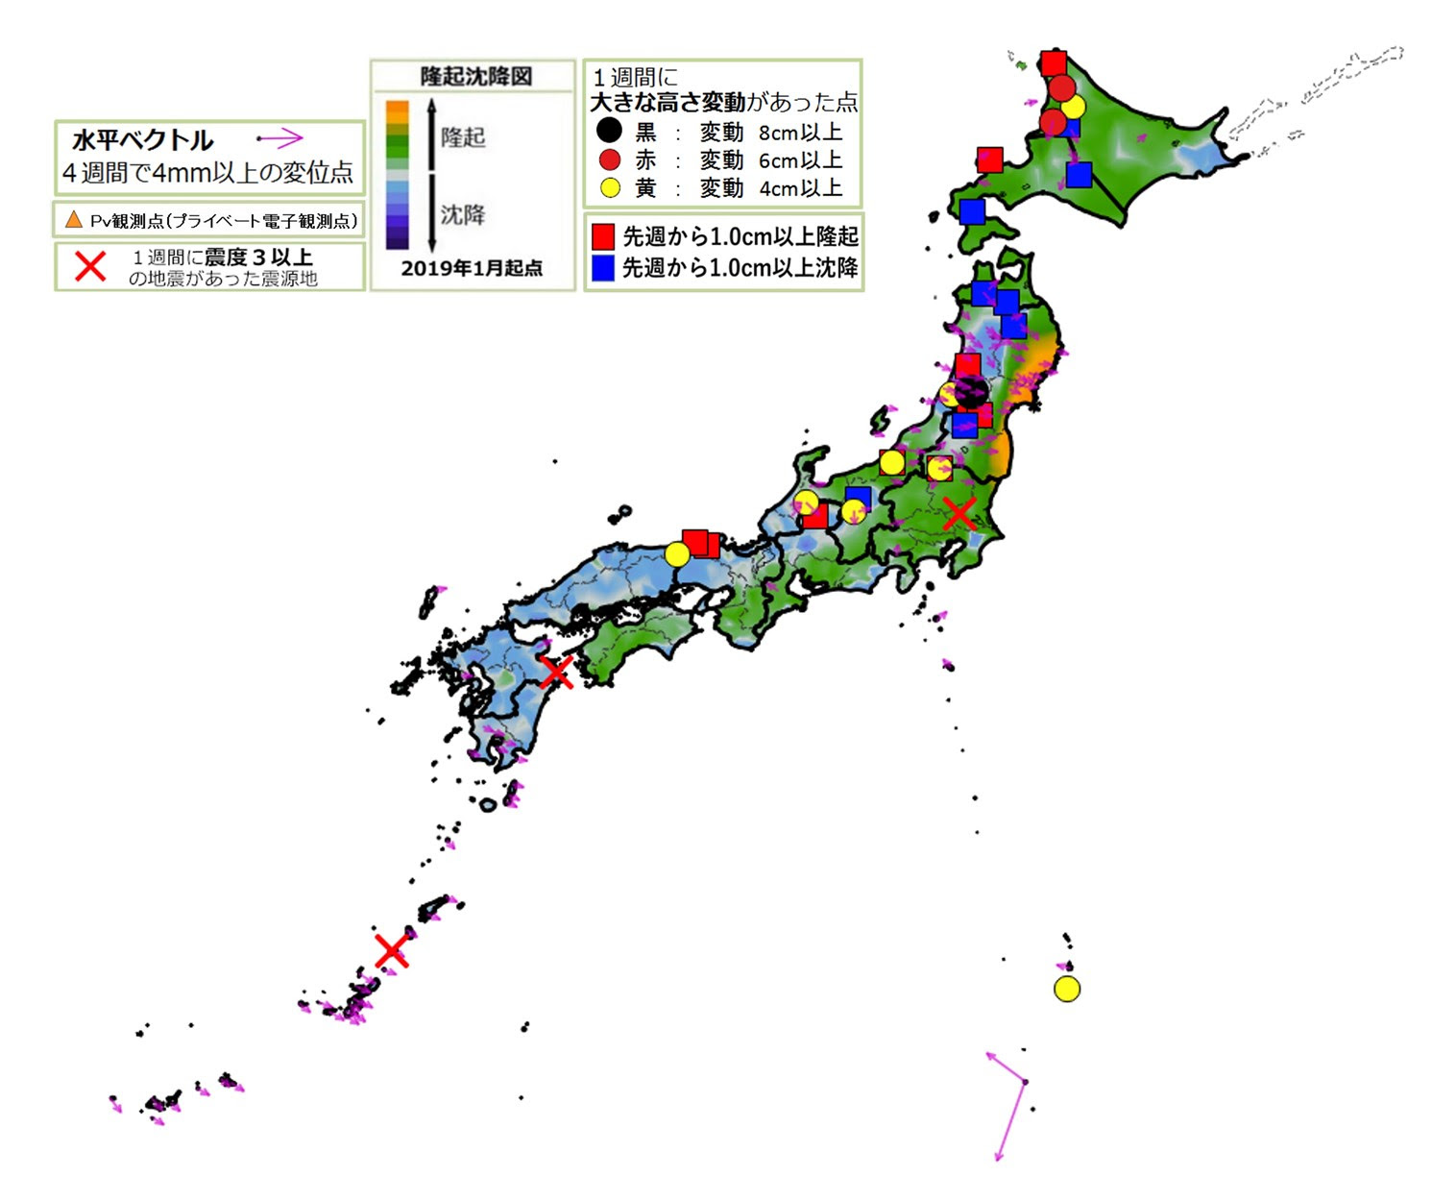
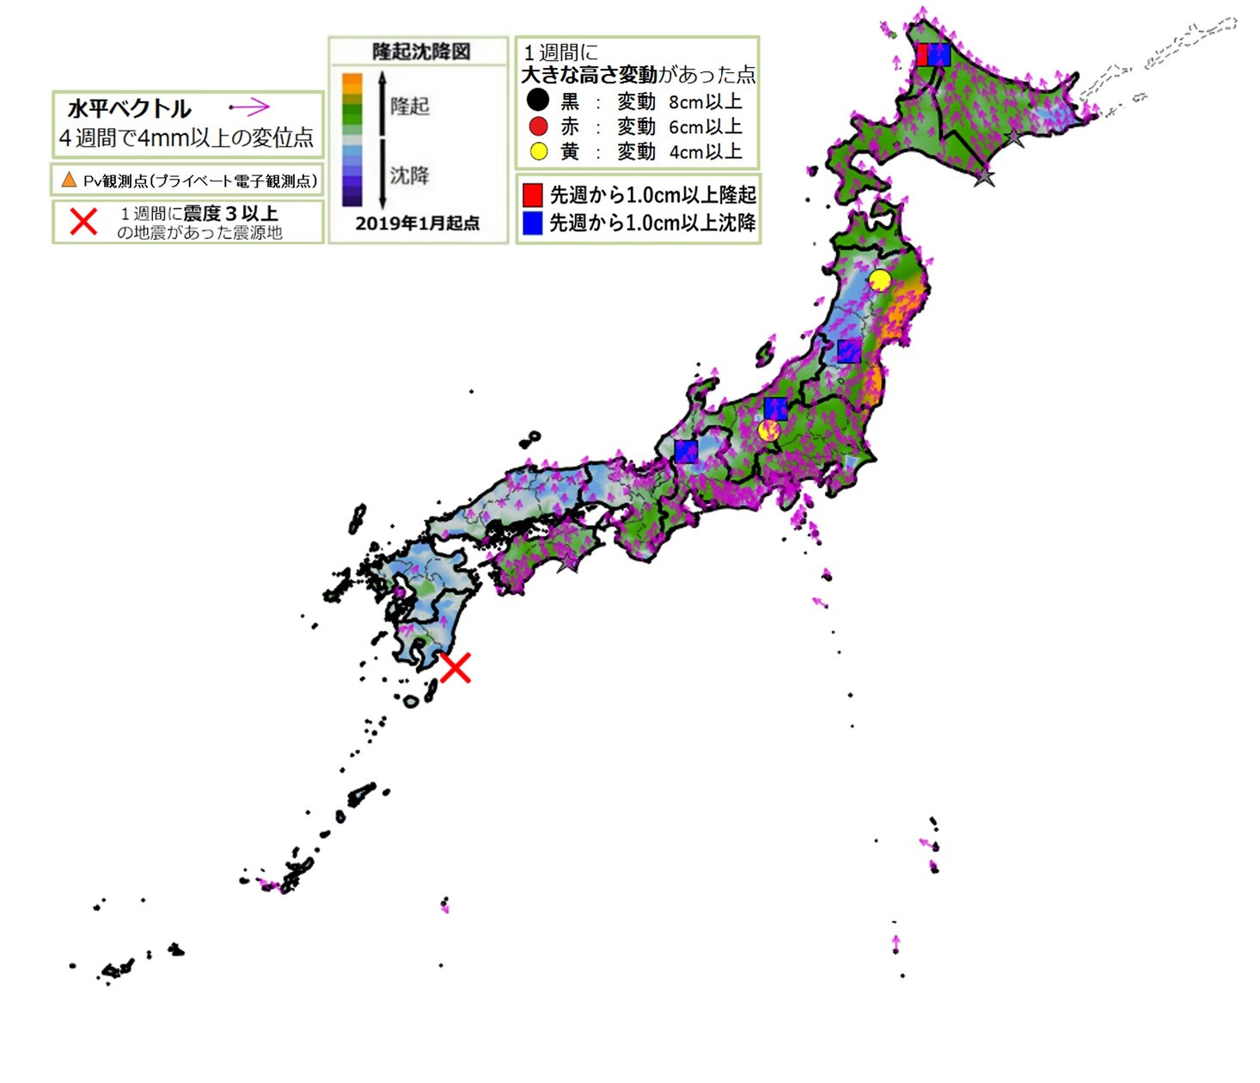
12/27 M5.4
X
2021_12_15
2021_12_22
X
2021_12_29
12/26 M6.0
12/30 M5.5
1/3 M6.3
X
2022_01_06
2022_01_12
2022_01_19
X
1/4 M6.1

Slide 3
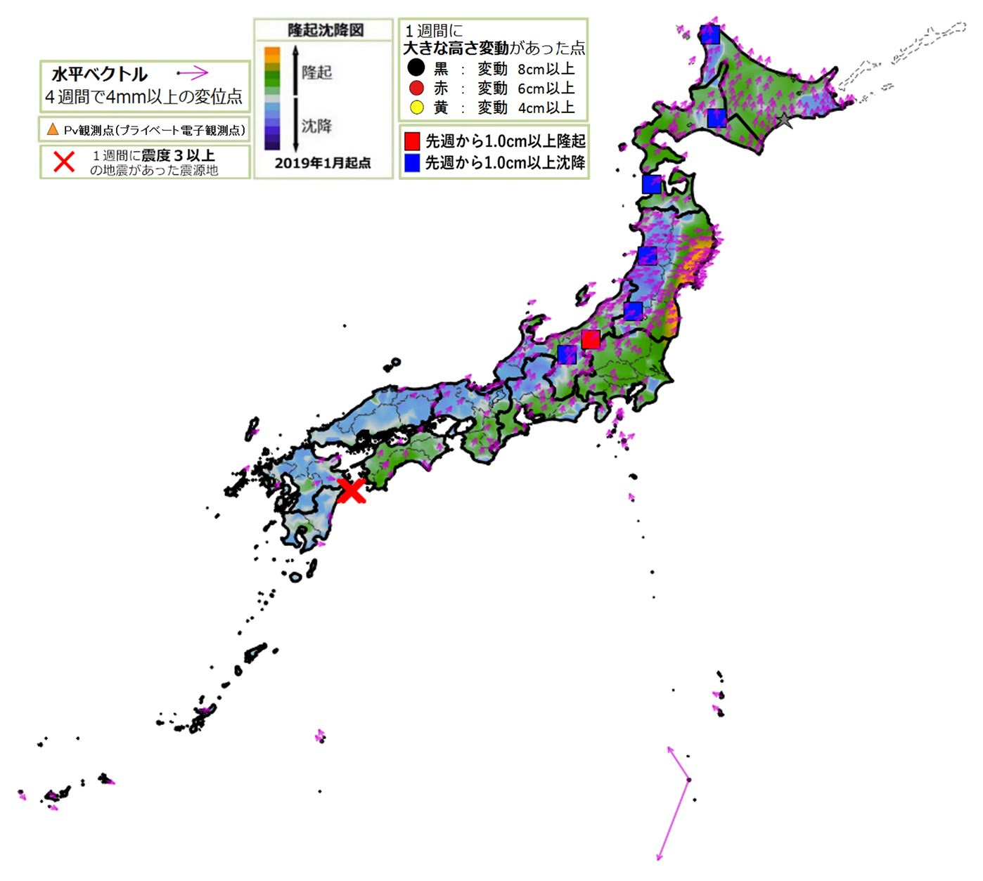
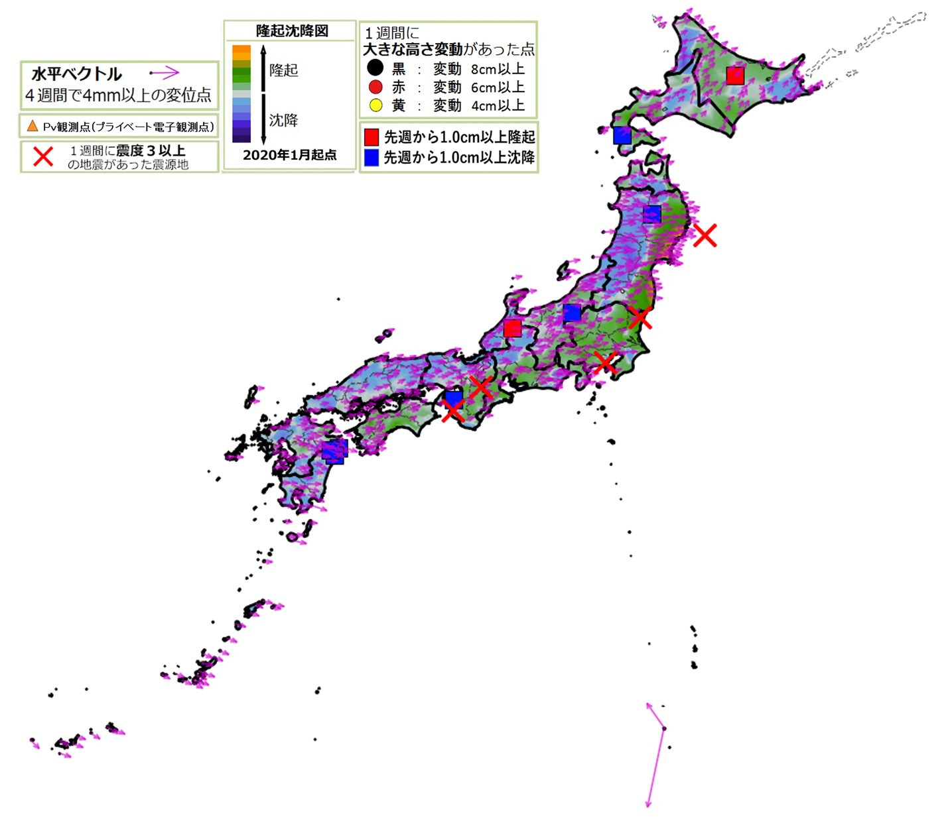
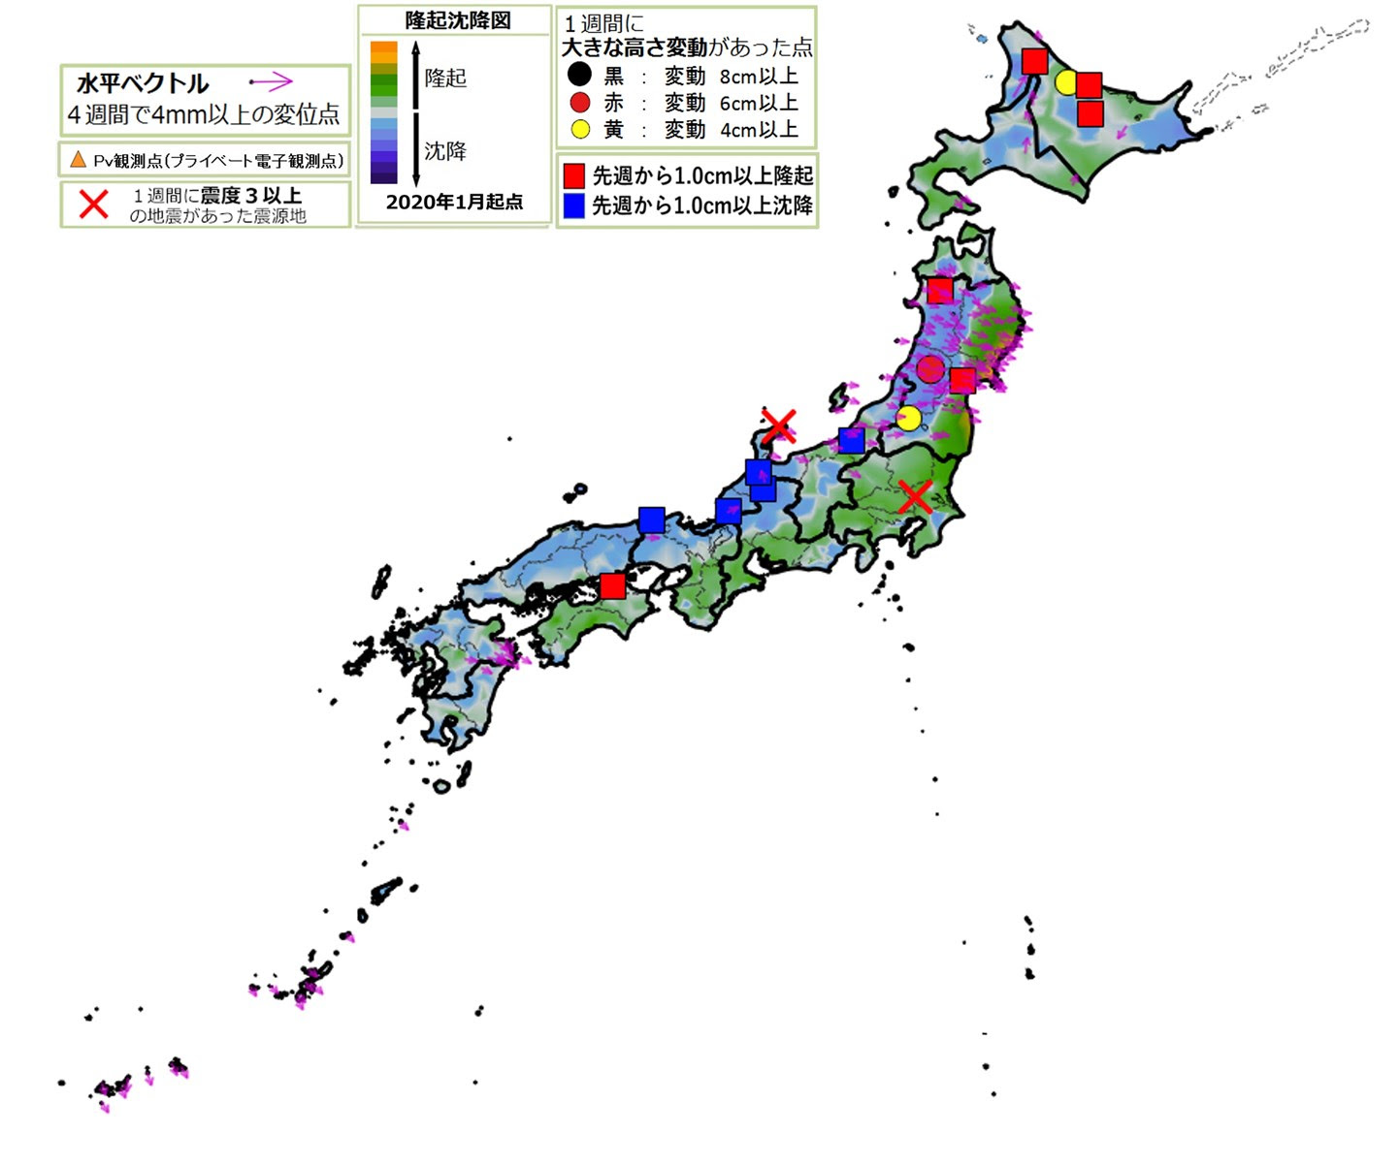
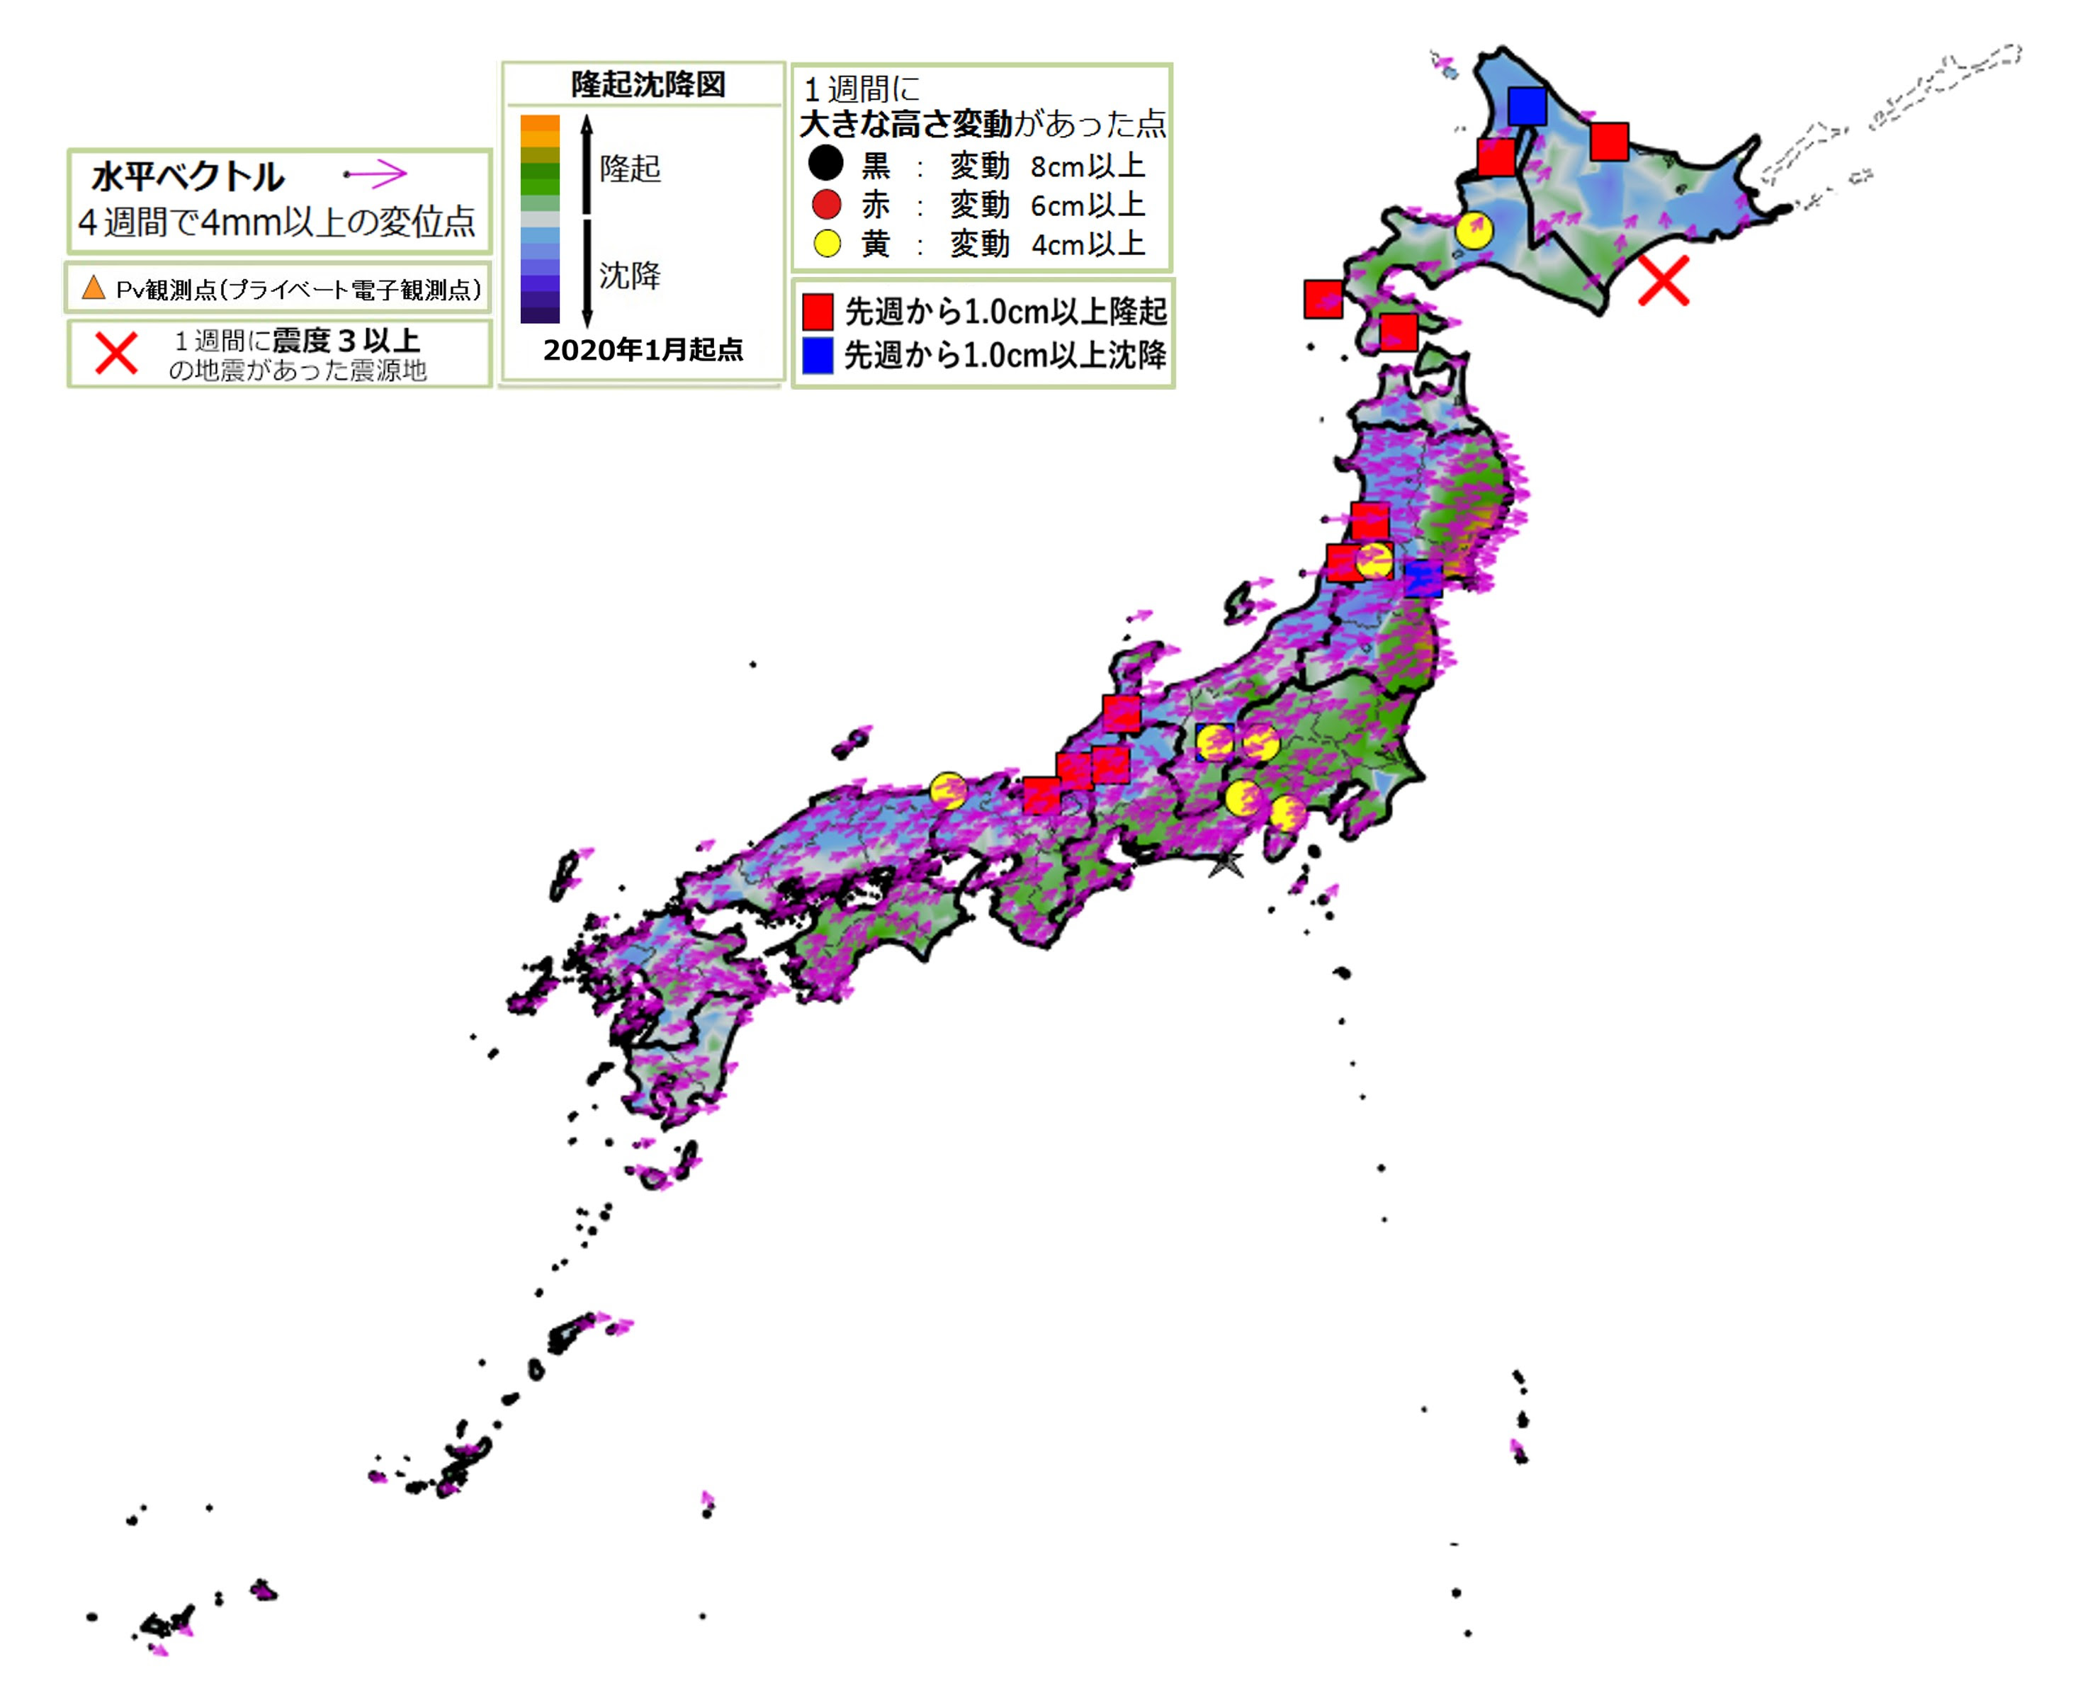
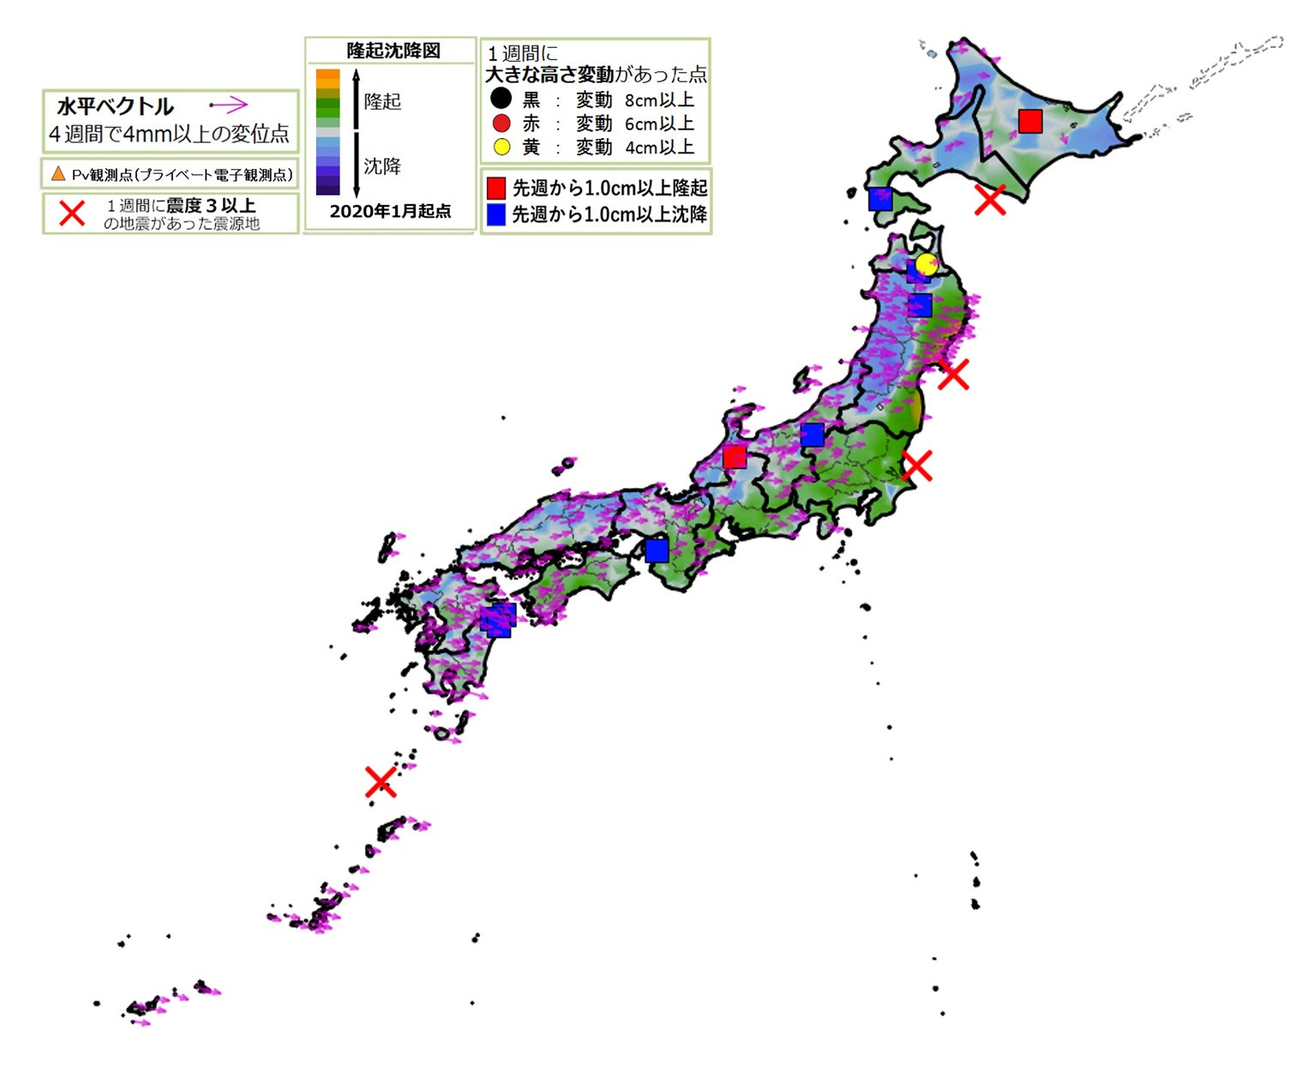
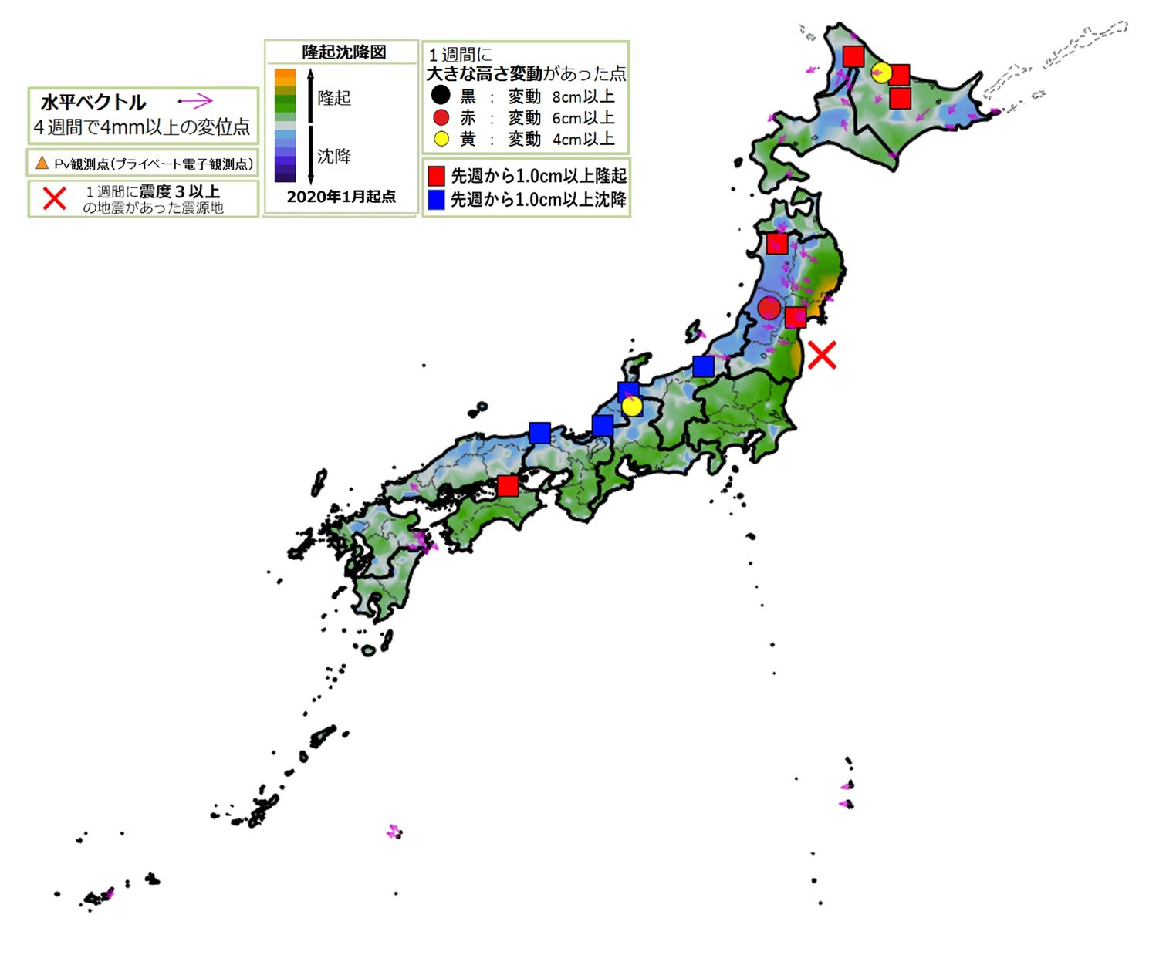
X
1/22 M6.6
2022_01_26
2022_02_02
2022_02_09
X
3/1 M5.2
X
2/18 M5.2
X
2/17 M4.9
2/9 M5.6
2/9 M5.0
2/22 M5.9
2/12 M5.8
X
2/25 M5.4
X
2022_02_16
2022_02_23
X
2022_03_02

Slide 4
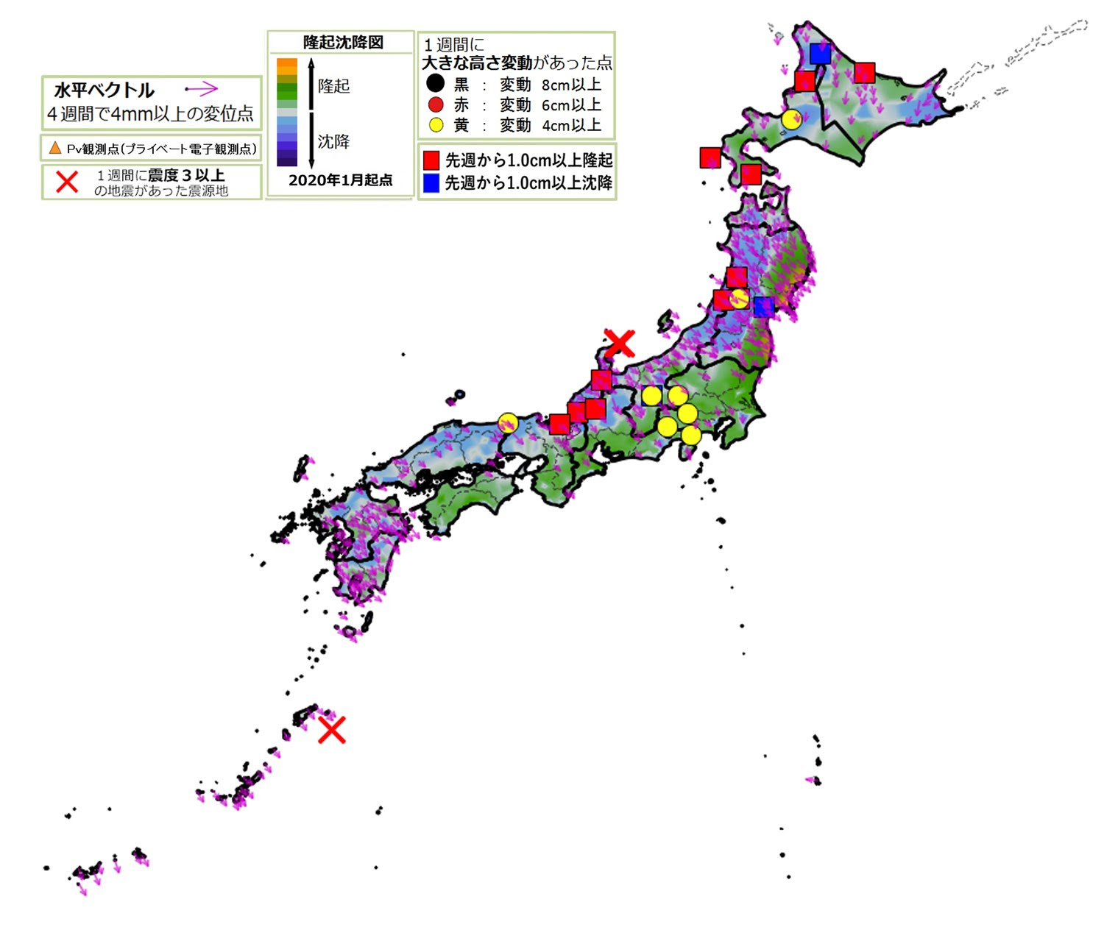
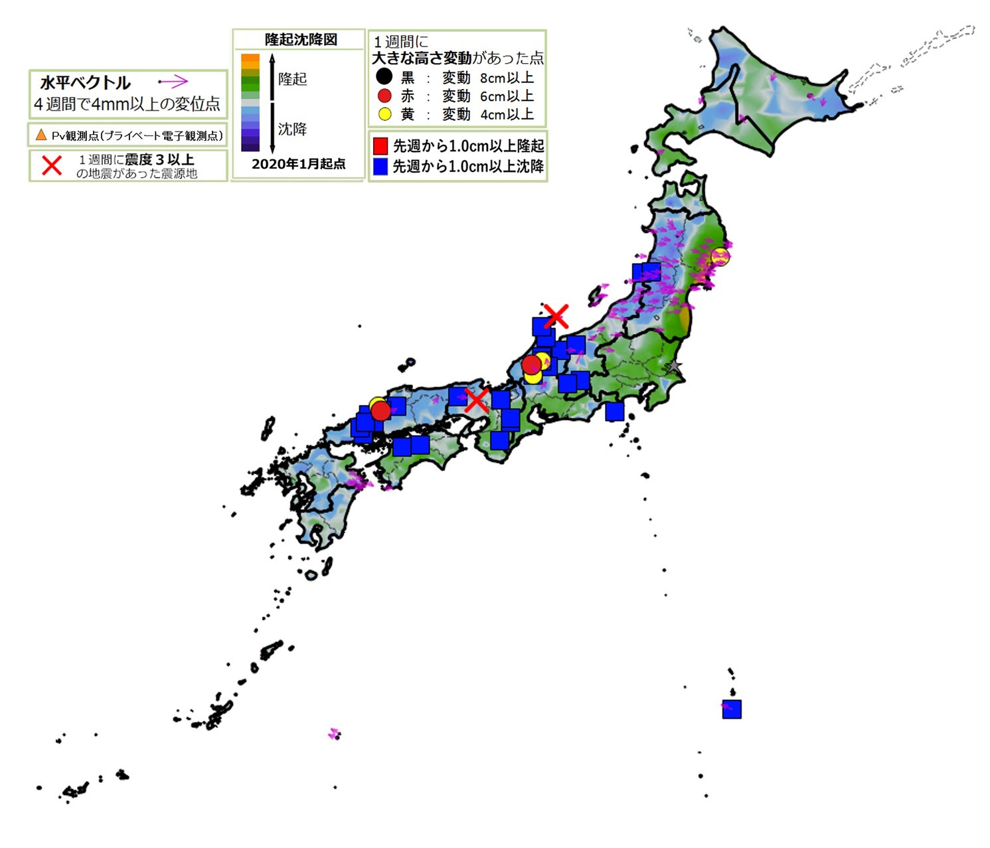
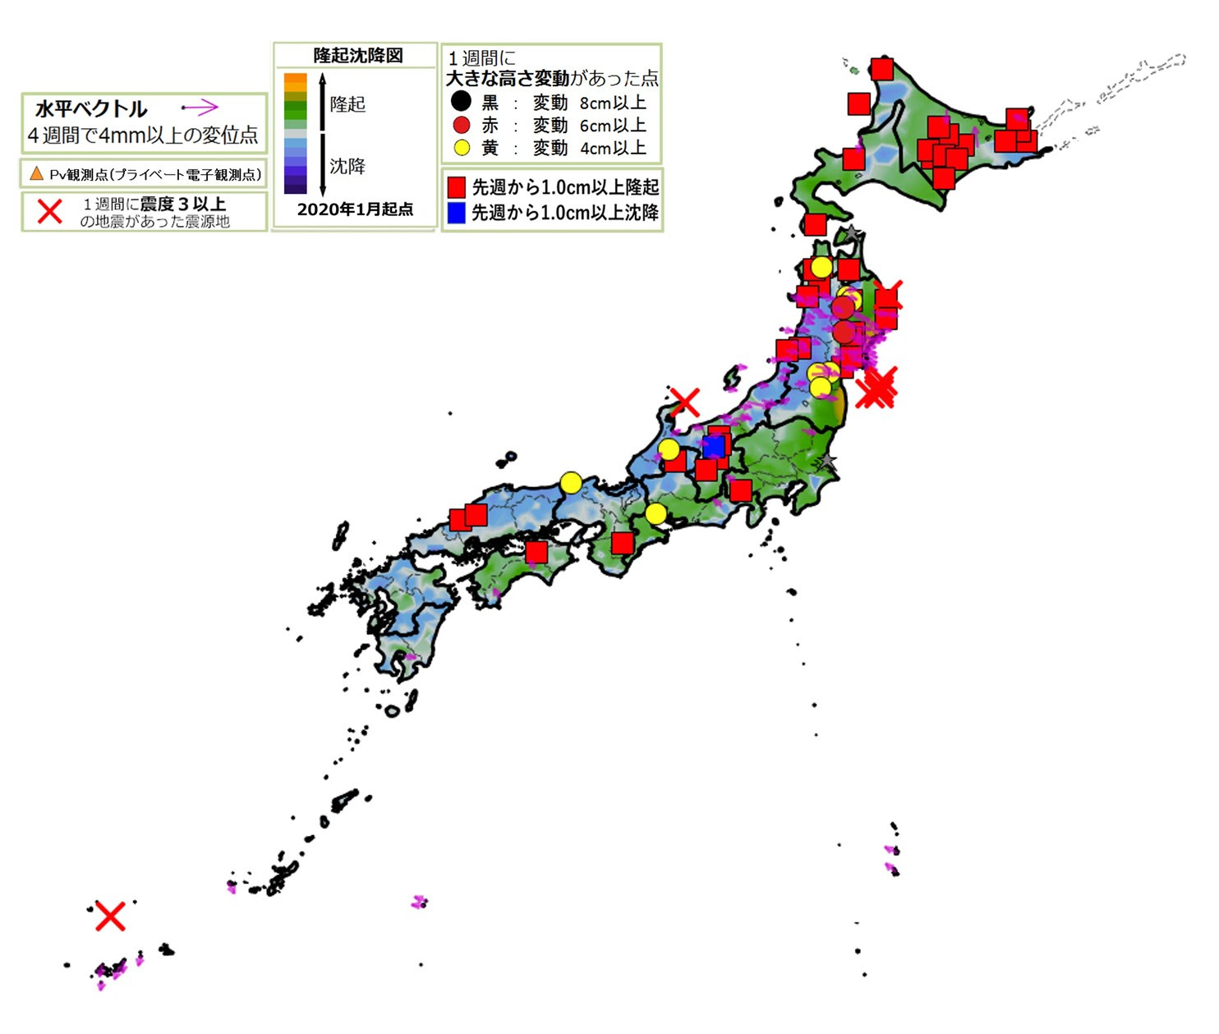
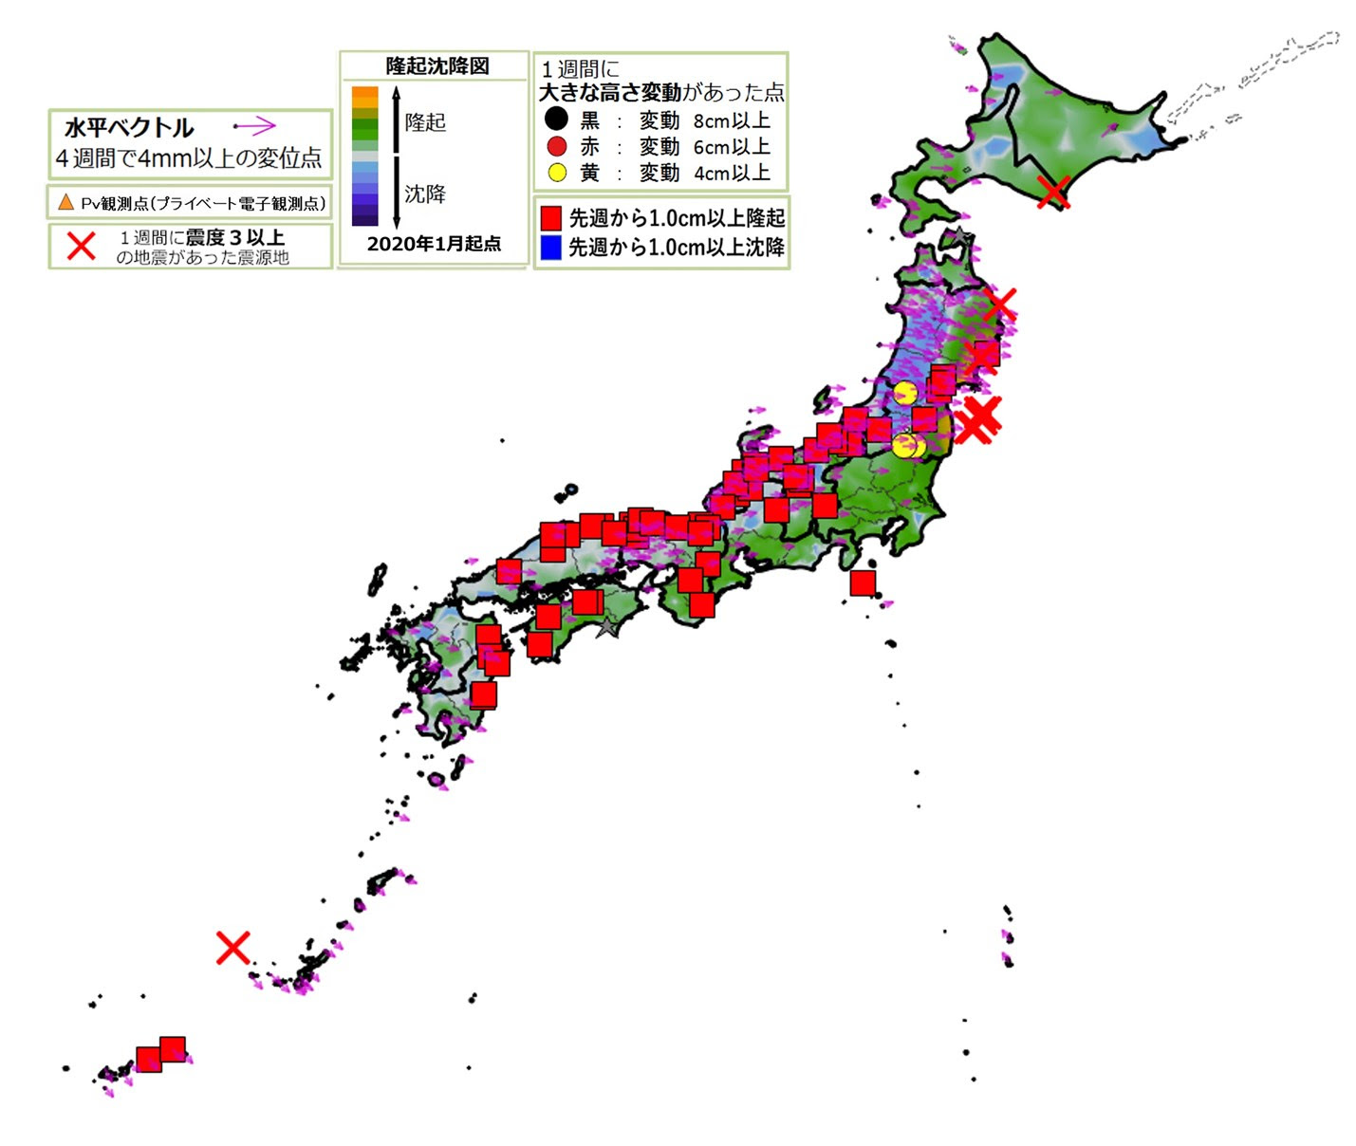
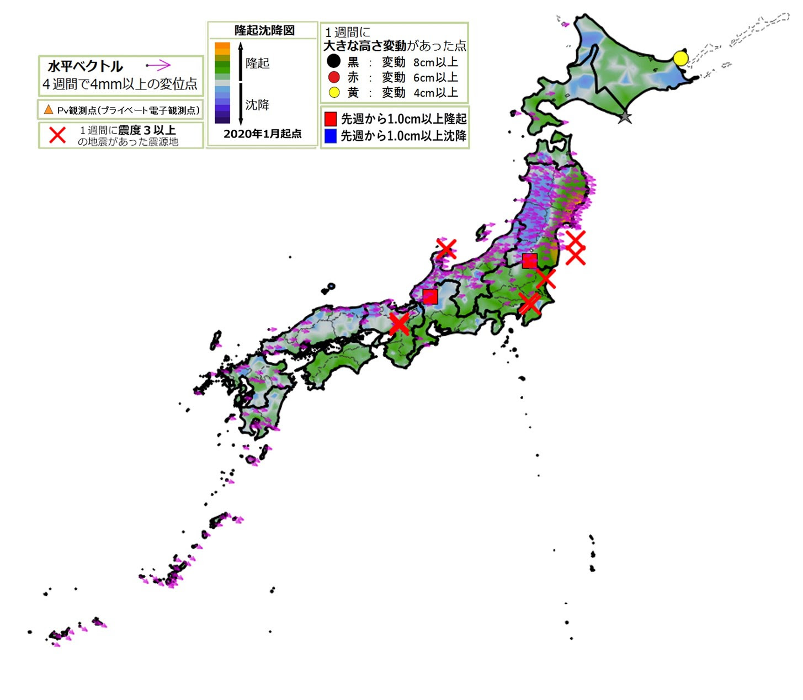
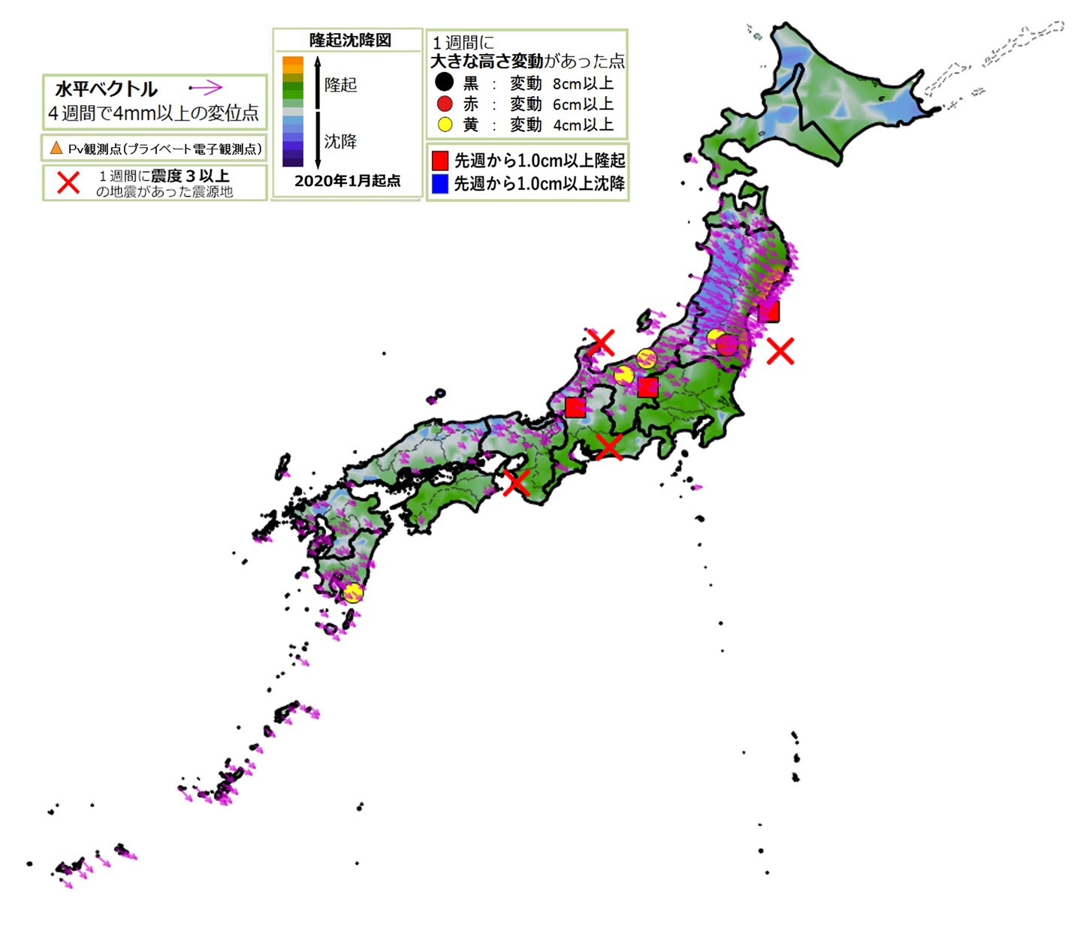
X
X
3/18 M5.6
3/15 M5.0
X
3/1 M7.4
3/17 M5.6
3/19 M5.1
3/17 M5.9
X
2022_03_09
2022_03_16
3/19 M5.9
2022_03_23
3/6 M5.0
X
X
3/27 M5.1
X
X
4/4 M5.1
X
3/25 M5.1
X
4/19 M5.4
4/10 M5.4
3/24 M5.1
3/27 M5.6
2022_03_30
2022_04_06
2022_04_13
3/30 M5.0
X
3/30 M5.5
X
4/13 M5.7
4/14 M5.0

Slide 5
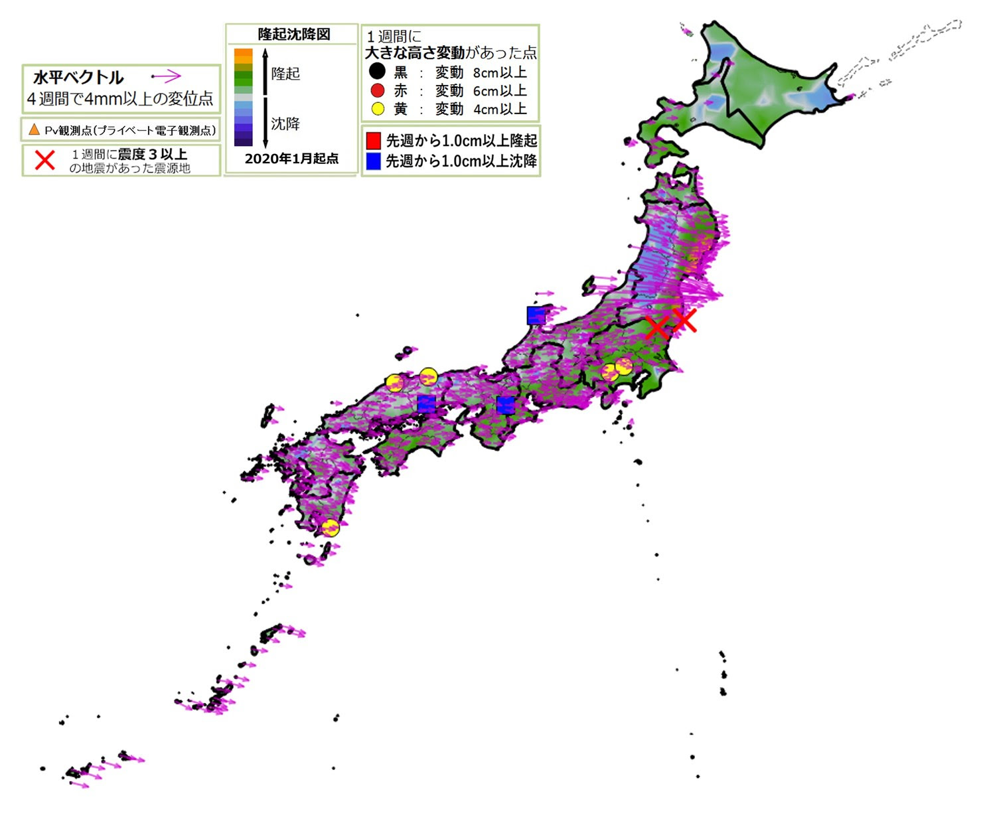
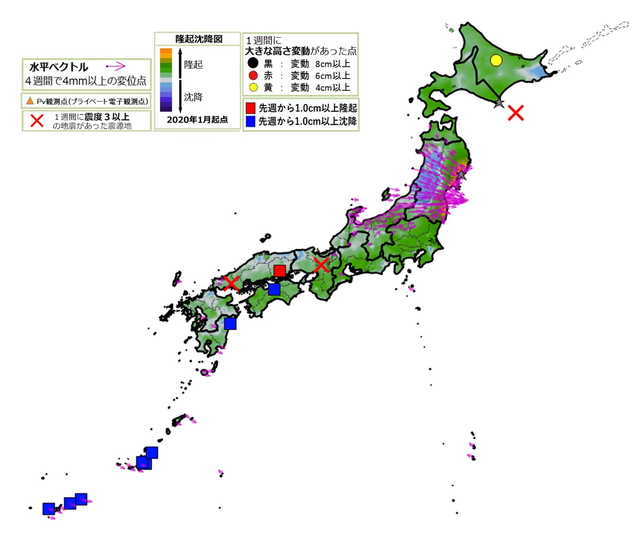
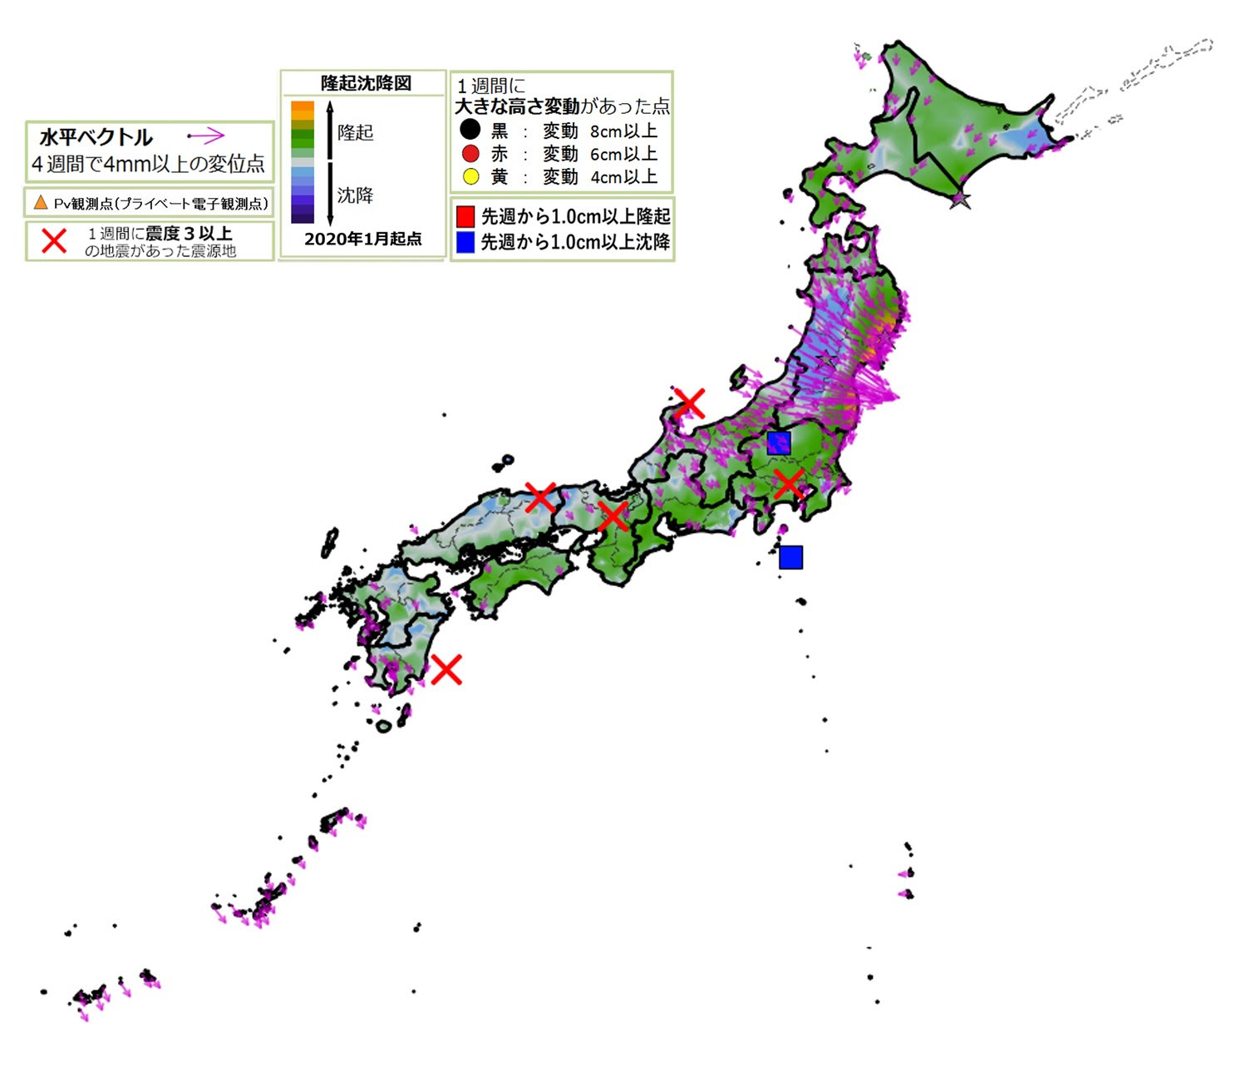
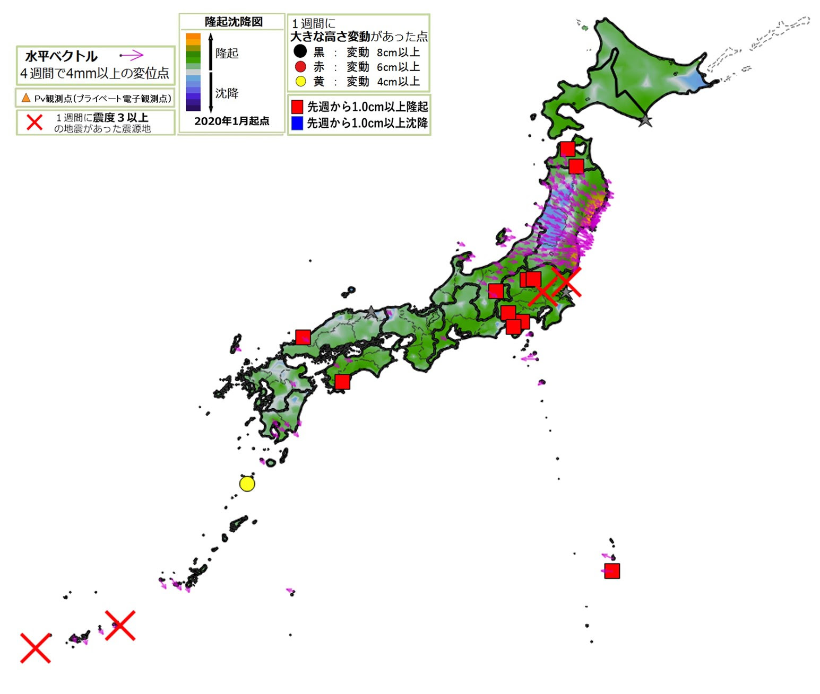
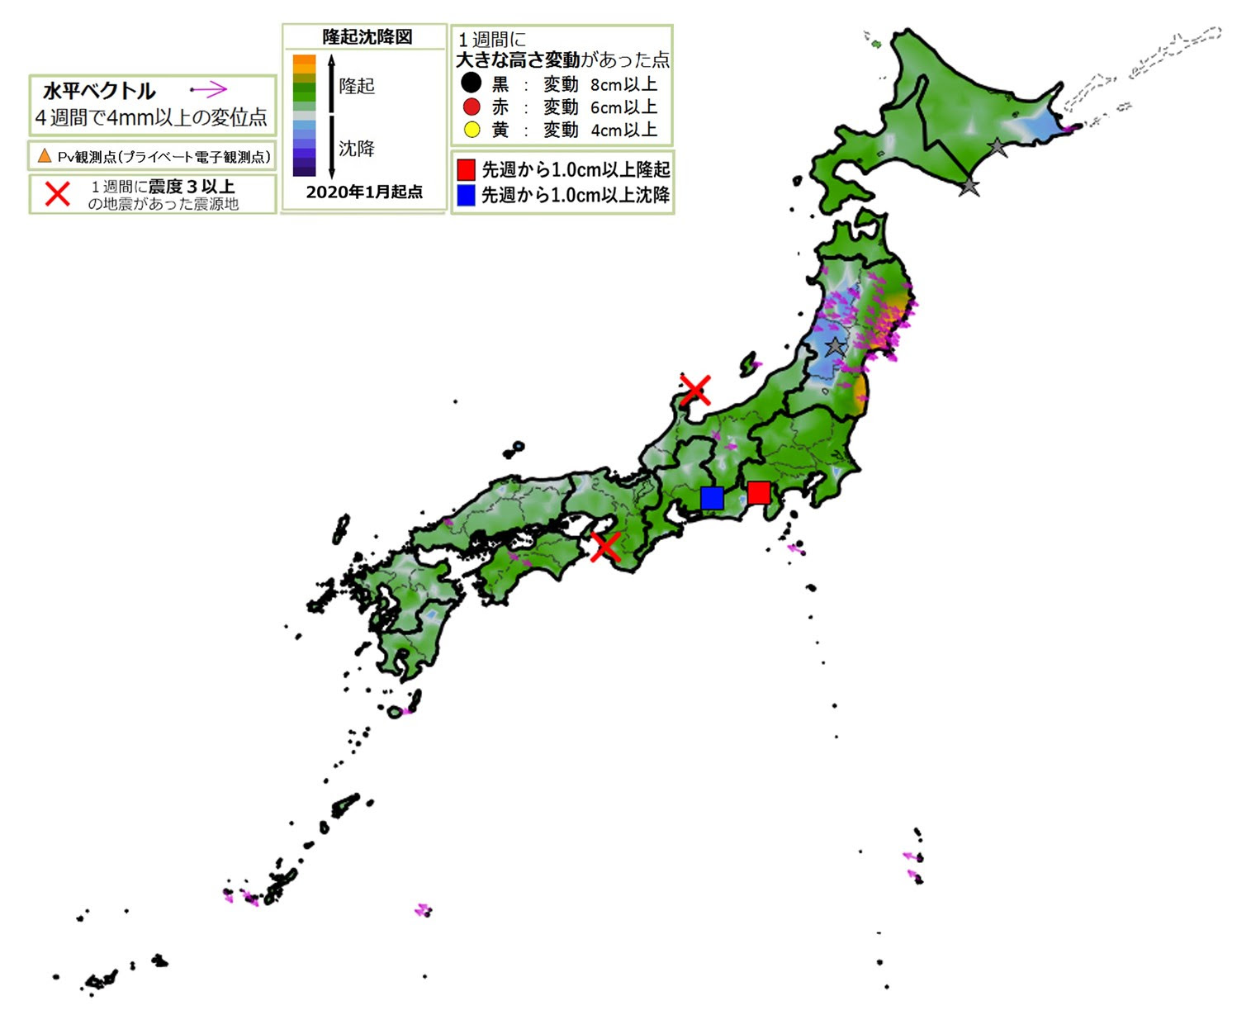
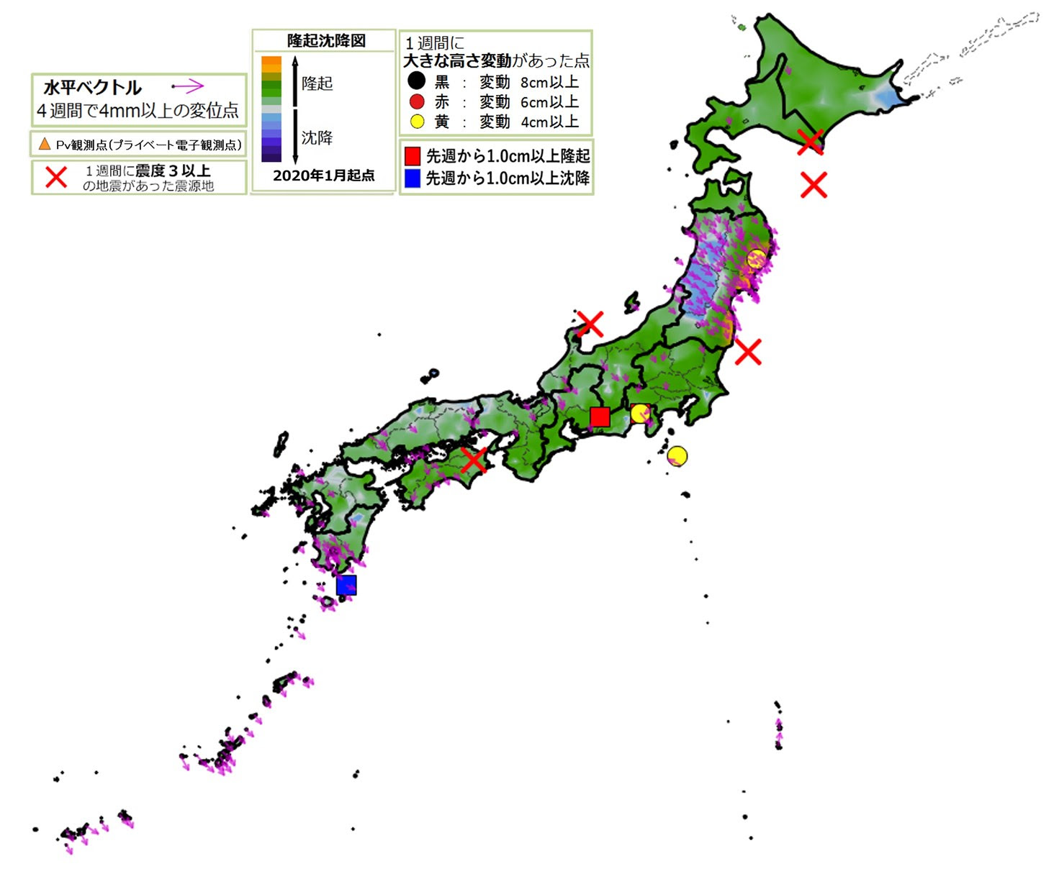
X
5/2 M5.0
2022_04_20
4/24 M5.5
2022_04_27
2022_05_04
X
X
5/23 M5.4
X
5/22 M6.0
5/6 M5.4
5/7 M5.7
X
X
5/9 M5.1(340km)
2022_05_11
2022_05_18
2022_05_25
X
5/19 M5.0
5/23 M6.1
X

Slide 6
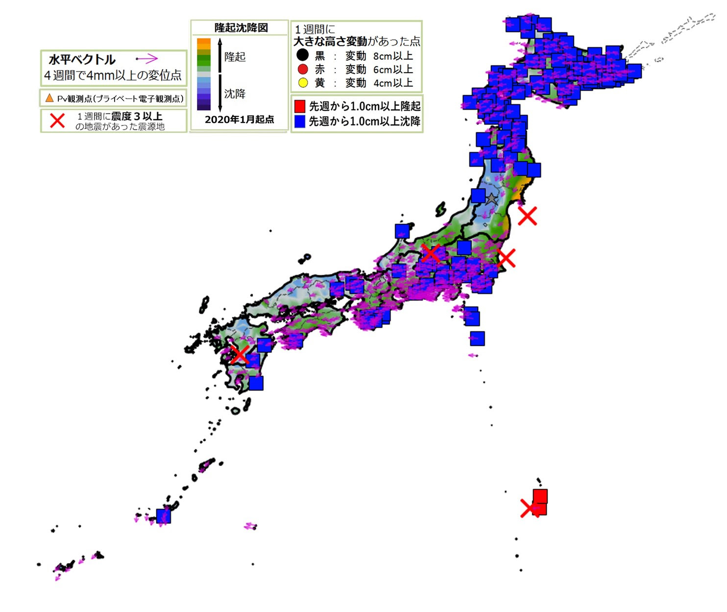
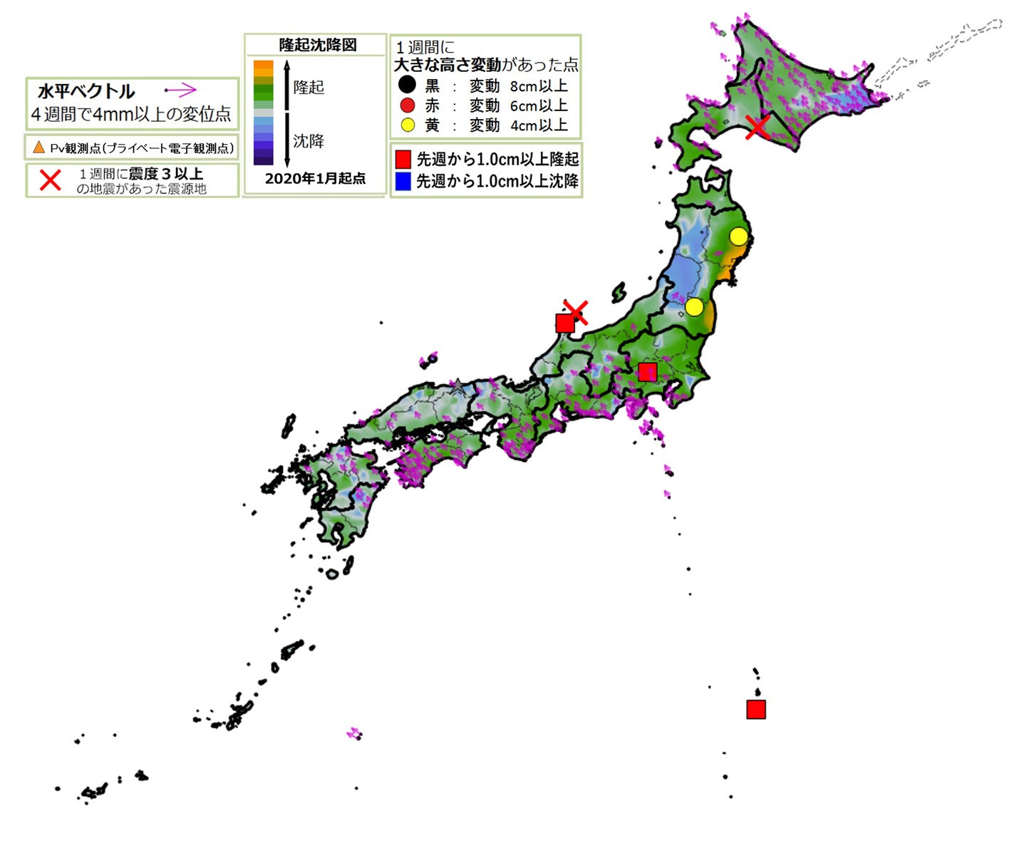
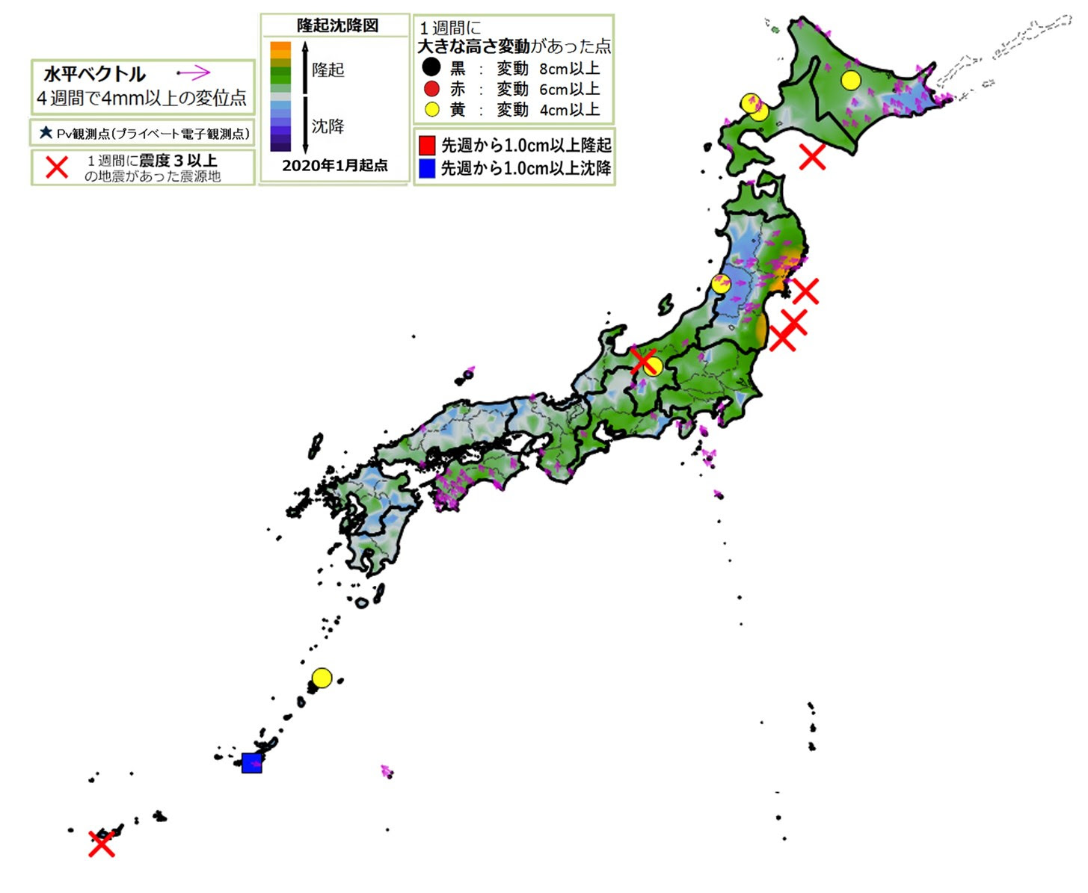
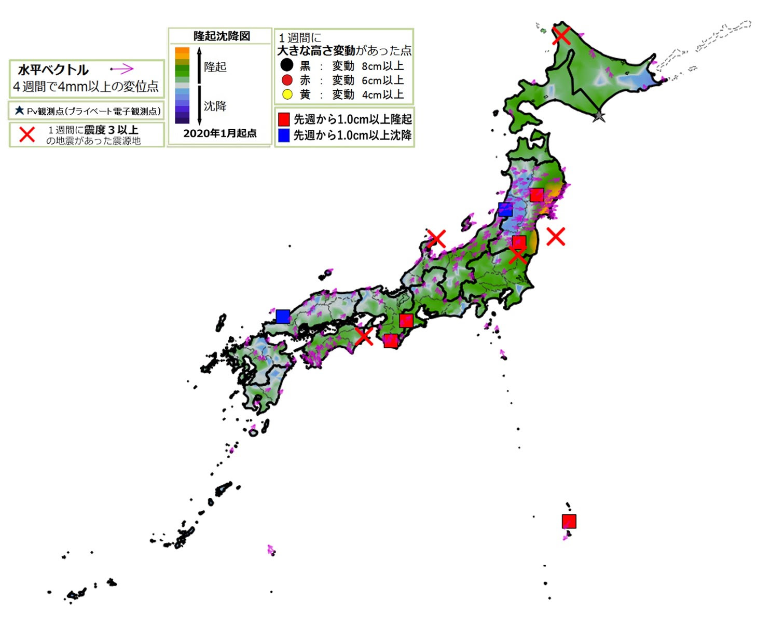
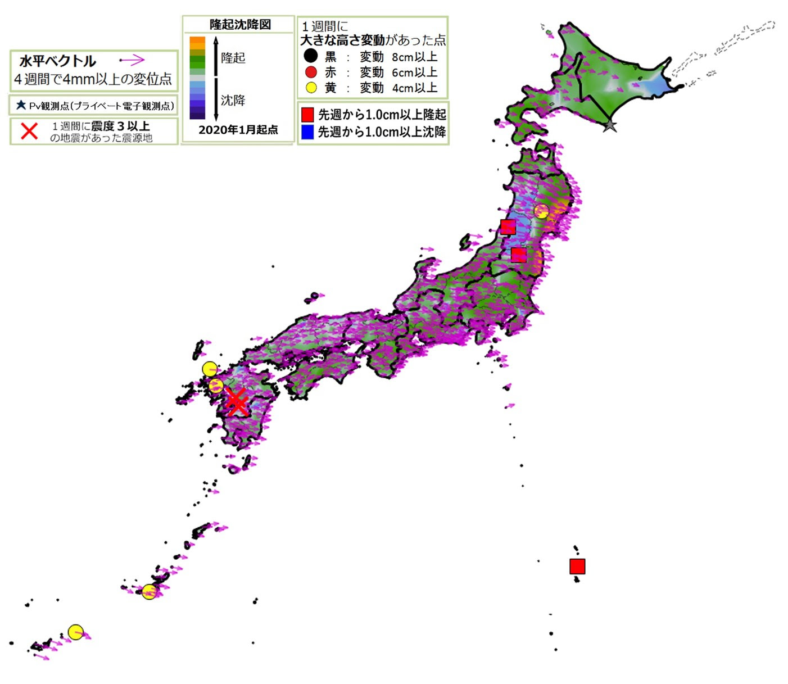
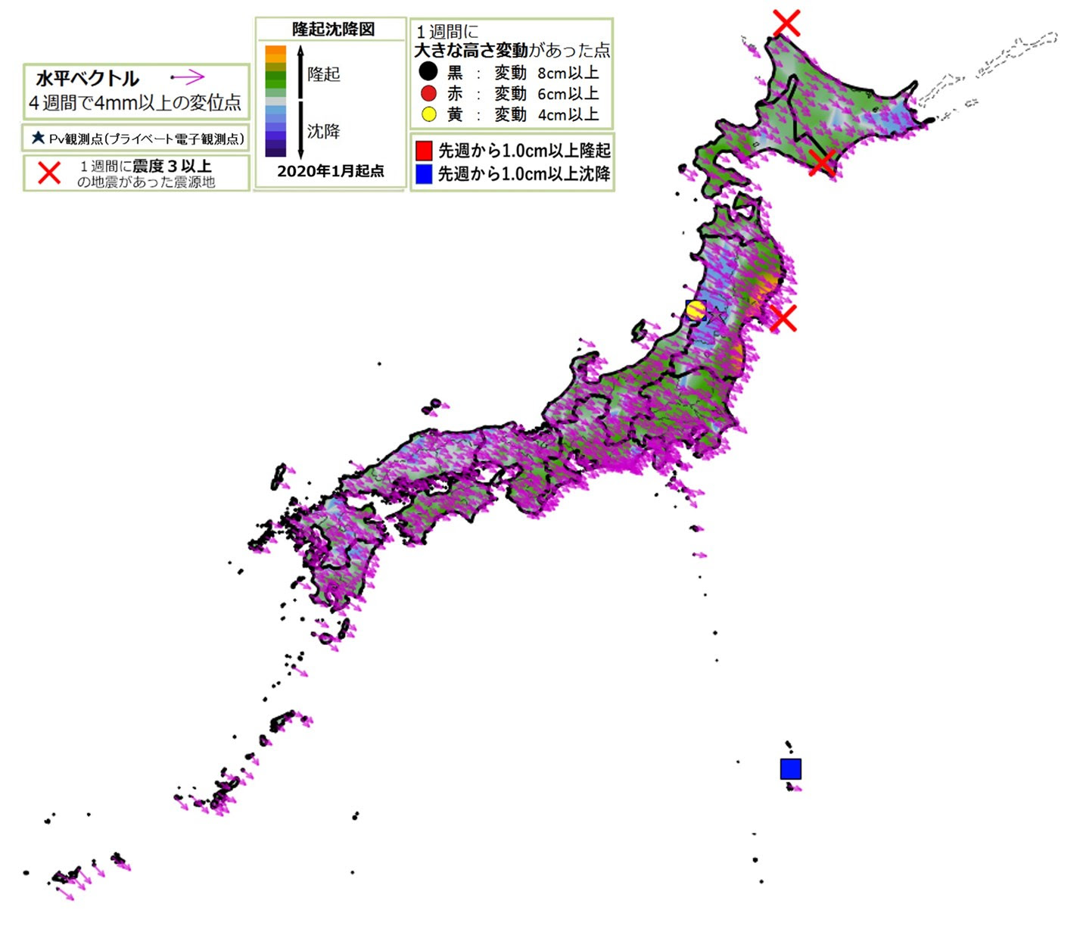
X
6/16 M4.8
X
X
6/12 M5.1
5/29 M5.4
6/7 M5.2
2022_06_01
X
6/3 M4.9
2022_06_08
2022_06_15
X
7/2 M5.9
X
6/19 M5.4
6/20 M5.0
X
X
7/6M5.4
X
7/6 M5.1
6/19 M5.7
6/18 M4.8
7/8 M5.0
X
2022_06_22
2022_06_29
X
2022_07_06
6/24 M5.6
X

Slide 7
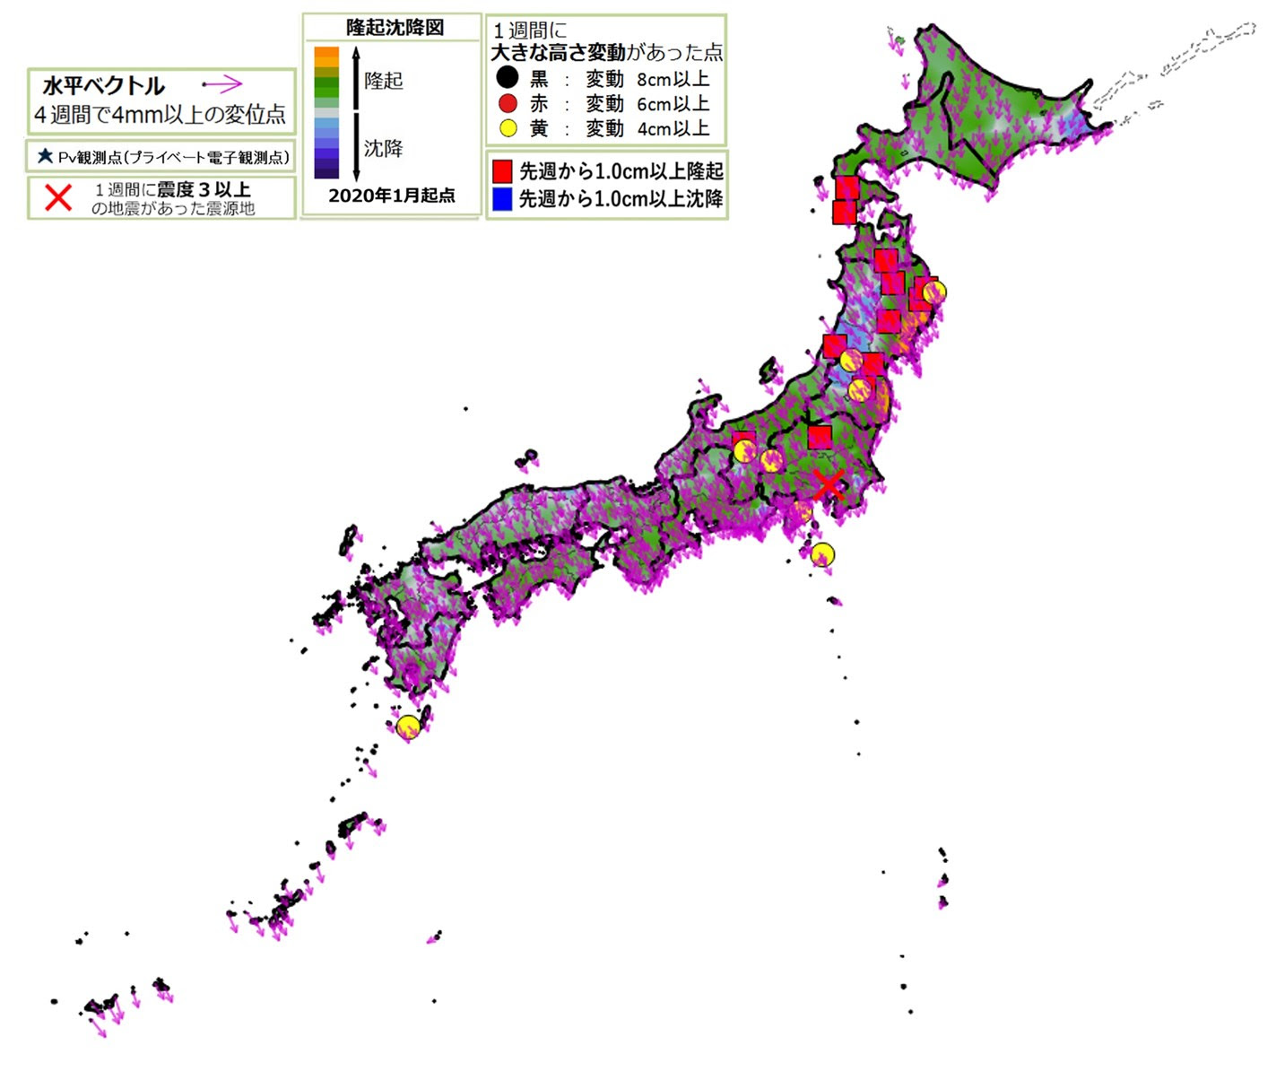
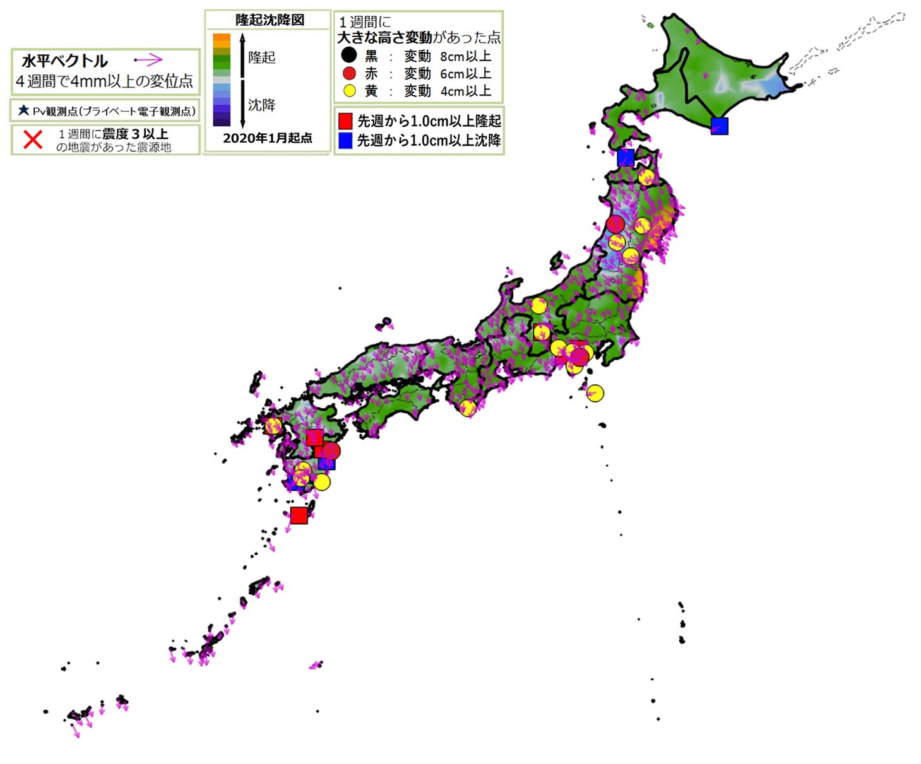
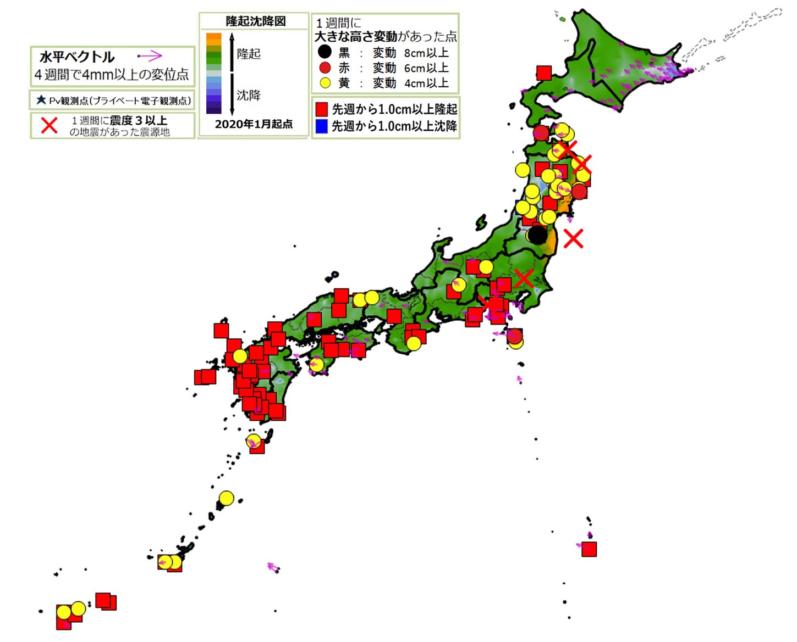
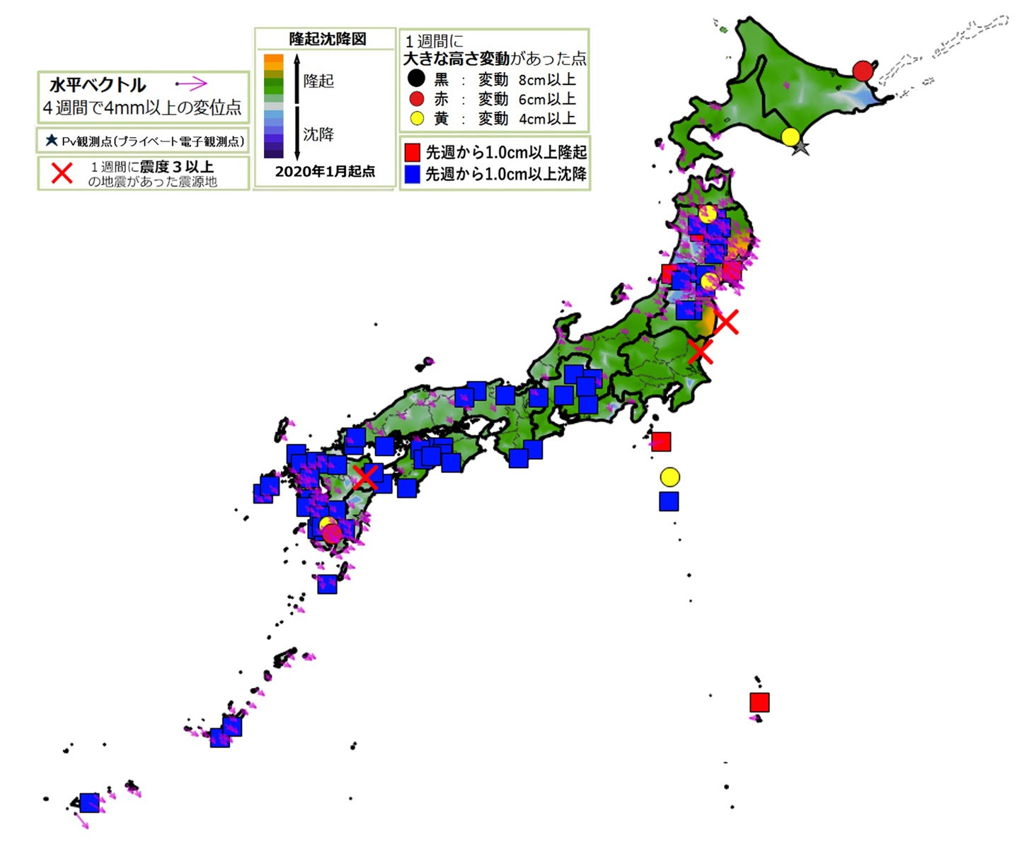
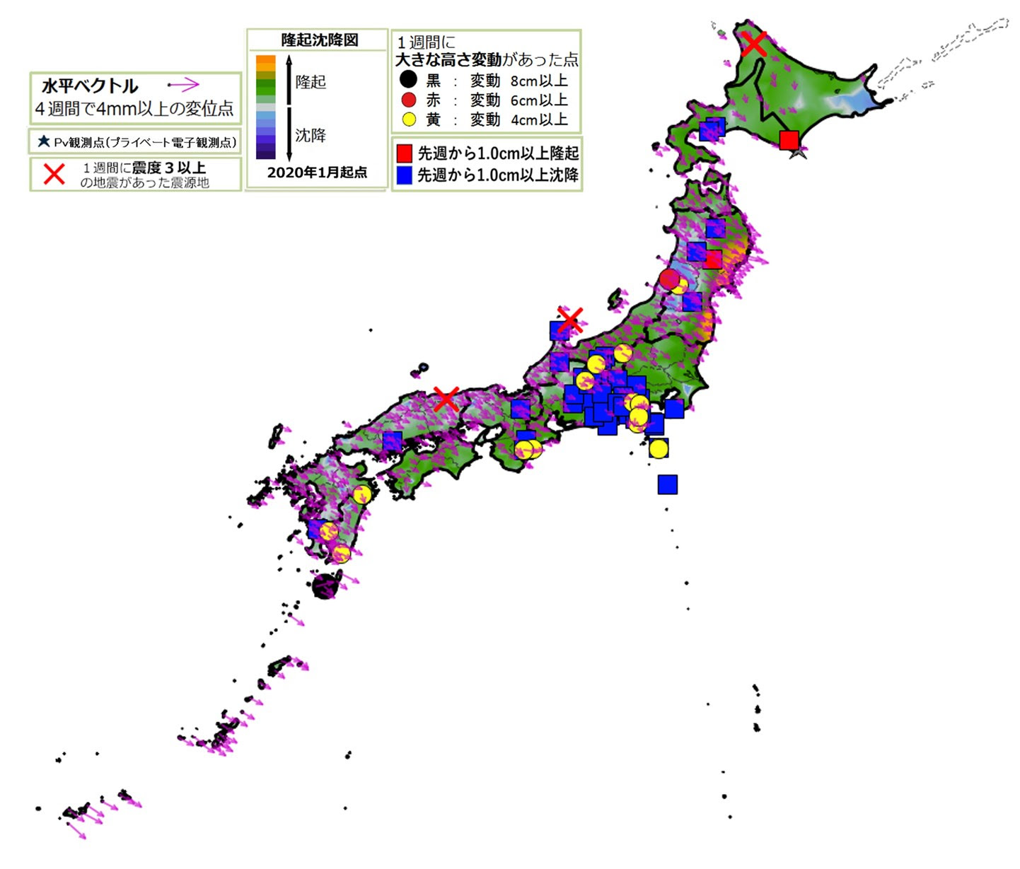
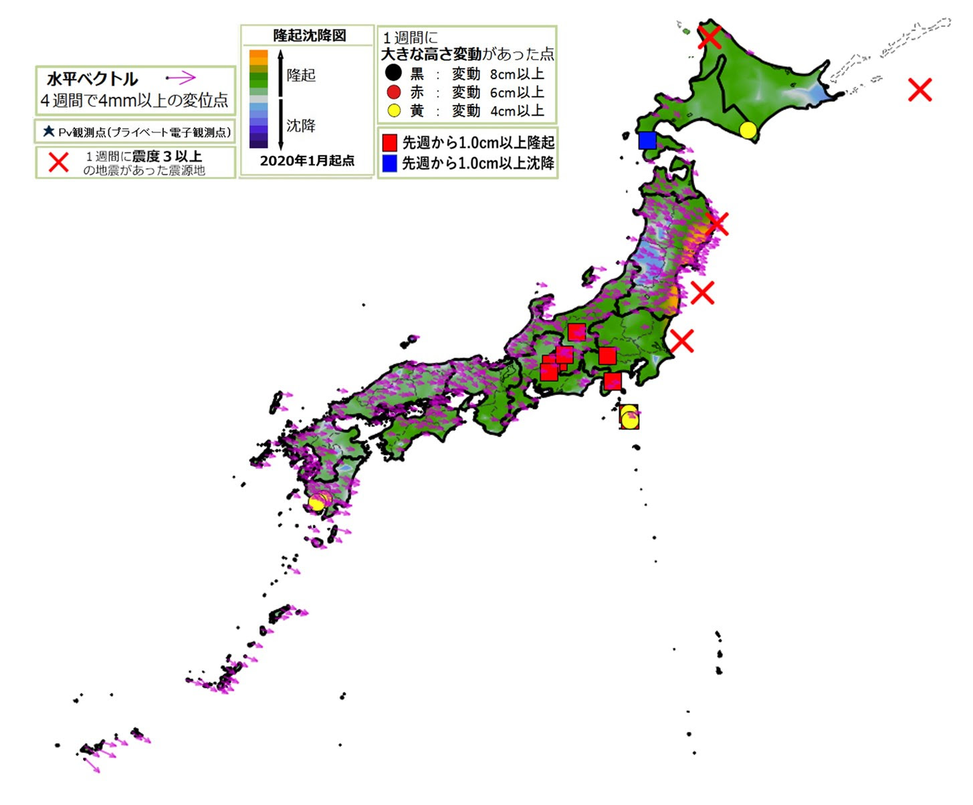
X
7/22 M5.1
X
2022_07_13
2022_07_20
7/25 M5.0
7/25 桜島噴火
2022_07_27
X
X
7/29 M6.1
8/11 M5.1
X
8/14 M5.5
(300km)
8/11 M5.3
8/11 M4.6
X
X
8/4 M5.6
X
8/18 M5.3
X
8/18 M5.0
2022_08_03
2022_08_10
2022_08_18
X
8/18 M5.0

Slide 8
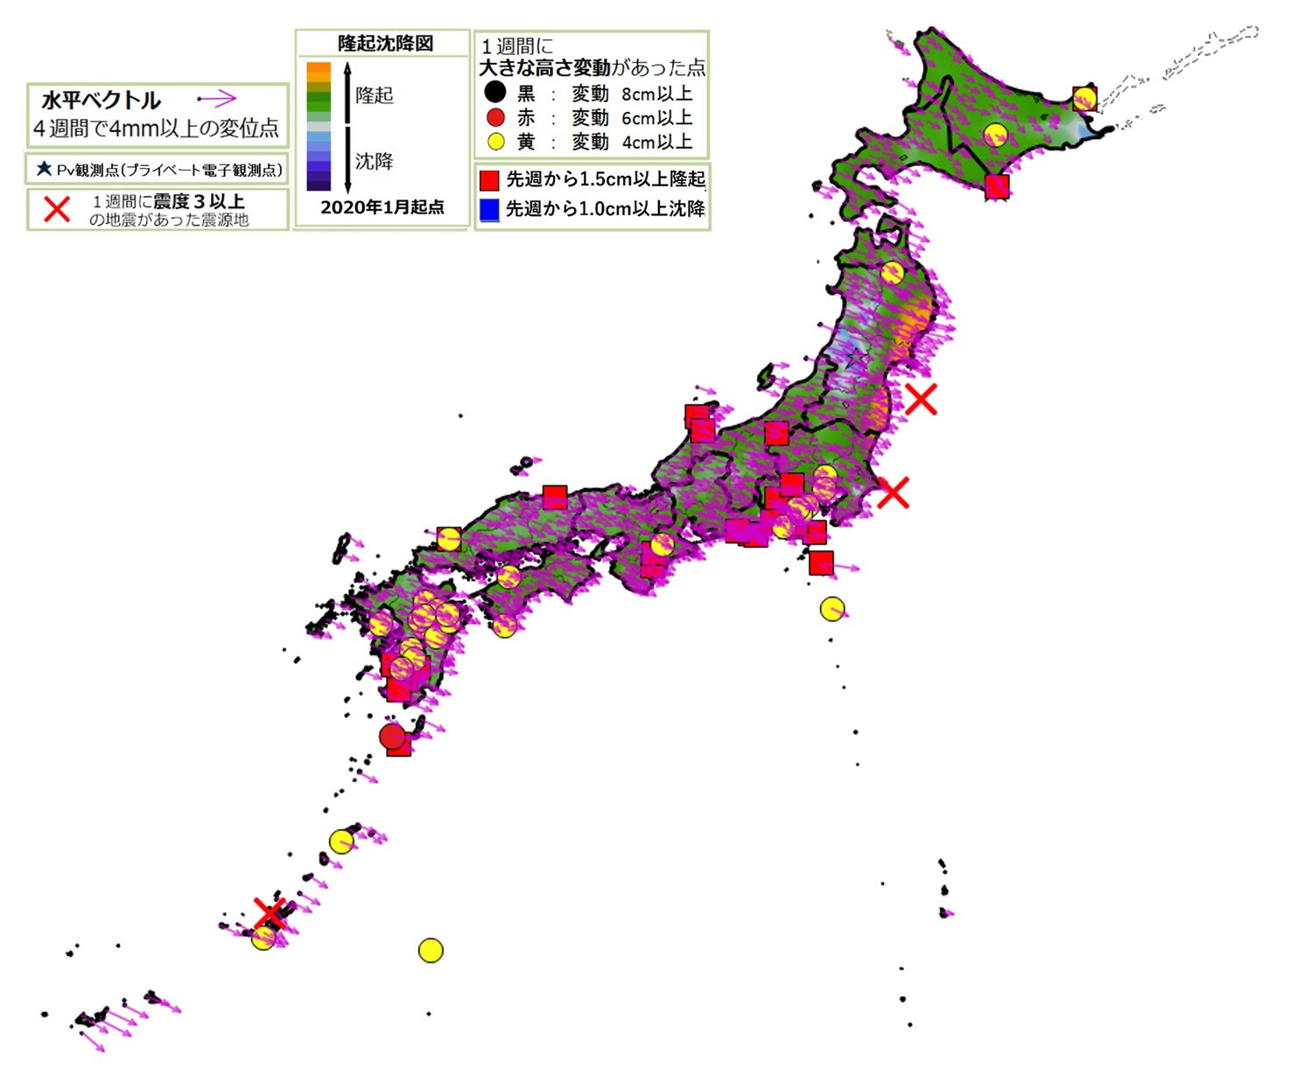
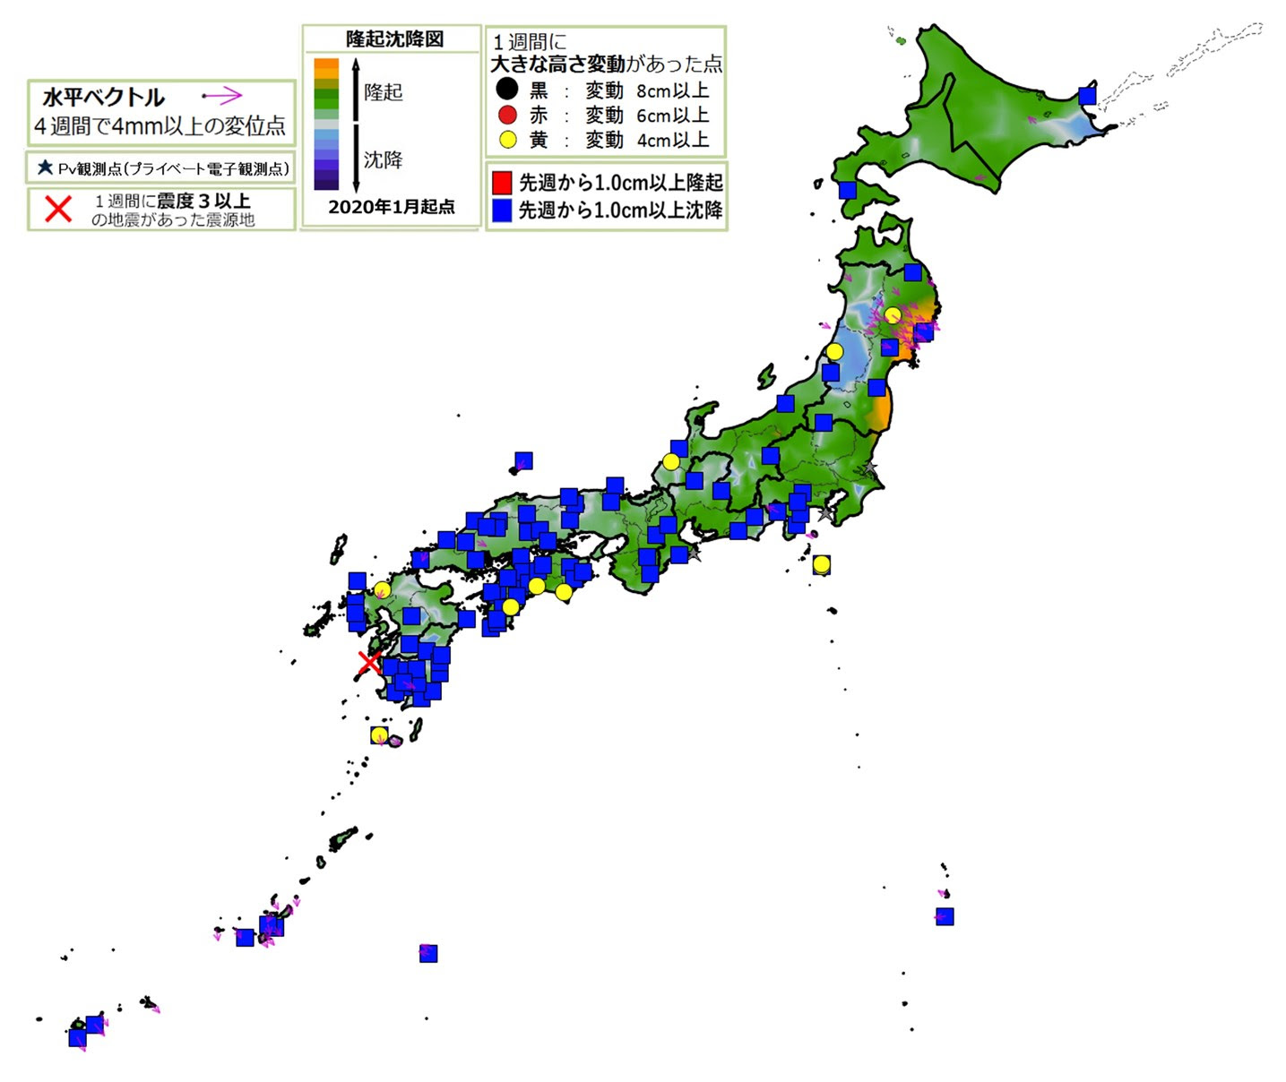
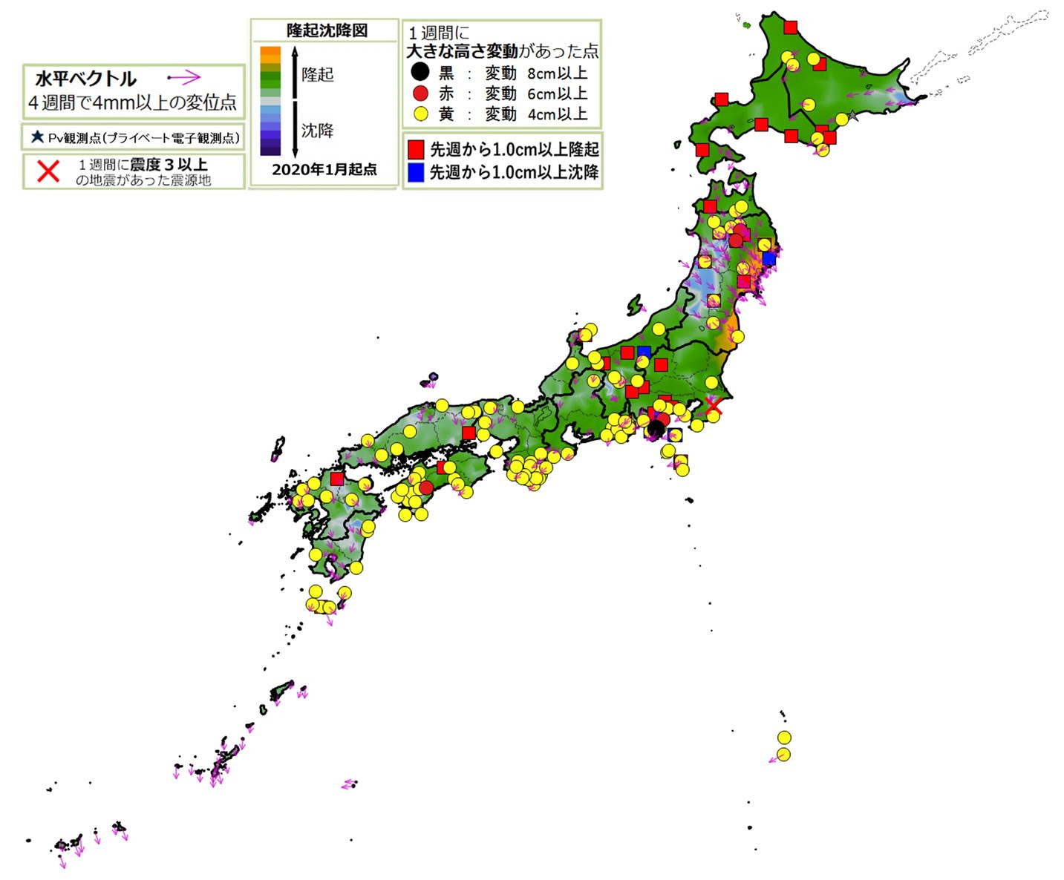
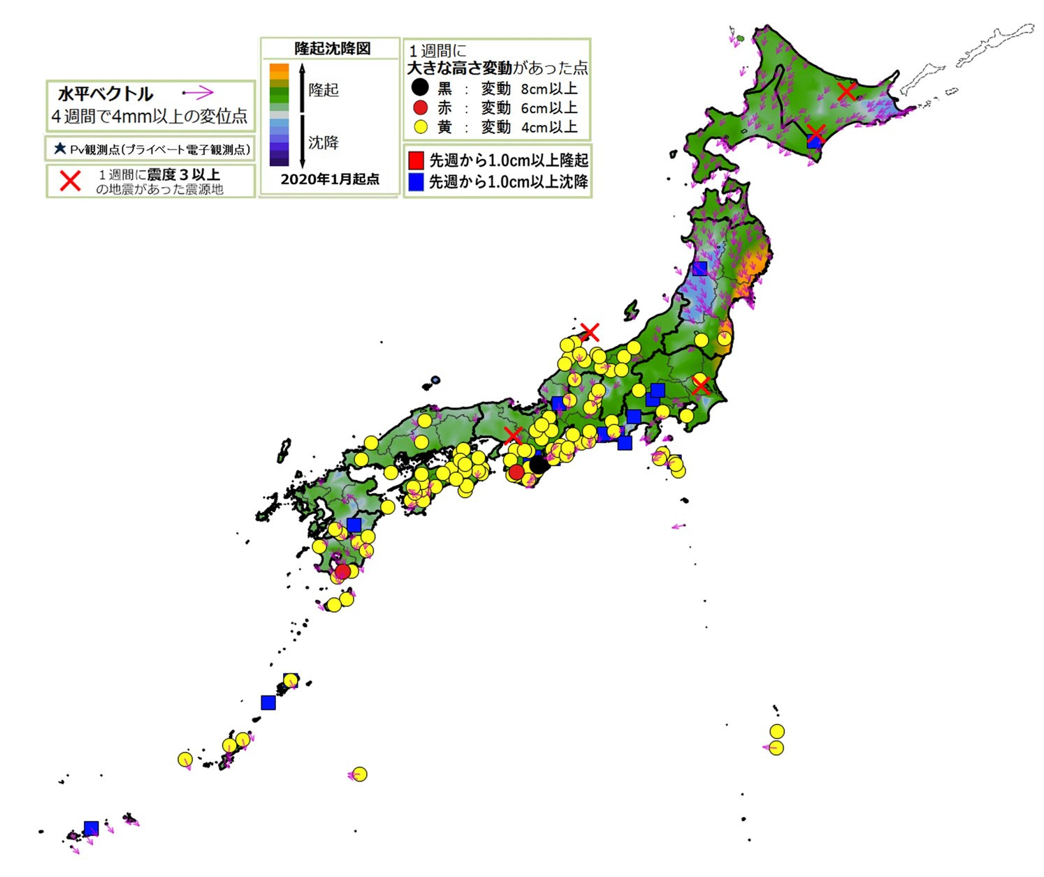
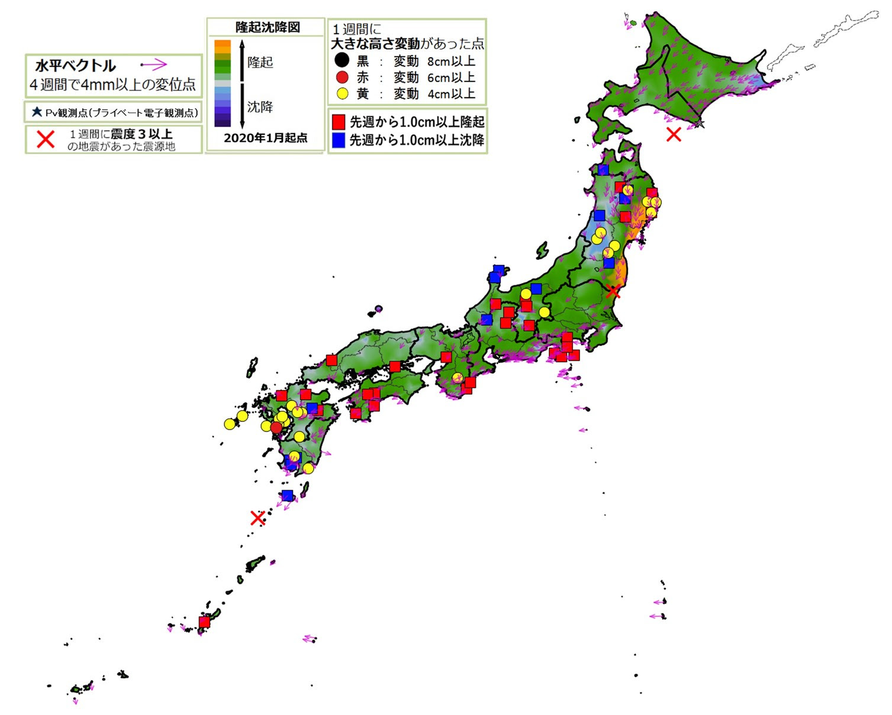
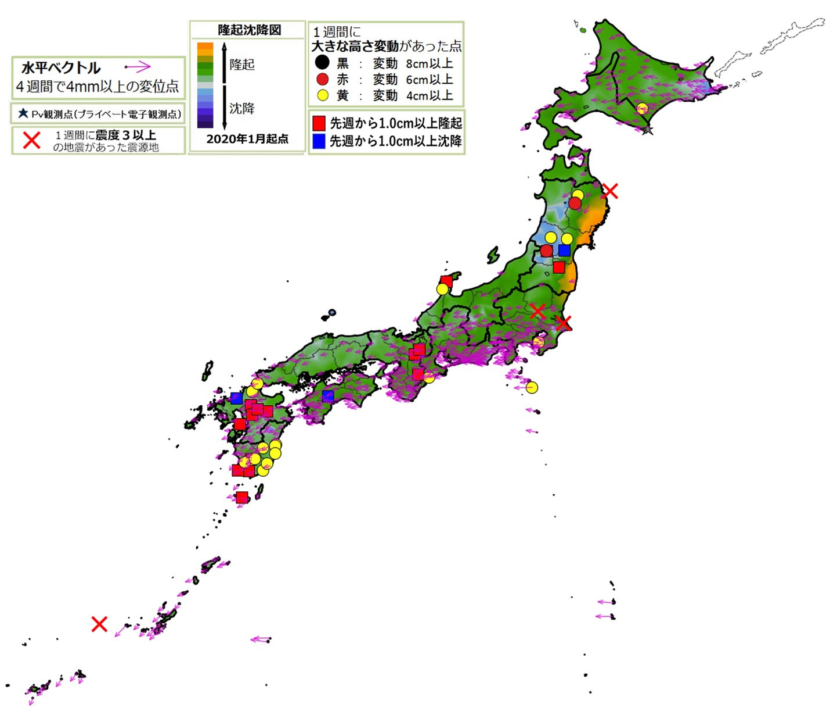
X
9/4 M4.7
8/26 M4.6
8/31 M4.6
X
X
X
2022_09_07
2022_08_24
9/1 M4.7
2022_08_31
X
8/29 M5.3
X
X
X
9/12 M5.1
X
9/27 M4.9
9/12 M4.8
9/13 M5.1
9/17 M4.8
9/19 M4.6
X
9/23 M4.6
9/18 M5.0
X
X
X
9/22 M5.3
9/18 M5.4
9/18 M4.6
9/18 M6.1
9/18 M4.8
9/22 M4.7
2022_09_14
9/18 M5.5
2022_09_21
X
X
9/18台湾 M7.3
2022_09_28

Slide 9
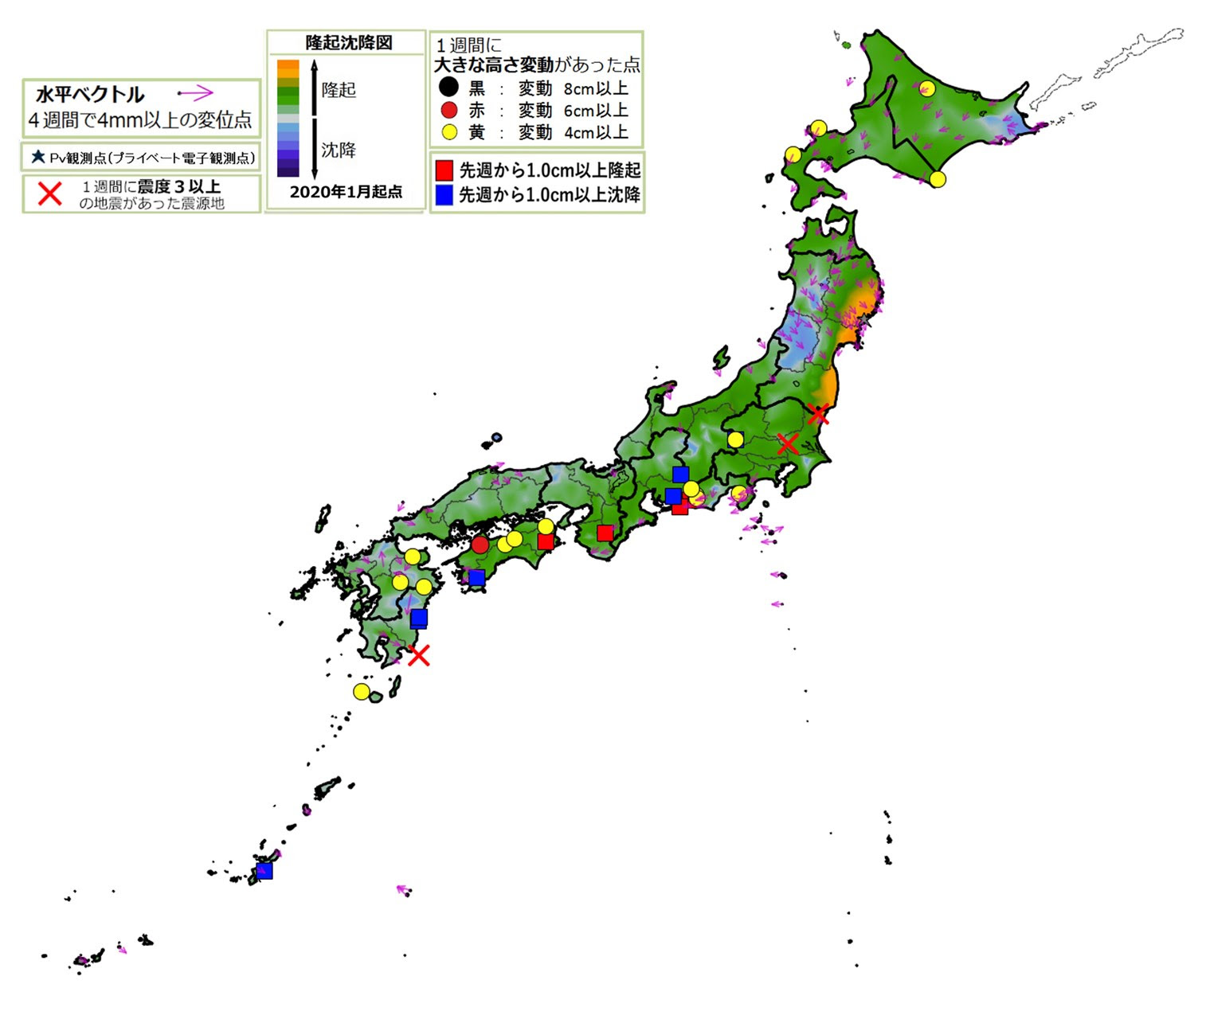
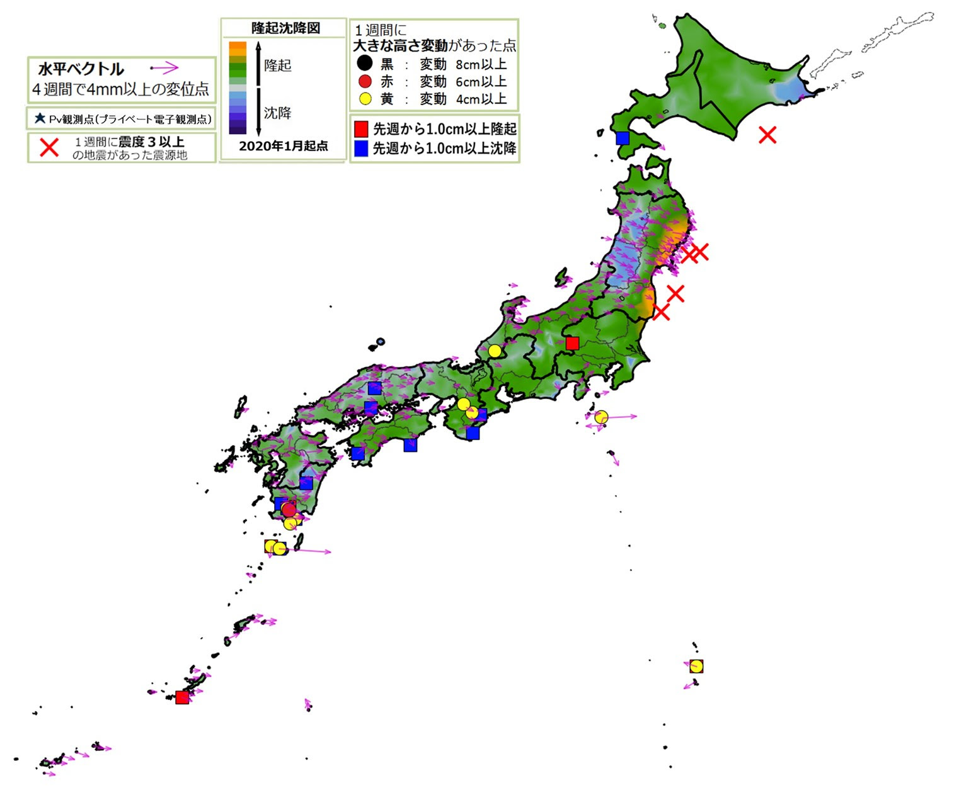
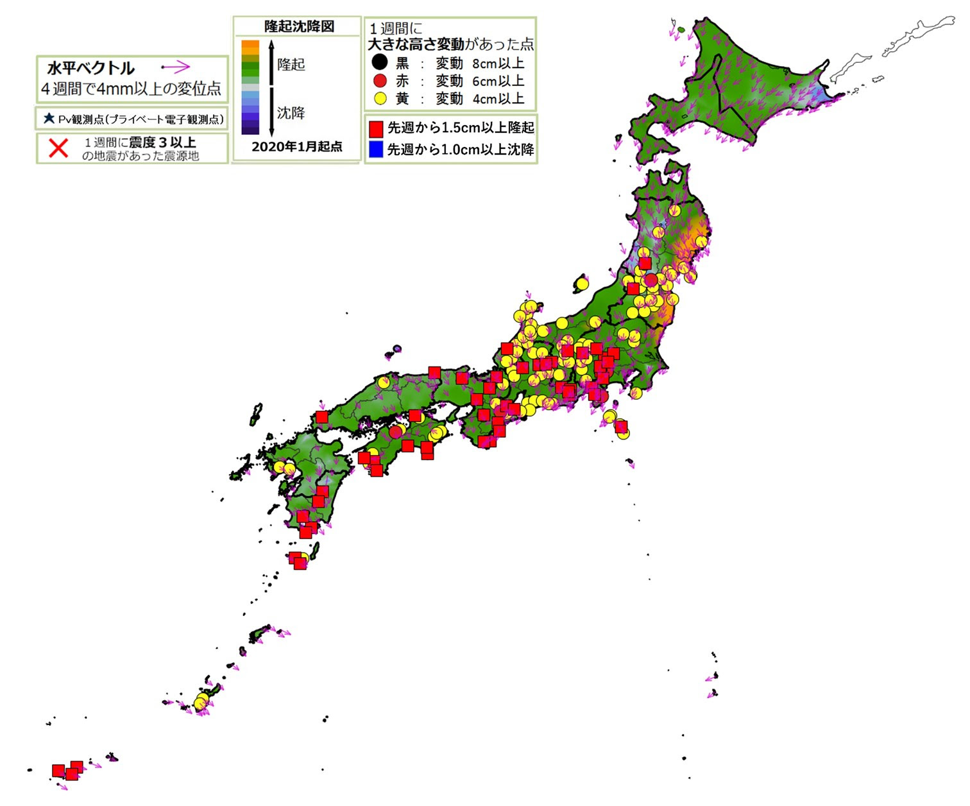
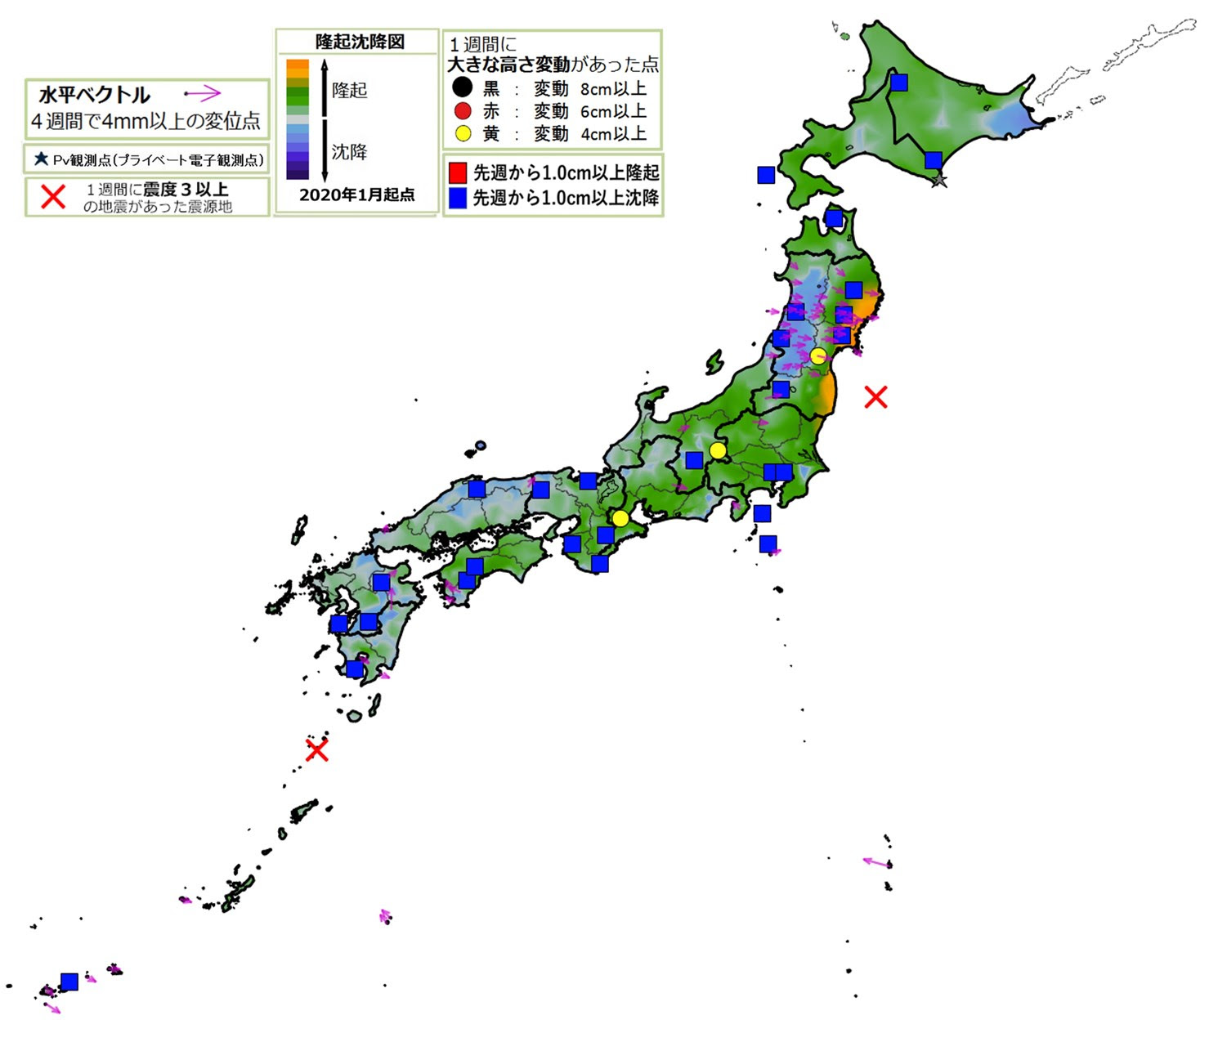
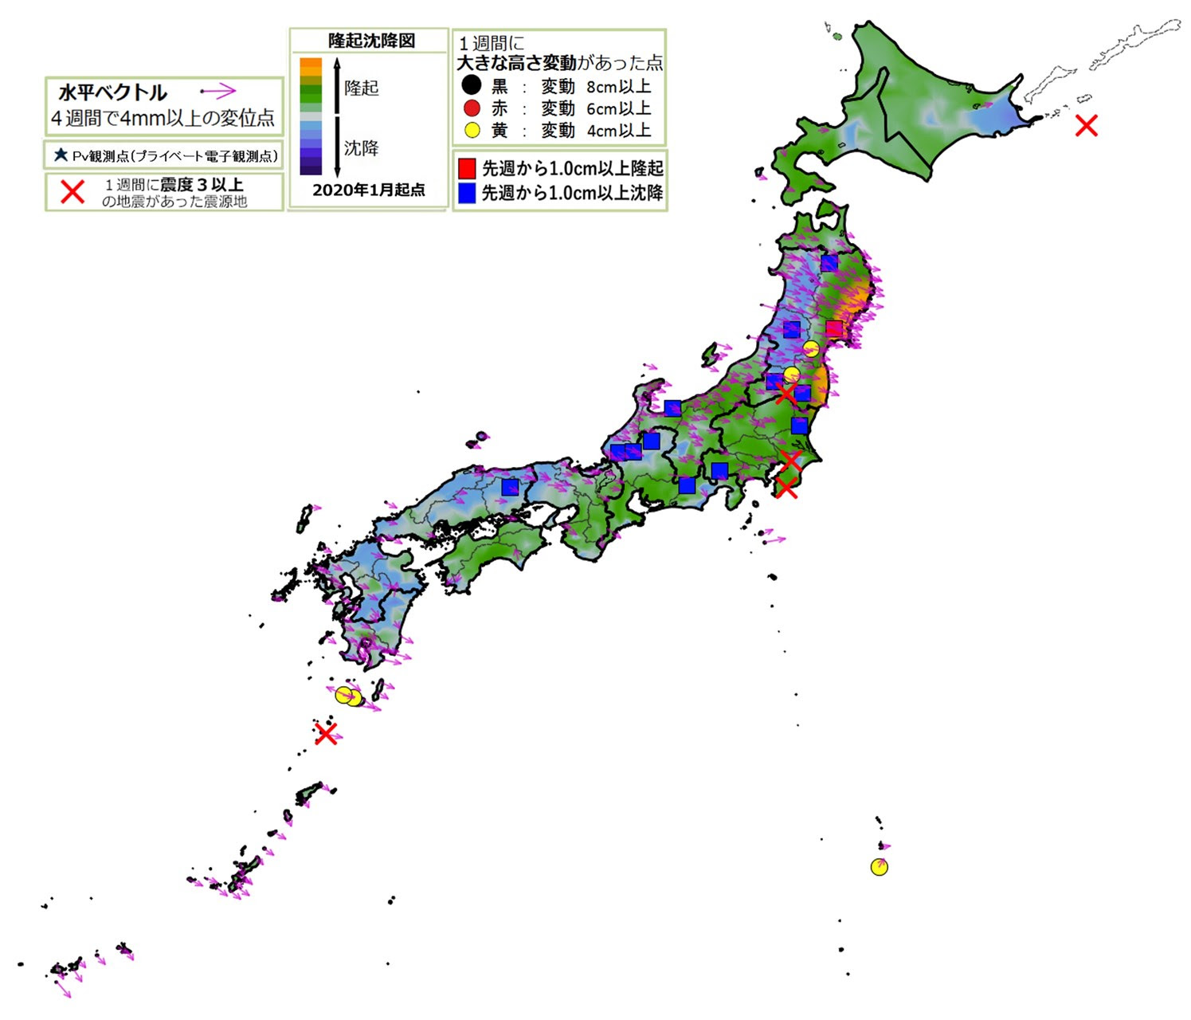
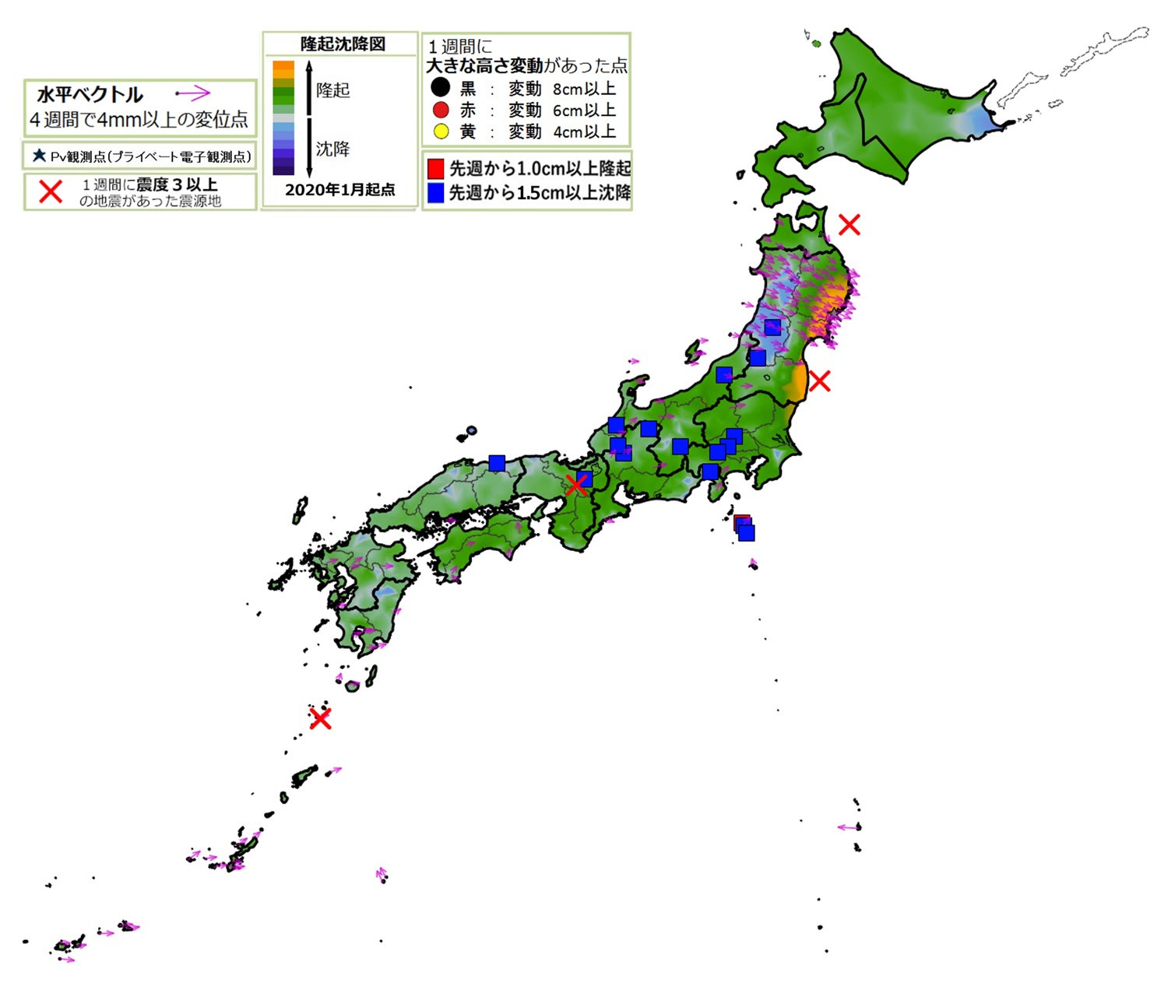
X
X
10/6 M4.5
10/19 M5.1
X
10/10 M4.5
X
10/11 M4.6
X
10/7 M4.7
X
10/2 M5.9
2022_10_05
10/7 M5.1
2022_10_12
2022_10_19
X
X
X
X
X
10/28 M4.5
11/06 M5.3
10/24 M4.7
10/26 M5.3
10/27 M5.0
11/02 M4.8
X
X
10/21 M5.0
11/03 M5.0
11/09 M4.9
X
10/26 M4.6
2022_10_26
2022_11_02
2022_11_09
X
11/01 M4.7

Slide 10
X
11/24 M4.5
11/13 M4.8
X
X
X
11/20 M4.7
X
11/17 M5.0
11/28 M4.5
X
11/30 M4.9
X
11/14 M6.1
X
11/24 M5.2
2022_11_16
2022_11_23
2022_11_30
X
X
11/21 M5.7
X
X
11/26 M4.6
11/23 M4.5
11/30 M5.2
11/28 M4.5
11/12 M5.2
X
12/11 M4.8
X
12/06 M4.5
12/11 M4.7
X
12/18 M4.7
X
12/14 M4.4
X
12/11 M4.7
X
12/18 M5.4
X
2022_12_07
2022_12_14
12/18 M4.8
2022_12_21
X
X
X
12/18 M4.9
12/13 M6.0
12/08 M4.6

Slide 11
X
01/03 M5.5
01/06 M4.6
X
X
欠
X
X
01/03 M4.9
12/28 M4.6
01/08 M4.7
2022_12_28
2023_01_04
2023_01_11
X
12/29 M4.8
X
12/24 M5.8 (580 km)
X
12/31 M4.7
2023年1月12日 ピンポイント予測を発出します。「東北地方でM6.0±0.5の地震が2023年2月12日までに起きる可能性があります。」
X
01/16 M4.5
X
01/20 M4.9
X
01/25 M4.9
X
01/29 M4.8
X
01/16 M6.1
01/19 M4.7
01/27 M4.7
X
X
01/15 M5.3
2023_01_18
X
X
X
01/18 M4.6
2023_01_25
2023_02_01
01/14 M4.9

Slide 12
02/10 M4.5
X
X
X
02/20 M4.7
02/14 M4.6
X
02/13 M4.9
2023_02_08
2023_02_15
2023_02_22
X
02/17 M5.1
X
X
03/02 M4.5
X
X
02/25 M6.0
03/11 M4.8
03/07 M5.0
X
02/28 M4.5
X
03/02 M5.1
03/02 M4.4
2023_03_08
2023_03_15
X
2023_03_01
X
02/25 M4.8
02/22 M4.4

Slide 13
X
X
03/28 M6.1
04/01 M4.7
X
03/22 M5.4
04/01 M5.0
X
X
03/27 M5.2
X
X
03/26 M4.4
03/20 M4.7
03/24 M4.7
03/30 M5.0
03/31 M5.7
03/31 M5.4
04/04 M4.9
2023_03_22
2023_03_29
04/04 M5.3
X
X
2023_04_05
X
X
X
X
04/06 M4.8
X
04/14 M4.4
X
04/17 M4.6
2023_04_12
2023_04_19
2023_04_26
X
04/05 M4.5
X
04/20 M4.4
X
X
X
X
04/06 M4.4
04/21 M5.6
X
04/07 M4.9
04/22 M4.4
04/11 M4.5
04/10 M5.0

Slide 14
05/05 M6.5
05/05 M5.9
05/05 M4.5
X
05/06 M4.5
05/05 M4.5
X
X
05/09 M4.9
05/06 M5.5
05/11 M5.4
05/10 M5.0
X
05/05 M4.5
2023_05_17
X
X
X
05/12 M4.2
X
X
05/11 M5.2
2023_05_03
X
X
2023_05_10
X
05/14 M4.7
04/27 M5.4
05/11 M4.4
X
05/14 M5.6
05/13 M5.1
X
05/14 M5.3
04/30 M4.5
05/14 M5.9
X
05/01 M5.2
X
X
X
X
X
05/01 M6.2
X
X
05/01 M5.0
X
05/11 M6.1
05/14 M4.5
05/01 M5.4
05/11 M4.6
X
05/21 M4.7
X
06/03 M5.1
X
05/20 M5.4
05/30 M4.5
X
06/01 M4.4
X
X
06/05 M4.5
X
X
06/04 M4.4
05/19 M4.4
X
06/04 M4.6
X
X
05/26 M6.2
X
X
05/22 M5.3
05/26 M4.4
05/22 M5.1
X
X
06/01 M4.4
2023_06_07
05/22 M5.4
X
05/27 M4.7
2023_05_31
2023_05_24

Slide 15
06/17 M5.8
X
X
06/24 M5.8
X
X
06/11 M6.2
X
06/19 M5.2
X
X
06/22 M4.5
X
06/28 M6.2
X
06/17 M5.7
06/22 M4.1
06/17 M4.8
X
06/24 M4.9
X
06/16 M4.9
X
06/28 M4.8
06/09 M4.6
X
2023_06_14
X
2023_06_21
2023_06_28
06/11 M4.7
06/19 M4.8
X
X
06/22 M5.2
X
06/24 M4.9
X
07/17 M4.4
X
07/13 M4.9
X
X
07/10 M4.4
X
07/01 M4.9
07/16 M4.0
2023_07_05
2023_07_12
2023_07_19
07/05 M5.5
X
X
07/17 M4.4

Slide 16
X
08/01 M4.4
07/27 M5.0
07/26 M4.5
X
X
08/01 M4.7
X
07/22 M4.8
X
X
X
07/20 M4.4
X
07/29 M4.4
08/07 M4.6
X
07/22 M4.9
X
07/26 M4.4
X
08/07 M5.4
X
08/07 M4.7
2023_07_26
2023_08_02
2023_08_09
X
08/25 M5.8
X
08/19 M4.4
X
X
08/19 M5.1
X
08/11 M5.9
X
08/23 M4.6
08/26 M4.6
08/25 M4.3
X
X
X
08/11 M4.7
08/19 M4.3
08/22 M4.3
X
08/28 M4.8
X
X
08/27 M4.5
2023_08_16
2023_08_23
2023_08_30
X
X
08/12 M4.4
08/16 M4.7

Slide 17
X
X
09/19 M5.5
X
08/31 M4.6
09/08 M5.5
X
09/16 M4.3
X
09/05 M4.4
X
09/05 M4.5
09/09 M5.0
X
09/11 M4.3
X
2023_09_06
X
X
2023_09_13
2023_09_20
X
X
X
X
09/19 M4.3
X
X
X
X
09/08 M4.4
X
X
X
09/08 M4.6
09/07 M4.3
09/12 M4.7
09/08 M4.6
09/18 M6.4
09/09 M4.4
09/09 M4.4
09/09 M4.3
09/11 M5.3
X
X
09/12 M4.5
09/29 M5.9
10/09 M5.3
X
X
09/26 M4.6
10/07 M4.9
X
X
09/29 M4.5
09/27 M4.8
X
10/03 M6.3
10/05 M6.5
X
X
X
10/06 M6.3
2023_09_27
2023_10_04
10/09 M-.-
2023_10_11

Slide 18
X
X
10/13 M5.0
10/24 M4.7
10/13 M4.8
X
X
10/14 M4.8
X
10/29 M4.4
X
10/29 M4.4
X
10/24 M4.4
10/16 M6.0
X
10/16 M4.6
2023_10_18
11/01 M4.9
10/17 M4.6
2023_10_25
2023_11_01
X
X
X
X
10/14 M5.1
X
10/19 M4.9
X
X
10/23 M4.3
X
10/24 M5.9
10/24 M4.9
X
X
11/08 M5.0
X
11/08 M5.0
11/19 M4.7
X
11/20 M5.8
X
11/06 M5.0
X
X
11/12 M4.6
X
11/10 M4.3
2023_11_08
2023_11_15
2023_11_22
11/11 M5.0
X
11/11 M4.7

Slide 19
X
X
11/27 M4.2
12/01 M4.5
X
11/28 M4.9
11/26 M5.2
2023_11_29
2023_12_06
11/26 M5.0
X
X
11/29 M4.3
X
12/04 M7.0
12/03 M7.0
X
12/02 M7.7
X
X

Slide 20
X
X
11/27 M4.2
12/01 M4.5
X
X
11/28 M4.9
12/09 M4.7
11/26 M5.2
2023_11_29
2023_12_06
2023_12_13
11/26 M5.0
X
X
11/29 M4.3
X
12/10 M5.3
X
X
12/28 M6.4
X
12/27 M4.6
X
X
12/22 M4.8
12/28 M4.4
X
X
X
X
X
X
X
12/17 M4.3
X
X
X
X
12/21 M4.8
X
X
X
X
12/21 M5.3
12/25 M5.0
12/21 M5.0
12/26 M5.3
X
12/22 M5.1
2023_12_20
2023_12_27
2024_01_10
X
12/31 M4.6

Slide 21
01/01 M5.7
01/02 M4.4
01/03 M4.9
01/04 M4.8
01/05 M4.4
01/06 M4.6
01/07 M4.5
01/09 M6.0
01/01 M7.6
01/02 M4.6
01/03 M4.4
01/04 M4.9
01/05 M4.4
01/06 M5.4
01/07 M4.5
01/09 M4.4
01/01 M6.1
01/02 M4.3
01/03 M4.5
01/04 M4.4
01/06 M4.5
01/07 M4.7
01/01 M4.5
01/02 M4.7
01/03 M4.0
01/04 M5.0
01/06 M4.3
01/01 M4.6
01/02 M4.9
01/03 M5.6
01/04 M4.4
01/01 M4.8
01/02 M4.7
01/03 M4.9
01/01 M4.3
01/02 M4.3
01/03 M4.8
01/01 M5.2
01/02 M4.3
01/01 M5.2
01/02 M4.7
01/01 M5.0
01/02 M5.6
X
01/01 M5.7
01/02 M4.5
01/01 M4.9
01/02 M4.6
12/28 M6.4
01/01 M5.2
01/02 M4.3
X
01/01 M4.6
12/28 M4.4
01/01 M4.8
X
X
X
X
X
X
X
X
01/01 M5.0
X
01/01 M4.7
01/01 M5.3
01/01 M4.7
01/01 M5.6
2024_01_10
01/01 M4.4
X
01/01 M4.9
01/01 M4.5
12/31 M4.6
01/01 M4.7
01/01 M4.5
01/01 M4.8
01/01 M4.3
01/01 M4.6
01/01 M4.6
01/01 M4.4
01/01 M4.6
01/01 M4.5
01/01 M4.3
01/01 M4.6
01/02 M4.5

